Slide 1
poshenloh
LIVE
LIVE
Math Professor
Founder
National Coach (2014–2023)

Slide 2
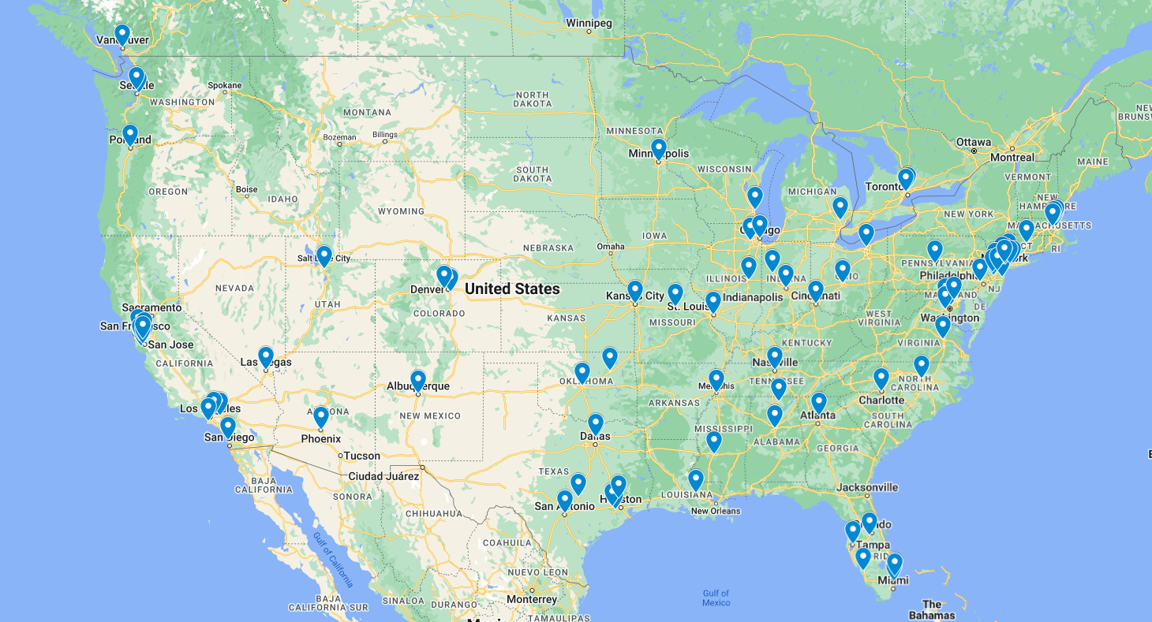

Slide 5
poshenloh
LIVE
LIVE
Math Professor
Founder
National Coach (2014–2023)

