Slide 1
Computer Assisted Mathematical Discovery
Minimizing Pentagons in the Plane
Subercaseaux, Mackey, Heule, Martins

Slide 2
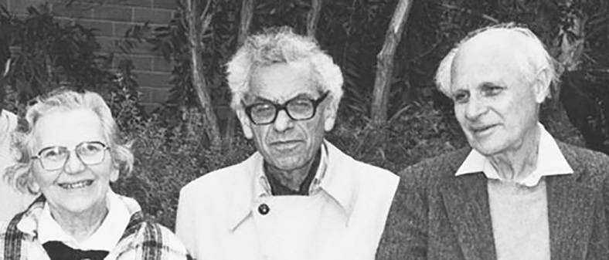
60 Seconds of History
Esther Klein, Paul Erdős and George Szekeres
Happy Ending Theorem

Slide 3
Esther: 5 points in the plane, without 3
on a line, must contain a convex 4-gon!
Let’s prove this by cases on the convex hull of the 5 points.
Case 1: 5 points on the CH
Case 2: 4 points on the CH
Case 3: 3 points on the CH

Slide 4
For every positive integer k, there is
a least integer g(k) such that any
set of g(k) points in the plane in general position must contain a convex k-gon.
Erdős-Szekeres Theorem

Slide 5
Recall: g(k) = the minimum number of points required
to guarantee a convex k-gon
g(4) = 5
Computational proof by Peters and Szekeres in 2006.
g(5) = 9
g(6) = 17
What’s known:
33 ≤ g(7) < 126
g(7) = 33 is
within reach
E-S Conjecture: g(k) = 1 + 2^{k-2}

Slide 6
μ_{k}(n) = the minimum possible number of convex k-gons for n points in general position
E.g. μ₄(4) = 0.
μ₄(5) = 1.
μ₃(5) = 10.

Slide 7
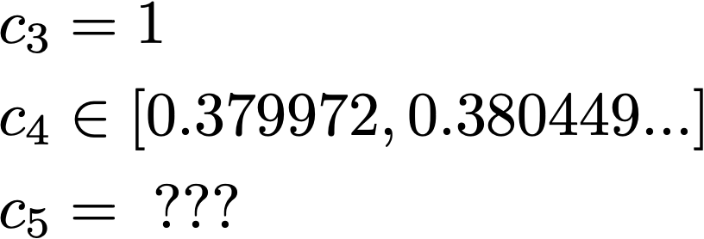
What is the limiting proportion?

Slide 8
The Triple-Orientation Abstraction (aka signotopes)
a
c
abc (a < b < c) is a counterclockwise turn
⟺
𝛔(a,b,c) = 1 (or True)
b
We don’t care about the coordinates of the points, we only care about the orientations of each of the n choose 3 triples of points!

Slide 9
Points are labeled in increasing order from left to right
b
If abc is a clockwise turn,
a
b
c
And bcd is a clockwise turn,
c
b
d
c
a
Then abd must be
a clockwise turn!
d

Slide 10
Points are labeled in increasing order from left to right

Slide 11
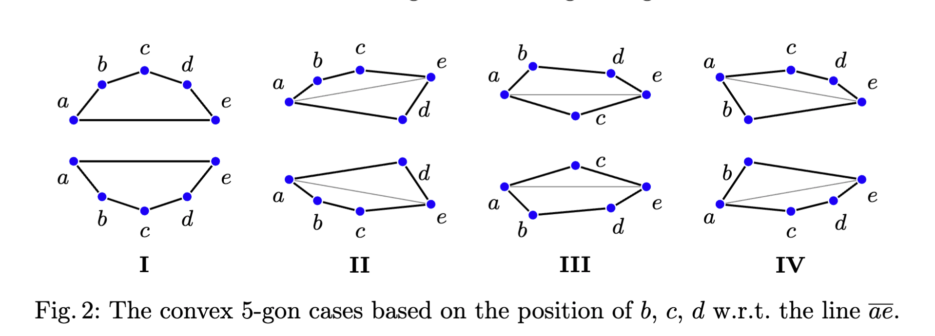
From orientations to convex 5-gons
(Peters and Szekeres, 2006)

Slide 12
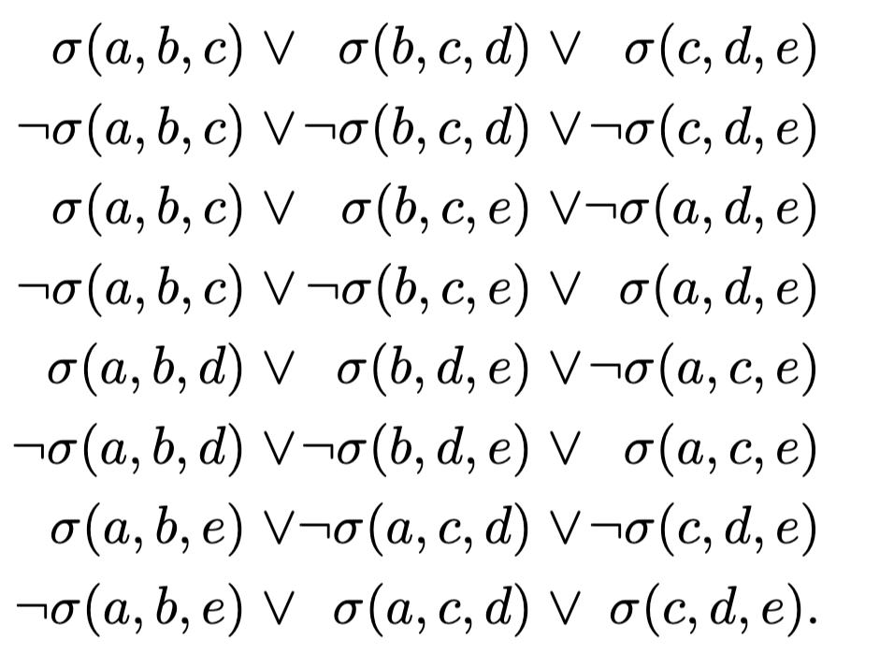

Slide 13
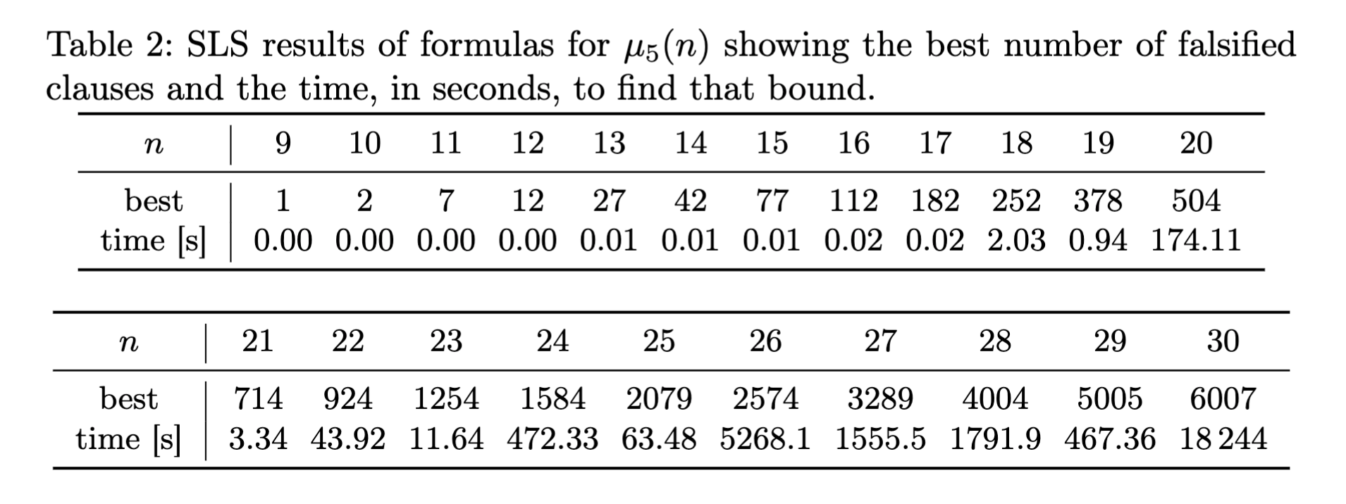

Slide 14
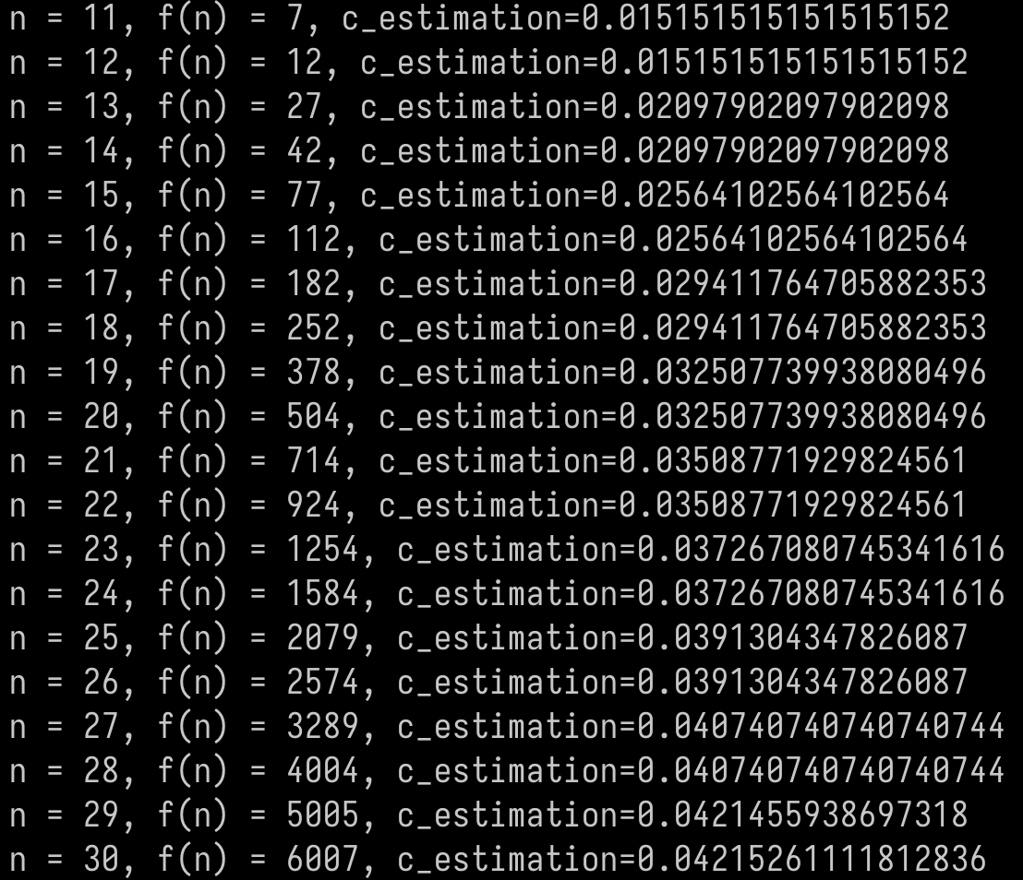
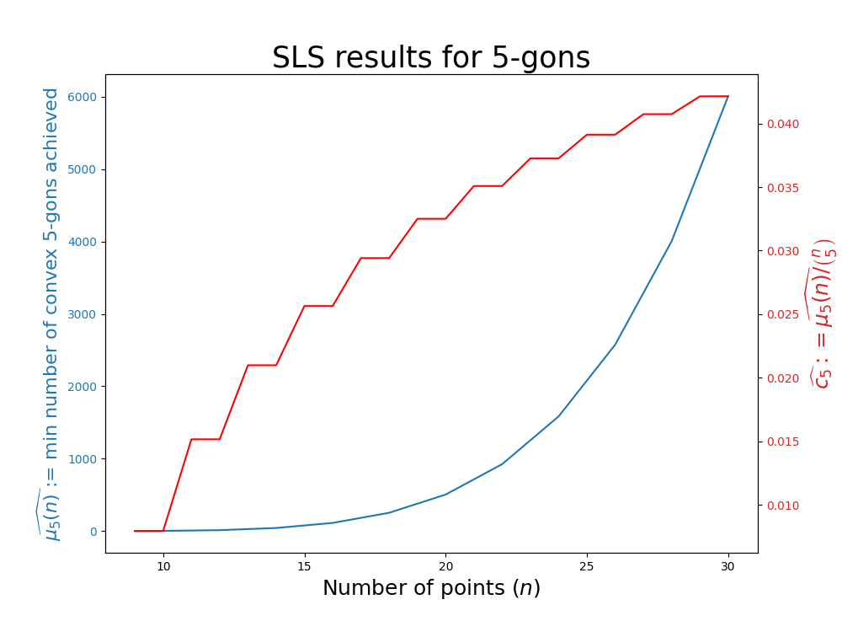
Seems to be slowly converging
Notice how the c_estimation for 2n+1 matches that of 2n+2 !!
The estimated fraction is equal for 2n+1 and 2n+2

Slide 15
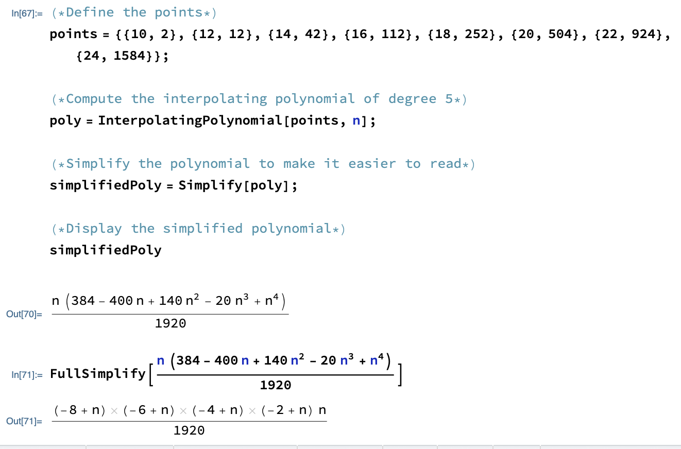

Slide 16
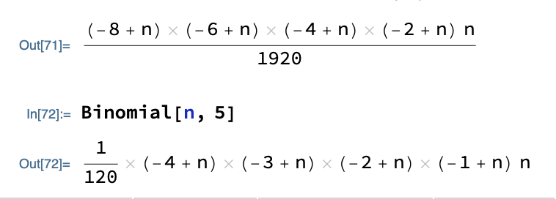

Slide 17
We have reached a conjecture!

Slide 18
Potential Issues
The assignments found by SLS might not actually minimize the # of false clauses.
The assignments found by SLS might not be realizable as sets of points in the plane.

Slide 19
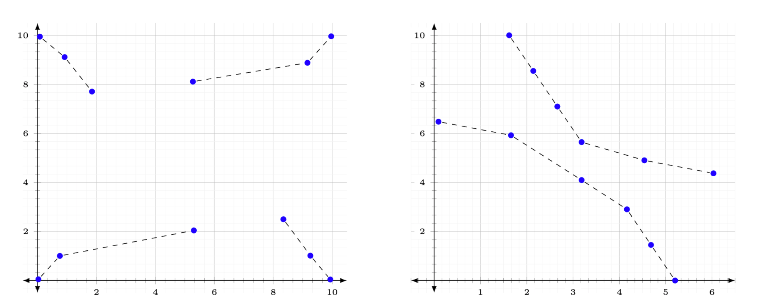

Slide 20
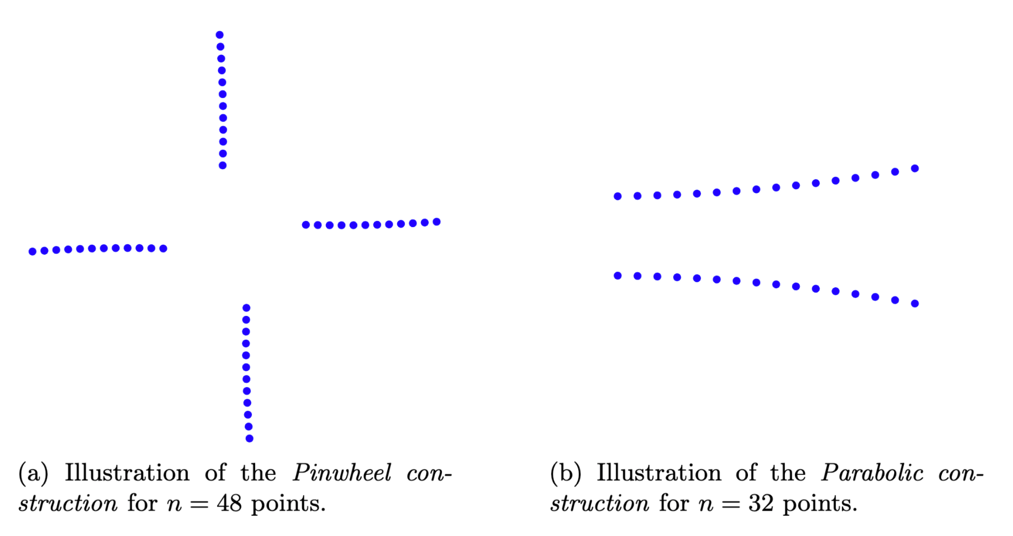

Slide 21
Remarkably, both constructions achieve exactly the conjectured values for μ₅(n)

Slide 23
Computer Assisted Mathematical Discovery
Minimizing Pentagons in the Plane
Subercaseaux, Mackey, Heule, Martins

