Slide 1
On Certain Properties of Random Apollonian Networks http://www.math.cmu.edu/~ctsourak/ran.html
Alan Frieze
af1p@random.math.cmu.edu
Charalampos (Babis) E. Tsourakakis
ctsourak@math.cmu.edu
WAW 2012
22 June ‘12

Slide 2
Outline
Introduction
Degree Distribution
Diameter
Highest Degrees
Eigenvalues
Open Problems

Slide 3
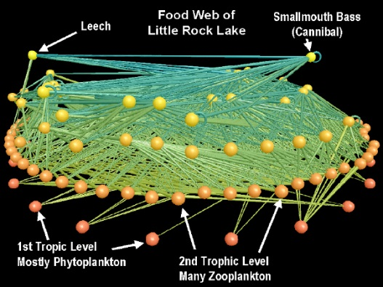
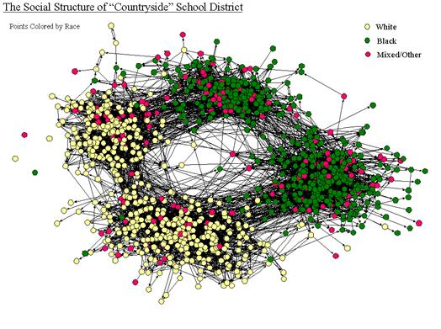
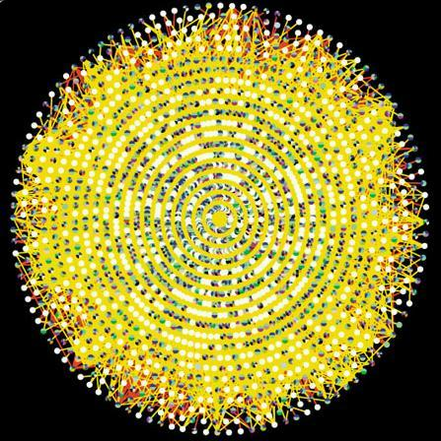
Motivation
Internet Map [lumeta.com]
Food Web [Martinez ’91]
Friendship Network [Moody ’01]
Protein Interactions [genomebiology.com]

Slide 4
Motivation
Modelling “real-world” networks has attracted a lot of attention. Common characteristics include:
Skewed degree distributions (e.g., power laws).
Large Clustering Coefficients
Small diameter
A popular model for modeling real-world planar graphs are Random Apollonian Networks.

Slide 5
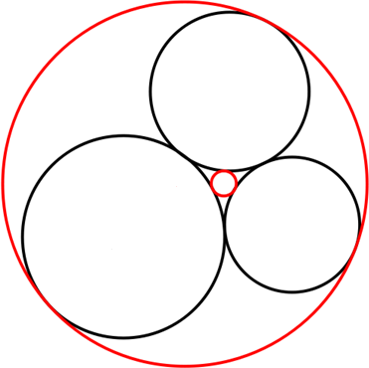
Problem of Apollonius
Construct circles that are tangent to
three given circles οn the plane.
Apollonius
(262-190 BC)

Slide 6
Apollonian Packing
Apollonian Gasket

Slide 7
Higher Dimensional Packings
Higher Dimensional (3d) Apollonian Packing. From now on, we shall discuss the 2d case.

Slide 8
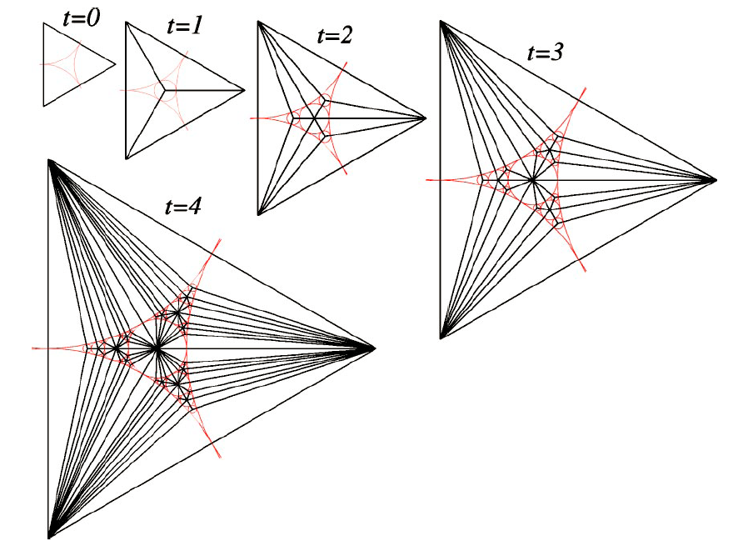
Apollonian Network
Dual version of Apollonian Packing

Slide 9
Random Apollonian Networks
Start with a triangle (t=0).
Until the network reaches the desired size
Pick a face F uniformly at random, insert a new vertex in it and connect it with the three vertices of F

Slide 10
Random Apollonian Networks
For any $t≥0$
Number of vertices n_{t} =t+3
Number of vertices m_{t}=3t+3
Number of faces F_{t}=2t+1
Note that a RAN is a maximal planar graph since for any planar graph
$$m_{t}≤3n_{t}−6=3t+3$$

Slide 11
Outline
Introduction
Degree Distribution
Diameter
Highest Degrees
Eigenvalues
Open Problems

Slide 12
Degree Distribution
Let N_{k}(t)=E[Z_{k}(t)]=expected #vertices of degree k at time t. Then:
$N_{3}\left(t+1\right)=N_{3}\left(t\right)+1−\frac{3N_{3}(t)}{2t+1}$
$N_{k}\left(t+1\right)=N_{k}\left(t\right)\left(1−\frac{k}{2t+1}\right)+N_{k−1}\left(t\right)\frac{k−1}{2t+1}$
Solving the recurrence results in a power law with “slope 3”.
Notes:
Paradoxically, a proper analysis of the degree distribution had been missing from the literature. See the references in our paper for more.

Slide 13
Degree Distribution
Z_{k}(t)=#of vertices of degree k at time t, $k≥3$
$b_{3}=\frac{2}{5},b_{4}=\frac{1}{5},b_{5}=\frac{4}{35},b_{k}=\frac{24}{k(k+1)(k+2)}$ $k≥6$
For t sufficiently large
$$|E\left[Z_{k}\left(t\right)\right]−b_{k}t|≤3.6$$
Furthermore, for all possible degrees k
$Prob\left({|Z}_{k}\left(t\right)−E\left[Z_{k}\left(t\right)\right]\right|≥10\sqrt{tlog(t})=o(1)$

Slide 14
Simulation (10000 vertices, results averaged over 10 runs, 10 smallest degrees shown)
Degree | Theorem | Simulation
3 | 0.4 | 0.3982
4 | 0.2 | 0.2017
5 | 0.1143 | 0.1143
6 | 0.0714 | 0.0715
7 | 0.0476 | 0.0476
8 | 0.0333 | 0.0332
9 | 0.0242 | 0.0243
10 | 0.0182 | 0.0179
11 | 0.0140 | 0.0137
12 | 0.0110 | 0.0111

Slide 15
Outline
Introduction
Degree Distribution
Diameter
Highest Degrees
Eigenvalues
Open Problems

Slide 16
Diameter
Depth of a face (recursively): Let α be the initial face, then depth(α)=1. For a face β created by picking face γ depth(β)=depth(γ)+1. e.g.,

Slide 17
Diameter
Note that if k* is the maximum depth of a face at time t, then diam(G_{t})=O(k*).
Let F_{t}(k)=#faces of depth k at time t. Then, $E\left[F_{t}\left(k\right)\right]$ is equal to
$$\sum_{1≤t_{1}<t_{2}<..<t_{k}≤t}{\begin{aligned}\prod_{j=1}^{k}{\frac{1}{2t_{j}+1}}≤\frac{1}{k!}{\left(\sum_{j=1}^{t}{\frac{1}{2j+1}}\right)}^{t}≤{\left(\frac{elog\left(t\right)}{2k}\right)}^{k+1} \\ \end{aligned}}$$
Therefore by a first moment argument k*=O(log(t)) whp.
Notes:
Again, the diameter had not been properly analyzed.

Slide 18
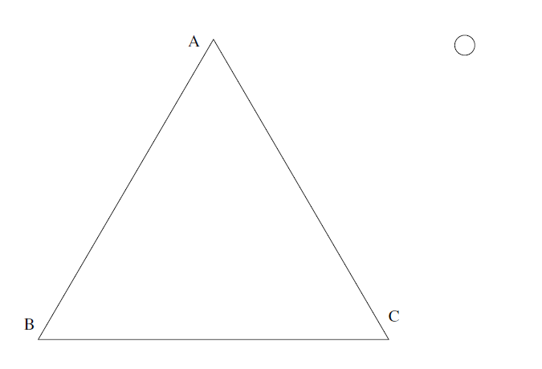
Bijection with random ternary trees
Notes:
Another perspective which gives more refined results …

Slide 19
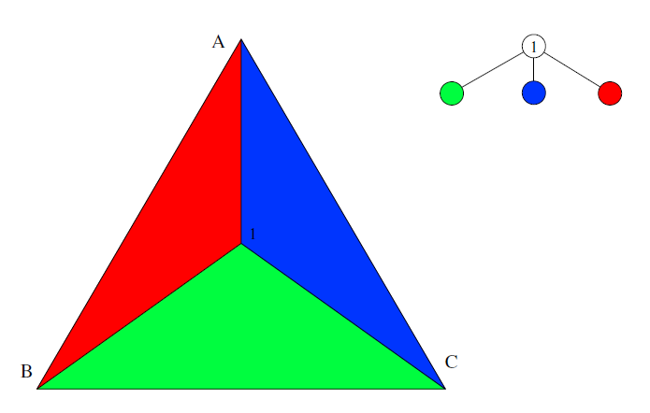
Bijection with random ternary trees

Slide 20
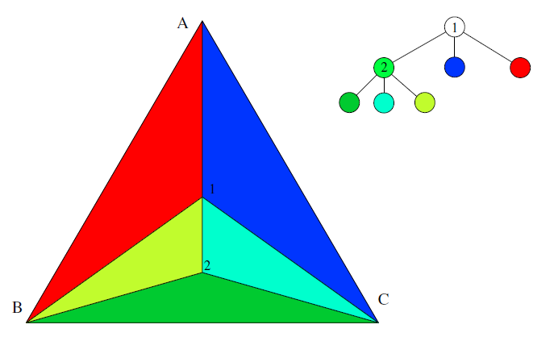
Bijection with random ternary trees

Slide 21
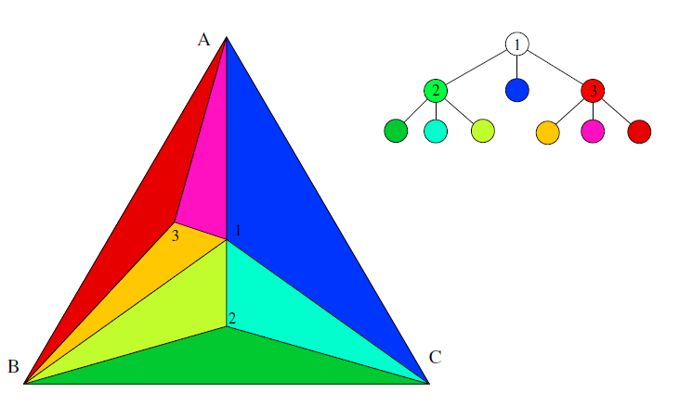
Bijection with random ternary trees

Slide 22
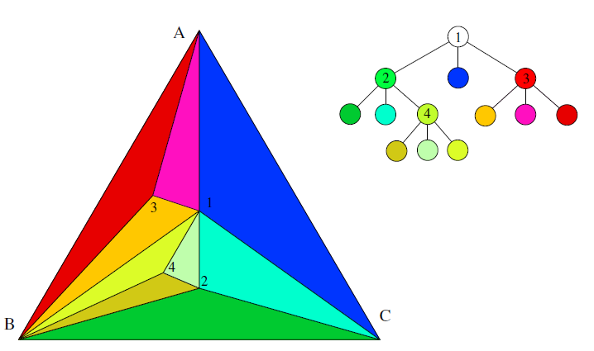
Bijection with random ternary trees

Slide 23
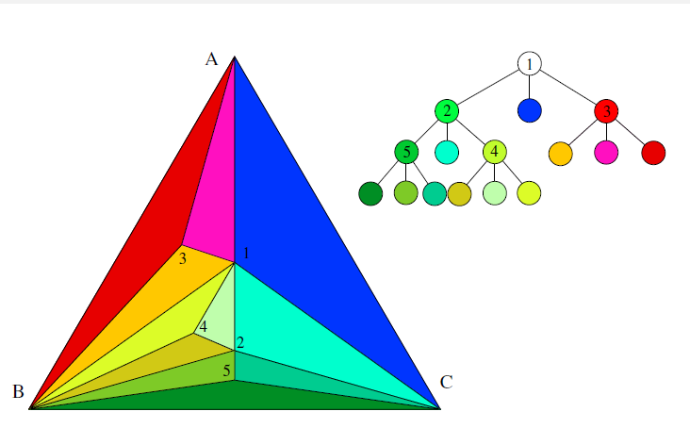
Bijection with random ternary trees

Slide 24
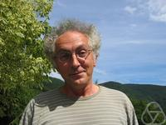
Diameter
Large Deviations for the Weighted
Height of an Extended Class of Trees.
Algorithmica 2006
Broutin
Devroye
The depth of the random ternary tree T in probability
is ρ/2 log(t) where 1/ρ=η is the unique solution greater than 1
of the equation η-1-log(η)=log(3).
Therefore we obtain an upper bound in probability
$$diam\left(G_{t}\right)≤ρlog⁡(t)$$

Slide 25
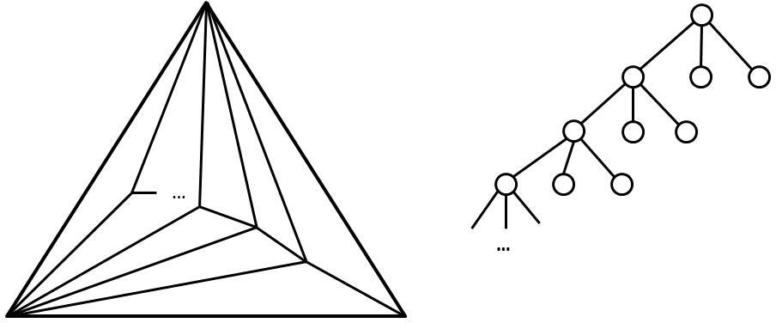
Diameter
This cannot be used though to get a lower bound:
Diameter=2,
Depth arbitrarily large

Slide 26
Outline
Introduction
Degree Distribution
Diameter
Highest Degrees
Eigenvalues
Open Problems

Slide 27
Highest Degrees, Main Result
Let $Δ_{1}≥Δ_{2}≥…≥Δ_{k}$ be the k highest degrees of the RAN G_{t} where k=O(1). Also let f(t) be a function s.t. $f\left(t\right)\overset{→}{t→∞}+∞.$ Then whp
$$\frac{\sqrt{t}}{f(t)}≤Δ_{1}≤\sqrt{t}f(t)$$
and for i=2,..,k
$$\frac{\sqrt{t}}{f(t)}≤Δ_{i}≤Δ_{i−1}−\frac{\sqrt{t}}{f(t)}$$

Slide 28
Proof techniques
$$t_{0}=log⁡log⁡(f\left(t\right))$$
$$t_{1}=log⁡(f\left(t\right))$$
$$t$$
Break up time in periods
Create appropriate supernodes according to their age.
Let Xt be the degree of a supernode. Couple RAN process with a simpler process Y such that
$$X_{t}≥Y_{t}, X_{t_{0}}=Y_{t_{0}}=d_{0}$$
Upper bound the probability
p*(r)=$\operatorname{Pr}\left(Y_{t}=d_{0}+r\right)$
Union bound and k-th moment arguments

Slide 29
Outline
Introduction
Degree Distribution
Diameter
Highest Degrees
Eigenvalues
Open Problems

Slide 30
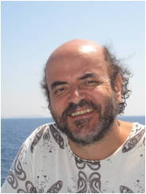
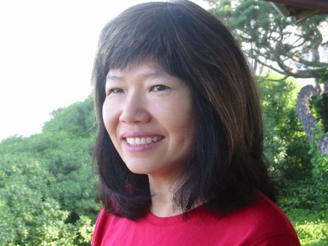
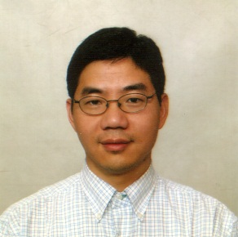
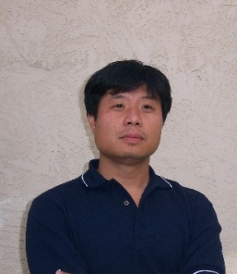
Eigenvalues, Main Result
Let $λ_{1}≥λ_{2}≥…≥λ_{k}$ be the largest k eigenvalues of the adjacency matrix of G_{t}. Then $λ_{i}=\left(1±o\left(1\right)\right)\sqrt{Δ_{i}}$ whp.
Proof comes for “free” from our previous theorem due to the work of two groups:
Chung
Lu
Vu
Mihail
Papadimitriou

Slide 31
Eigenvalues, Proof Sketch
$$t_{0}=0$$
$$t_{1}=t^{1/8}$$
$$t_{2}=t^{9/16}$$
$$t$$
S₁
S₂
S₃
….
….
….
Star forest consisting of edges between S₁ and S₃-S’₃
where S’₃ is the subset of vertices of S₃ with two or more
neighbors in S₁.

Slide 32
Eigenvalues, Proof Sketch
Lemma: ${|S}_{ 3}^{′}|≤t^{1/6}$
This lemma allows us to prove that in F
$$λ_{i}\left(F\right)=\left(1−o\left(1\right)\right)\sqrt{Δ_{i}}$$
….
….
….

Slide 33
Eigenvalues, Proof Sketch
Finally we prove that in H=G-F
$$λ_{1}\left(Η\right)=o\left(λ_{k}\left(F\right)\right)$$
Proof Sketch
First we prove a lemma. For any ε>0 and any f(t) s.t. $f\left(t\right)\overset{→}{t→∞}+∞$ the following holds whp: for all s with $f\left(t\right)≤s≤t$ for all vertices $r≤s$ then $d_{s}\left(r\right)≤s^{ε+\frac{1}{2}} r^{−\frac{1}{2}}.$

Slide 34
Eigenvalues, Proof Sketch
Consider six induced subgraphs H_{i}=H[S_{i}] and H_{ij}=H(S_{i},S_{j}). The following holds:
$$λ_{1}\left(H\right)≤\sum_{i=1}^{3}{λ_{1}\left(H_{i}\right)}+\sum_{i<j}{λ_{1}(H_{i},H_{j})}$$
Bound each term in the summation using the lemma and the fact that the maximum eigenvalue is bounded by the maximum degree.

Slide 35
Outline
Introduction
Degree Distribution
Diameter
Highest Degrees
Eigenvalues
Open Problems

Slide 36
Open Problems
Conductance Φ is at most t^{-1/2} .
Conjecture: Φ= Θ(t^{-1/2})
Are RANs Hamiltonian?
Conjecture: No
Length of the longest
path?
Conjecture: Θ(n)

Slide 37
Thank you!

