Slide 1
Algorithmic Analysis of Large Datasets
Charalampos (Babis) E. Tsourakakis
Brown University
charalampos_tsourakakis@brown.edu
Brown University
May 22nd 2014

Slide 2
Outline
Introduction
Finding near-cliques in graphs
Conclusion

Slide 3
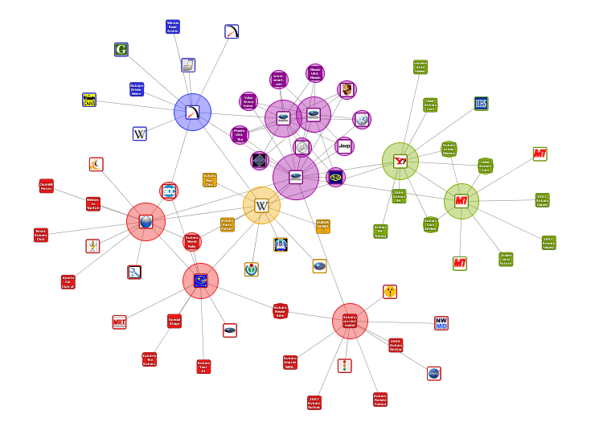
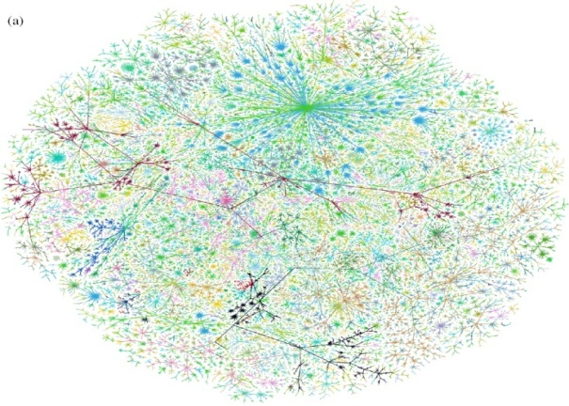
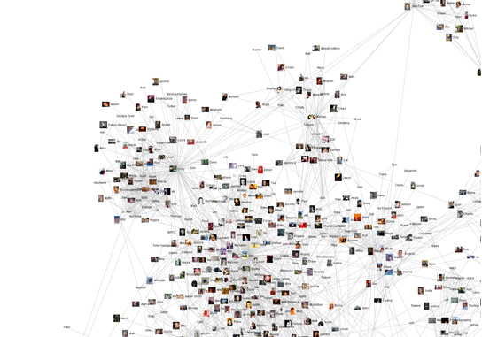
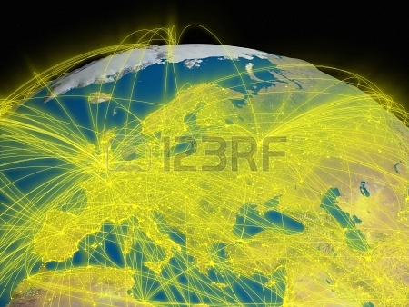
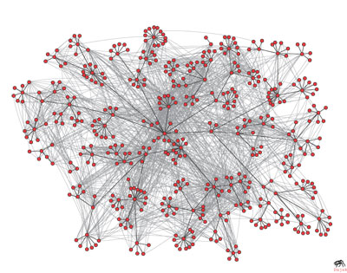
Networks
a) World Wide Web
b) Internet (AS)
c) Social networks
d) Brain
e) Airline
f) Communication
Notes:
Have text next to network picture

Slide 4
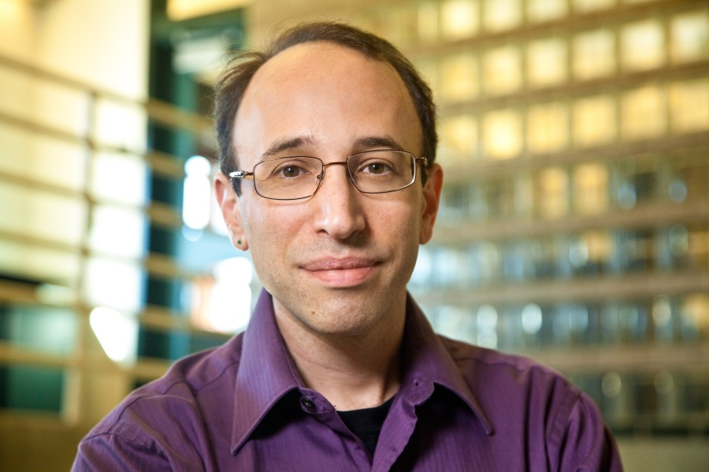
Networks
Daniel Spielman
“Graph theory is the new calculus”
Used in analyzing: log files, user browsing behavior, telephony data, webpages, shopping history, language translation, images …

Slide 5
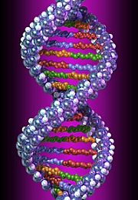
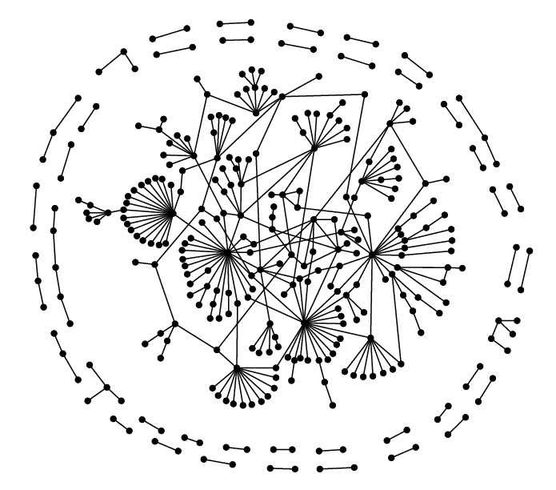
Biological data
tumors
genes
aCGH
data
Protein interactions
Gene Expression
data

Slide 6
Data
Big data is not about creating huge data warehouses.
The true goal is to create value out of data
How do we design better marketing strategies?
How do people establish connections and how does the underlying social network structure affect the spread of ideas or diseases?
Why do some mutations cause cancer whereas others don’t?
Unprecedented opportunities for answering long-standing and emerging problems
come with unprecedented challenges

Slide 7
My research
 | Research topics
Modelling | Q1: Real-world networks Q2: Graph mining problems Q3: Cancer progression (joint work with NIH)
Algorithm design | Q4: Efficient algorithm design ( RAM, MapReduce, streaming) Q5: Average case analysis Q6: Machine learning
Implementations and Applications | Q7: Efficient implementations for Petabyte-sized graphs. Q8: Mining large-scale datasets (graphs and biological datasets)

Slide 8
Outline
Introduction
Finding near-cliques in graphs
Conclusion

Slide 9
Cliques
Maximum clique problem: find clique of maximum possible size. NP-complete problem
Unless P=NP, there cannot be a
polynomial time algorithm that approximates the maximum clique problem within a factor better than $O(n^{1−ε})$
for any ε>0 [Håstad ‘99].
K4

Slide 10
Near-cliques
Given a graph G(V,E) a near-clique is a subset of vertices S that is “close” to being a clique.
E.g., a set S of vertices is an α-quasiclique if $e\left[S\right]≥α(\begin{aligned}\left|S\right| \\ 2\end{aligned})$ for some constant $0<α≤1$.
Why are we interested in large near-cliques?
Tight co-expression clusters in microarray data [Sharan, Shamir ‘00]
Thematic communities and spam link farms [Gibson, Kumar, Tomkins ‘05]
Real time story identification [Angel et al. ’12]
Key primitive for many important applications.

Slide 11
(Some) Density Functions
$\text{f}\text{e} \text{(}\text{S}\text{)=}\frac{e[S]}{(\begin{aligned}\left|S\right| \\ 2\end{aligned})}$
$δ\text{ (}\text{S}\text{)=}\frac{2e[S]}{|S|}$
$δ\text{ (}\text{S}\text{)=}\frac{2e[S]}{|S|}\text{, |}\text{S}\text{|=}\text{k}$
$δ\text{ (}\text{S}\text{)=}\frac{2e[S]}{|S|}\text{, |}\text{S}\text{|}≥\text{k} \text{(|}\text{S}\text{| }≤$ k)
A single edge achieves always maximum possible f_{e}
Densest subgraph problem
k-Densest subgraph problem
DalkS (Damks)

Slide 12
Densest Subgraph Problem
Solvable in polynomial time (Goldberg, Charikar, Khuller-Saha)
Fast ½-approximation algorithm (Charikar)
Remove iteratively the smallest degree vertex
Remark: For the k-densest subgraph problem the best known approximation is O(n^{1/4}) (Bhaskara et al.)

Slide 13
Edge-Surplus Framework [T., Bonchi, Gionis, Gullo, Tsiarli.’13]
For a set of vertices S define
$$f_{α}\left(S\right)=g\left(e\left[S\right]\right)−ah\left(|S|\right)$$ where g,h are both strictly increasing, α>0.
Optimal (α,g,h)-edge-surplus problem Find S* such that $f_{α}\left(S^{∗}\right)≥f_{α}(S)$.

Slide 14
Edge-Surplus Framework
When g(x)=h(x)=log(x), α=1, then
the optimal (α,g,h)-edge-surplus problem becomes $\max{\log{\frac{e[S]}{|S|}}}$, which is the densest subgraph problem.
g(x)=x, h(x)=0 if x=k, o/w +∞ we get the k-densest subgraph problem.

Slide 15
Edge-Surplus Framework
When g(x)=x, h(x)=x(x-1)/2 then we obtain $\max_{S⊆V,\left|S\right|≥2}{ e\left[S\right]−α(\begin{aligned}\left|S\right| \\ 2\end{aligned}) }$, which we defined as the optimal quasiclique (OQC) problem (NP-hard).
Theorem: Let g(x)=x, h(x) concave. Then the optimal (α,g,h)-edge-surplus problem is poly-time solvable.
However, this family is not well suited for applications as it returns most of the graph.

Slide 16
Dense subgraphs
Strong dichotomy
Maximizing the average degree $\max_{S⊆V} δ\text{ (}\text{S}\text{)=}\frac{2e[S]}{|S|}$, solvable in polynomial time but tends not to separate always dense subgraphs from the background.
For instance, in a small network with 115 nodes the DS problem returns the whole graph with $\text{f}\text{e}\text{ (}\text{V}\text{)=}$0.094 when there exists a near-clique S on 18 vertices with $\text{f}\text{e}\text{ (}\text{S}\text{)=0.48}$
NP-hard formulations, e.g., [T. et al.’13], which are frequently inapproximable too due to connections with the maximum clique problem [Hastad ’99].

Slide 17
Near-cliques subgraphs
Motivating question
Can we combine the best of both worlds?
Formulation solvable in polynomial time.
Consistently succeeds in finding near-cliques?
Yes! [T. ’14]

Slide 18
Triangle Densest Subgraph
Formulation, $\max_{S⊆V} τ\text{ (}\text{S}\text{)=}\frac{3t[S]}{|S|}, where t[S]$ is the number of induced triangles by S.
In general the two objectives
can be very different.
E.g., consider $K_{n,n}∪K_{3}$.
But what about real data?
Whenever the densest subgraph problem fails to output a near-clique, use the triangle densest subgraph instead!
.
.
.
.
.
.

Slide 19
Triangle Densest Subgraph
Goldberg’s exact algorithm does not generalize to the TDS problem.
Theorem: The triangle densest subgraph problem is solvable in time $O(m^{\frac{3}{2}}+nt+{\min\left(n,t\right)}^{3}$)
where n,m, t are the number of vertices, edges and triangles respectively in G.
We show how to do it in $O(m^{\frac{3}{2}}+\left(nt+{\min\left(n,t\right)}^{3}\right)log⁡(n)$).

Slide 20
Triangle Densest Subgraph
Proof Sketch: We will distinguish three types of triangles with respect to a set of vertices S. Let$t_{i}(S)$ be the respective count.
Type 3
Type 2
Type 1

Slide 21
Triangle Densest Subgraph
Perform binary searches: $∃S s.t. t_{3}\left(S\right)>α\left|S\right|?$
Since the objective is bounded by $n^{3}$ and any two distinct triangle density values differ by at least $\frac{1}{n\left(n−1\right)}, O(\log\left(n\right))$ iterations suffice.
But what does a binary search correspond to?..

Slide 22
Triangle Densest subgraph
..To a max flow computation on this network
3α
v
t_{v}
1
s
t
2
A=V(G)
B=T(G)

Slide 23
Notation
Min-(s,t) cut
s
.
.
.
.
.
t
A₂
B₂
A₁
B₁

Slide 24
Triangle Densest Subgraph
We pay 0 for each type 3 triangle in a minimum st cut
.
.
.
.
.
s
.
.
.
.
.
t
.
.
.
.
.
A₂
B₂
A₁
B₁

Slide 25
Triangle Densest Subgraph
We pay 2 for each type 2 triangle in a minimum st cut
.
.
.
.
.
.
.
s
.
.
.
s
1
.
.
.
2
B₁
A₁
B₁
A₁
1
.
.
.
.
.
.
.
.
.
.
t
t
.
.
.
.
A₂
B₂
A₂
B₂

Slide 26
Triangle Densest Subgraph
We pay 1 for each type 1 triangle in a minimum st cut
1
.
.
s
.
.
.
.
.
.
.
.
t
B₁
.
.
A₁
A₂
B₂

Slide 27
Triangle Densest Subgraph
Therefore, the cost of any minimum cut in the network is
$$\sum_{v∉A_{1}}{t_{v}+3α|A_{1}|}+2t_{2}\left(A_{1}\right)+t_{1}(A_{1})$$
But notice that $∃S s.t. t_{3}\left(S\right)>α\left|S\right|→$
$$3t>\sum_{v∉A_{1}}{t_{v}+3α|A_{1}|}+2t_{2}\left(A_{1}\right)+t_{1}(A_{1})$$

Slide 28
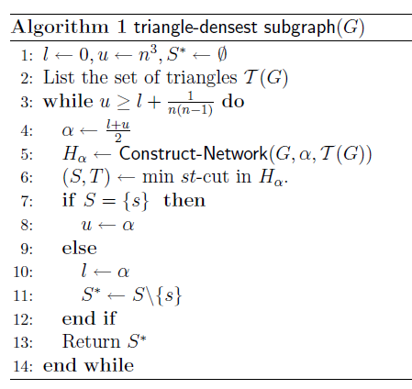
Triangle Densest Subgraph
Running time analysis
$O\left(m^{3/2}\right)$ to list triangles
[Itai,Rodeh’77].
$O\left(\log{n}\right)$ iterations, each taking
$$O\left(nt+{\min\left(n,t\right)}^{3}\right)$$ using Ahuja, Orlin, Stein, Tarjan algorithm.

Slide 29
Triangle Densest Subgraph
Theorem: The algorithm which peels triangles is a 1/3 approximation algorithm and runs in O(mn$)$ time.
Remark: This algorithm is not suitable for MapReduce, the de facto standard for processing large-scale datasets

Slide 30
MapReduce implementation
Theorem: There exists an efficient MapReduce algorithm which runs for any ε>0 in O(log(n)/ε) rounds and provides a 1/(3+3ε) approximation to the triangle densest subgraph problem.

Slide 31
Notation
$\text{δ}\text{(}\text{S}\text{)}\text{=}\frac{2e[S]}{|S|}\text{, } \text{f}\text{e}\text{(}\text{S}\text{)=}\frac{e[S]}{(\begin{aligned}\left|S\right| \\ 2\end{aligned})}$ $,{τ(S)=\frac{3t[S]}{|S|},f}_{t}\text{ (}\text{S}\text{)=}\frac{t[S]}{(\begin{aligned}\left|S\right| \\ 3\end{aligned})}.$
DS: Goldberg’s exact method for densest subgraph problem
½-DS: Charikar’s ½-approximation algorithm
TDS: our exact algorithm for the triangle densest subgraph problem
1/3-TDS: our 1/3-approximation algorithm for TDS problem.

Slide 32
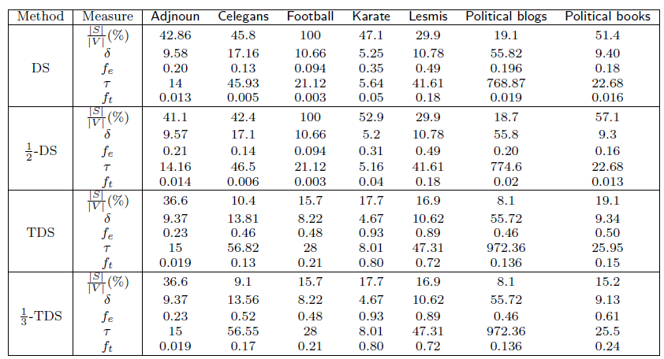
Some results

Slide 33
k-clique Densest subgraph
Our techniques generalize to maximizing the average k-clique density for any constant k.
kα
v
c_{v}
1
s
t
k-1
A=V(G)
B=C(G)

Slide 34
Triangle counting
Triangle counting appears in many applications!
Friends of friends tend to become
friends themselves!
A
Social networks are abundant in
triangles. E.g., Jazz network
n=198, m=2,742, T=143,192
B
C
[Wasserman Faust ’94]

Slide 35
Motivation for triangle counting
Degree-triangle correlations
Empirical observation
Spammers/sybil accounts
have small clustering coefficients.
Used by [Becchetti et al., ‘08],
[Yang et al., ‘11] to find Web Spam
and fake accounts respectively
The neighborhood of a
typical spammer (in red)

Slide 36
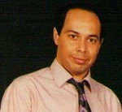
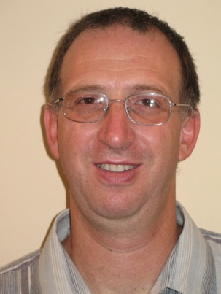
Related Work: Exact Counting
Alon
Yuster
Zwick
Running Time: ${O(m}^{2ω/(ω+1)})$
where $ω≤2.37$
Asymptotically the fastest algorithm but not practical for large graphs.
In practice, one of the iterator algorithms are preferred.
Node Iterator (count the edges among the neighbors of each vertex)
Edge Iterator (count the common neighbors of the endpoints of each edge)
Both run asymptotically in O(mn) time.

Slide 37
Related Work: Approximate Counting
r independent samples of three distinct vertices
T₃
X=1
X=0
T₀
T₁
T₂

Slide 38
Related Work: Approximate Counting
r independent samples of three distinct vertices
Then the following holds:
with probability at least 1-δ
Works for dense graphs. e.g., T₃ n²logn

Slide 39
Related Work: Approximate Counting
(Yosseff, Kumar, Sivakumar ‘02) require n²/polylogn edges
More follow up work:
(Jowhari, Ghodsi ‘05)
(Buriol, Frahling, Leondardi, Marchetti, Spaccamela, Sohler ‘06)
(Becchetti, Boldi, Castillio, Gionis ‘08)
…..

Slide 40
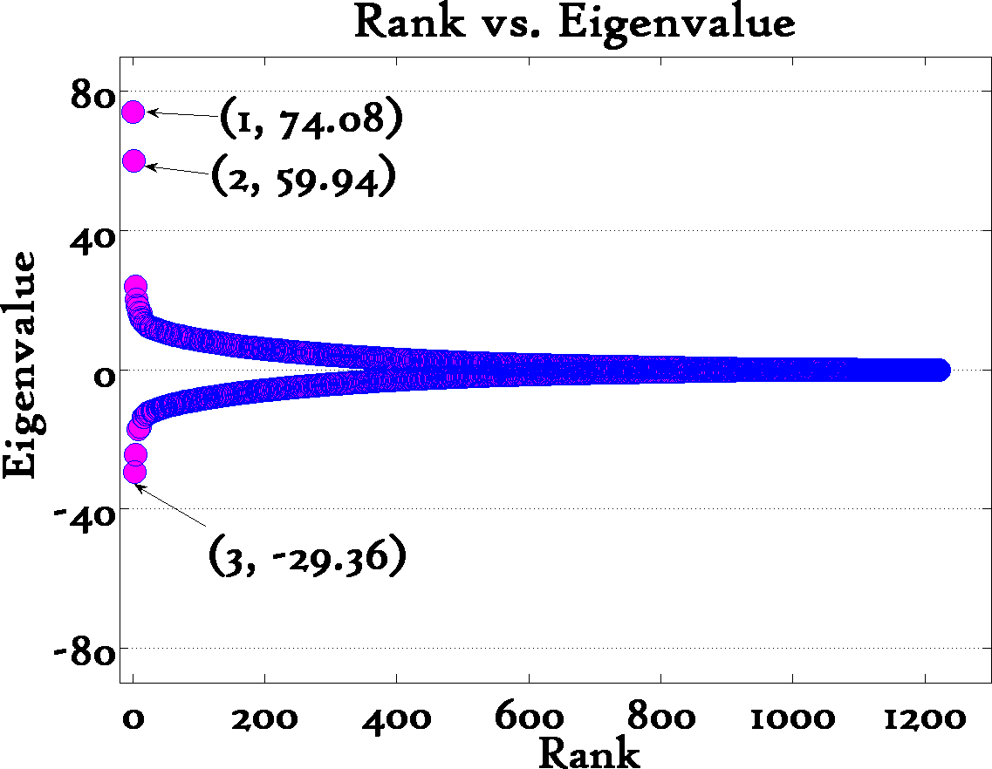
Constant number of triangle
[T.’08]
Political Blogs
eigenvalues of adjacency matrix
i-th eigenvector
Keep only 3!
3

Slide 41
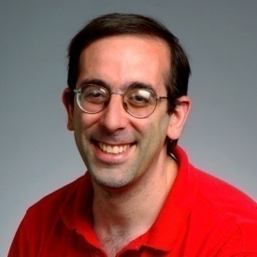
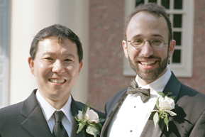
Related Work: Graph Sparsifier
Approximate a given graph G with a sparse graph H, such that H is close to G in a certain notion.
Examples:
Cut preserving Benczur-Karger
Spectral Sparsifier Spielman-Teng

Slide 42
Some Notation
t: number of triangles.
T: triangles in sparsified graph, essentially our estimate.
Δ: maximum number of triangles an edge is contained in.
Δ=O(n)
t_{max}: maximum number of triangles a vertex is contained in.
t_{max} =Ο(n²)

Slide 43
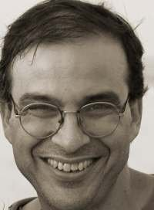
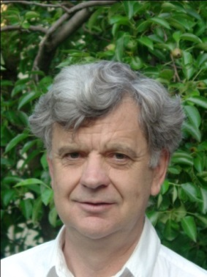
Triangle Sparsifiers
Joint work
with:
Mihail N. Kolountzakis
University of Crete
Gary L. Miller
CMU

Slide 44
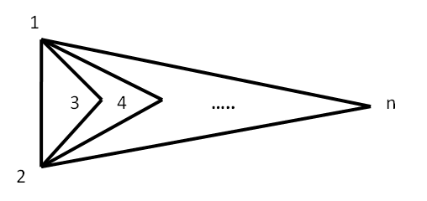
Triangle Sparsifiers
Theorem
If $p≥\max\left(\frac{Δ polylog(n)}{t},\frac{polylog(n)}{t^{1/3}}\right)$ then T~E[T] with probability 1-o(1).
Few words about the proof
$X_{e}$=1 if e survives in G’, otherwise 0. $T=\sum_{\left\{Δ\left(e,f,g\right)\right\}}{X_{e}X_{f}X_{g}}.$Clearly E[T]=p³t
Unfortunately, the multivariate polynomial is not smooth.
Intuition: “smooth” on average.

Slide 45
Triangle Sparsifiers
$p\frac{t}{Δ}≫1$,
o/w no hope
for concentration
….
….
Δ
….
t/Δ

Slide 46
Triangle Sparsifiers
….
$p^{3}t≫1$,
o/w no hope
for concentration
t=n/3

Slide 47
Expected Speedup
Notice that speedups are quadratic in p if we use any classic iterator counting algorithm.
Expected Speedup: 1/p²
To see why,
let R be the running time of Node Iterator after the
sparsification:
Therefore, expected speedup:

Slide 48
Corollary
For a graph with $t∼n^{3/2}$ and Δ$=O(n)$, we can use $p=n^{−1/2}$.
This means that we can obtain a highly concentrated estimate and a speedup of O(n)
Can we do even better? Yes, [Pagh, T.]

Slide 49
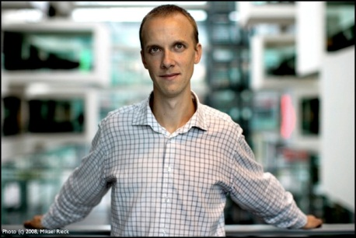
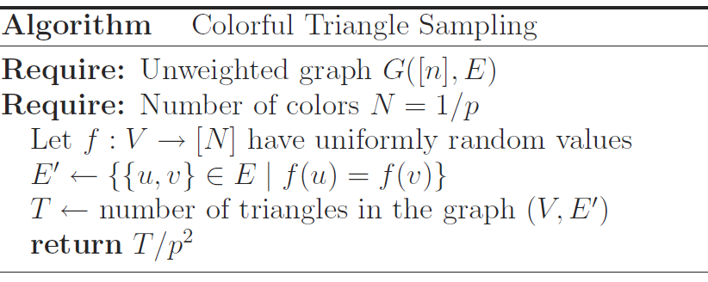
Colorful Triangle Counting
Joint work
with:
Rasmus Pagh, U. of Copenhagen

Slide 50
Colorful Triangle Counting
Set $X_{e}$=1 if e is monochromatic. Notice
that we have a correlated sampling scheme.
${If X}_{e}$=1
${and X}_{f}$=1
${then X}_{g}$=1.

Slide 51
Colorful Triangle Counting
This reduces the degree of the multivariate polynomial from triangle sparsifiers $T=\sum_{\left\{Δ\left(e,f,g\right)\right\}}{X_{e}X_{f}X_{g}}$ by 1 but we introduce dependencies
$$T= \frac{1}{3}\sum_{\left\{Δ\left(e,f,g\right)\right\}}{{(X}_{e}X_{f}+X_{e}X_{g}+X_{f}X_{g})}$$
However, the second moment method will give us tight results.

Slide 52
Colorful Triangle Counting
Theorem
If $p≥\max\left(\frac{Δlogn}{t},\sqrt{\frac{logn}{t}}\right)$ then T~E[T] with probability 1-o(1).

Slide 53
Colorful Triangle Counting
$p\frac{t}{Δ}≫1$,
o/w no hope
for concentration
….
….
Δ
….
t/Δ

Slide 54
Colorful Triangle Counting
….
$p^{2}t≫1$,
o/w no hope
for concentration
[Improves significantly
Triangle sparsifiers]
t=n/3

Slide 55
Colorful Triangle Counting
Theorem
If $p^{2}≥ \frac{16 t_{max}log⁡(n) }{ε^{2}t}$
then$\text{Pr}\text{(|}\text{T}\text{−}\text{E}\text{[}\text{T}\text{]| }≥εΕ[Τ])≤1/n.$

Slide 56
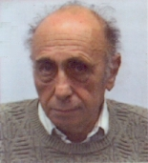
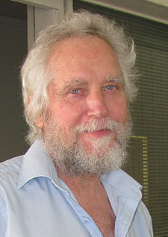
Hajnal-Szemerédi theorem
Every graph on n vertices with max. degree Δ(G) =k is
(k+1) -colorable with all color classes differing at size by at
most 1.
1
k+1
2
….

Slide 57
Proof sketch
Create an auxiliary graph where each triangle is a vertex and two vertices are connected iff the corresponding triangles share a vertex.
Invoke Hajnal-Szemerédi theorem and apply Chernoff bound per each chromatic class. Finally, take a union bound.
Q.E.D.

Slide 58
Why vertex and not edge disjoint?
Pr(X_{i}=1|rest are monochromatic) =p
≠ Pr(X_{i}=1)=p²

Slide 59
Remark
This algorithm is easy to implement in the MapReduce and streaming computational models.
See also Suri, Vassilvitski ‘11
As noted by Cormode, Jowhari [TCS’14] this results in the state of the art streaming algorithm in practice as it uses O(mΔ/Τ+m/T^{0.5}) space. Compare with Braverman et al’ [ICALP’13], space usage O(m/T^{1/3}).

Slide 60
Outline
Introduction
Finding near-cliques in graphs
Conclusion

Slide 61
Open problems
Faster exact triangle-densest subgraph algorithm.
How do approximate triangle counting methods affect the quality of our algorithms for the triangle densest subgraph problem?
How do we extract efficiently all subgraphs whose density exceeds a given threshold?

Slide 62
Questions?
Acknowledgements
Philip Klein
Yannis Koutis
Vahab Mirrokni
Clifford Stein
Eli Upfal
ICERM

Slide 63
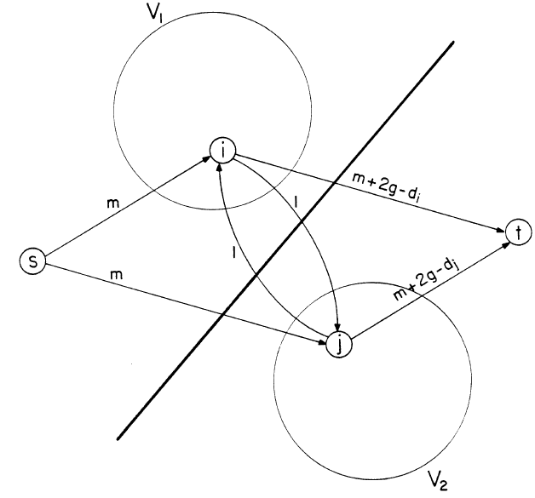
Goldberg’s network

Slide 64
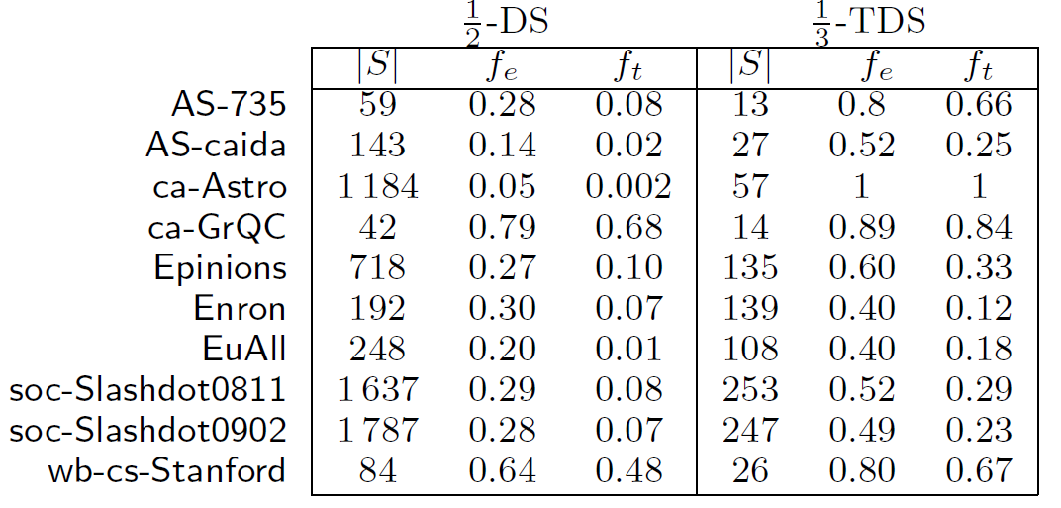
Additional results

