Slide 1


Efficient Triangle Counting in Large Graphs via Degree-based partitioning
Charalampos (Babis) E. Tsourakakis
ctsourak@math.cmu.edu
WAW 2010, Stanford
16th December ‘10

Slide 2
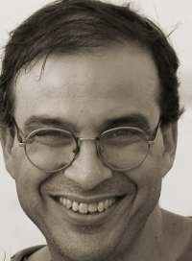
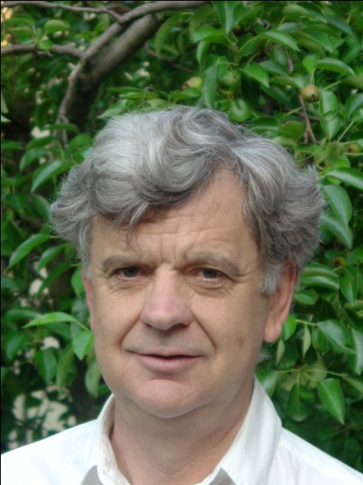
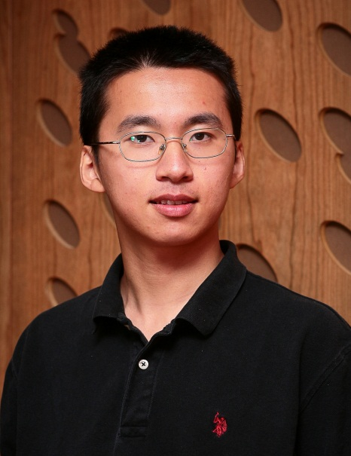
Joint work
Mihail N. Kolountzakis
Math, University of Crete
Gary L. Miller
SCS, CMU
Richard Peng
SCS, CMU

Slide 3
Outline
Motivation
Existing Work
Our contributions
Experimental Results
Ramifications
Conclusions

Slide 4
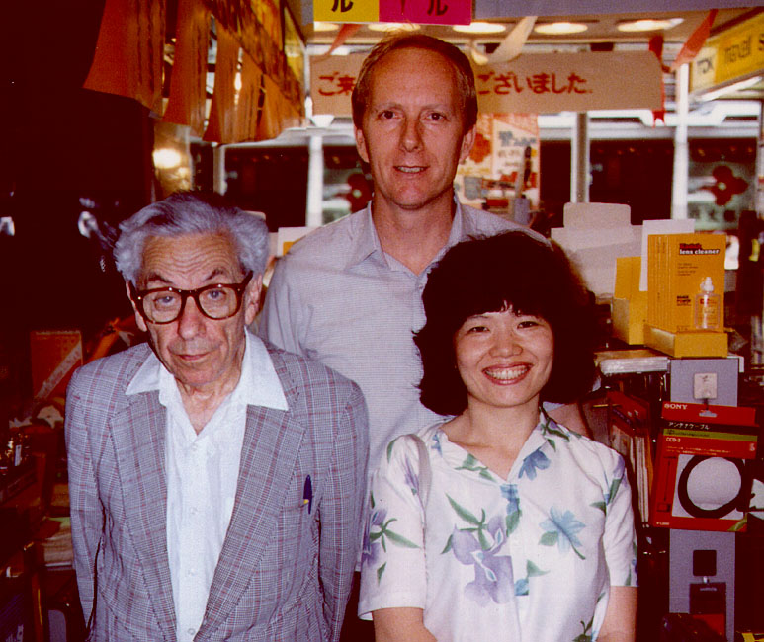
Motivation I
Friends of friends tend to become
friends themselves!
A
B
C
(Wasserman Faust ‘94)
(left to right) Paul Erdös , Ronald Graham, Fan Chung Graham

Slide 5
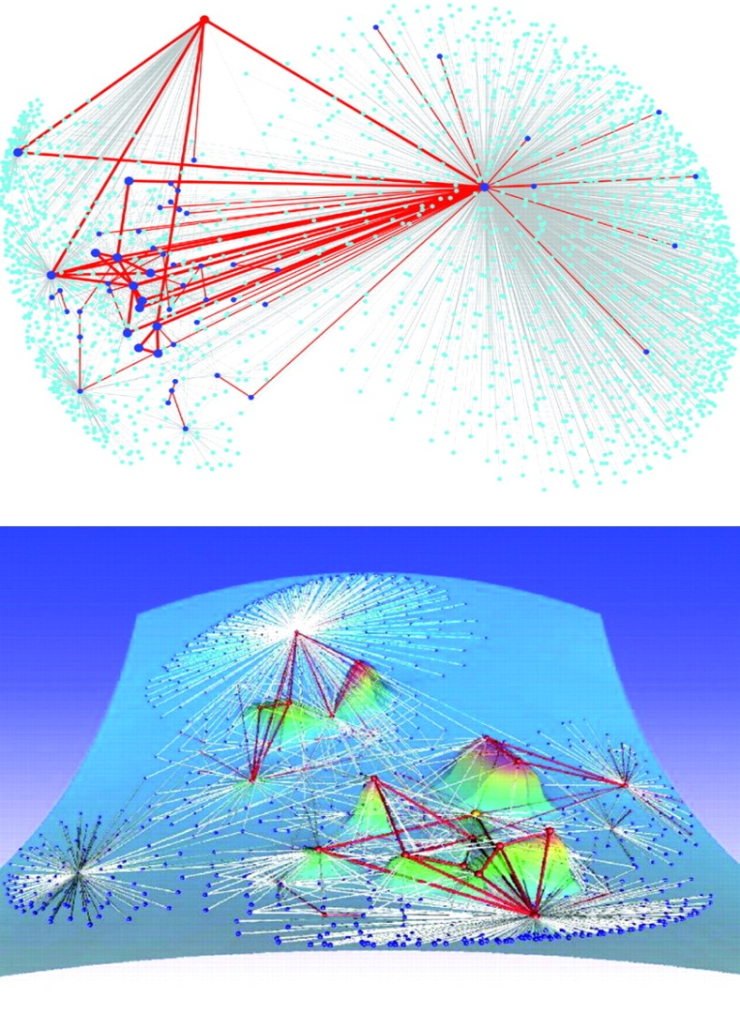
Motivation II
Eckmann-Moses, Uncovering the Hidden Thematic Structure of the Web (PNAS, 2001)
Key Idea: Connected regions of high curvature (i.e., dense in triangles) indicate a common topic!

Slide 6
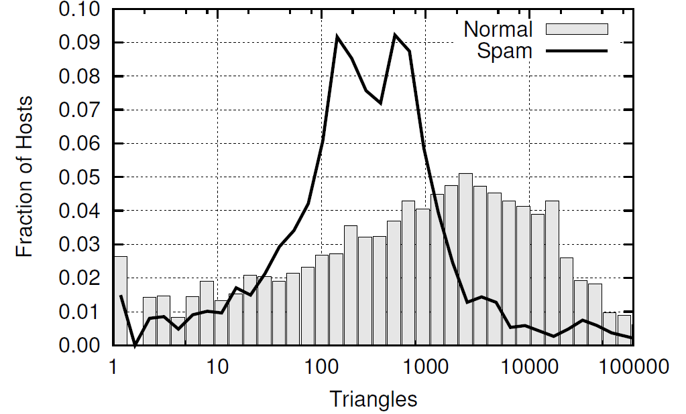
Motivation III
Triangles used for Web Spam Detection (Becchetti et al. KDD ‘08)
Key Idea: Triangle Distribution among
spam hosts is significantly different
from non-spam hosts!

Slide 7
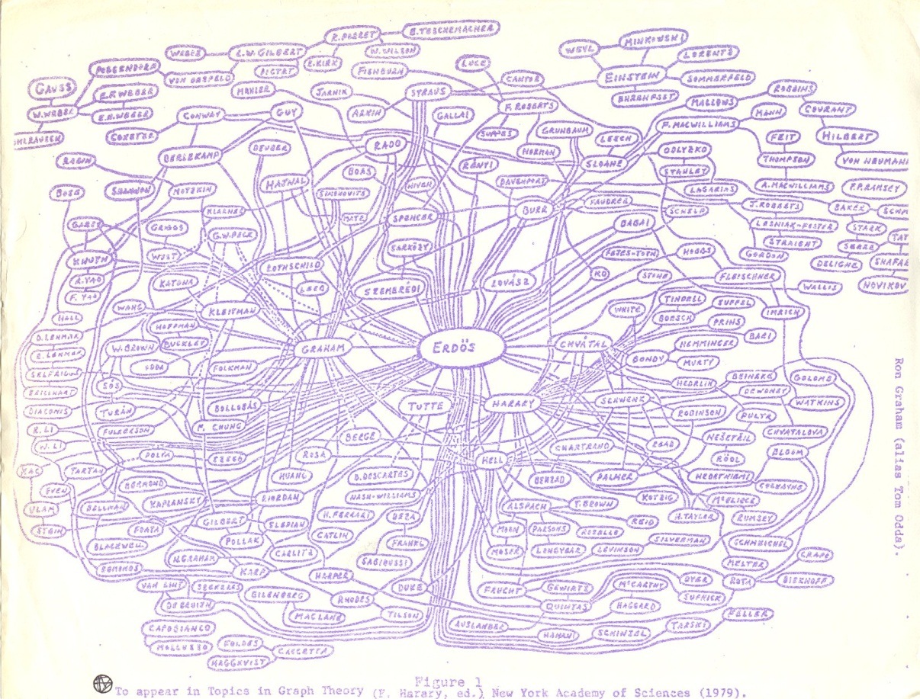
Motivation IV
Triangles used for assessing Content Quality in Social Networks
Welser, Gleave, Fisher, Smith Journal of Social Structure 2007
Key Claim: The amount of triangles in the self-centered social network of a user is a good indicator of the role of that user in the community!

Slide 8
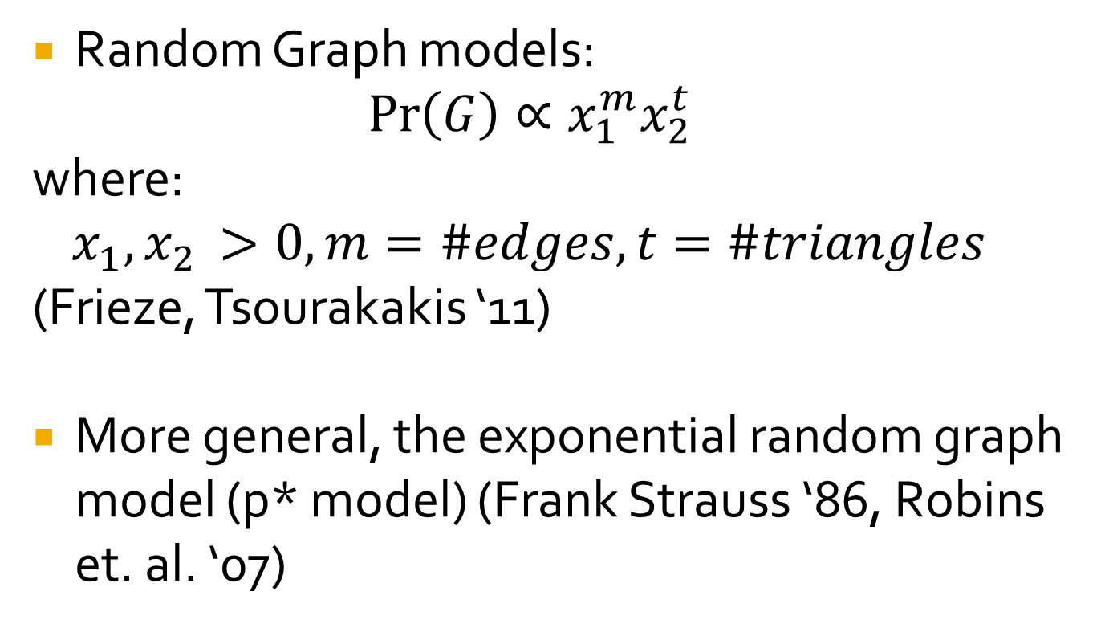
Motivation V
Random Graph models:
$$\operatorname{Pr}\left(G\right)∝x_{1}^{m}x_{2}^{t}$$
where:
$$x_{1},x_{2 }>0, m=\#edges, t=\#triangles$$
(Frieze, Tsourakakis ‘11)
More general, the exponential random graph model (p* model) (Frank Strauss ‘86, Robins et. al. ‘07)

Slide 9
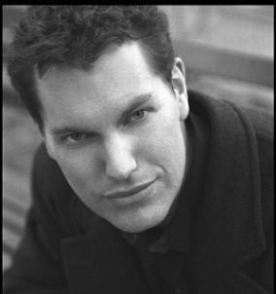
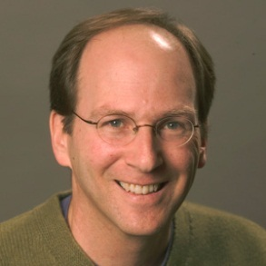
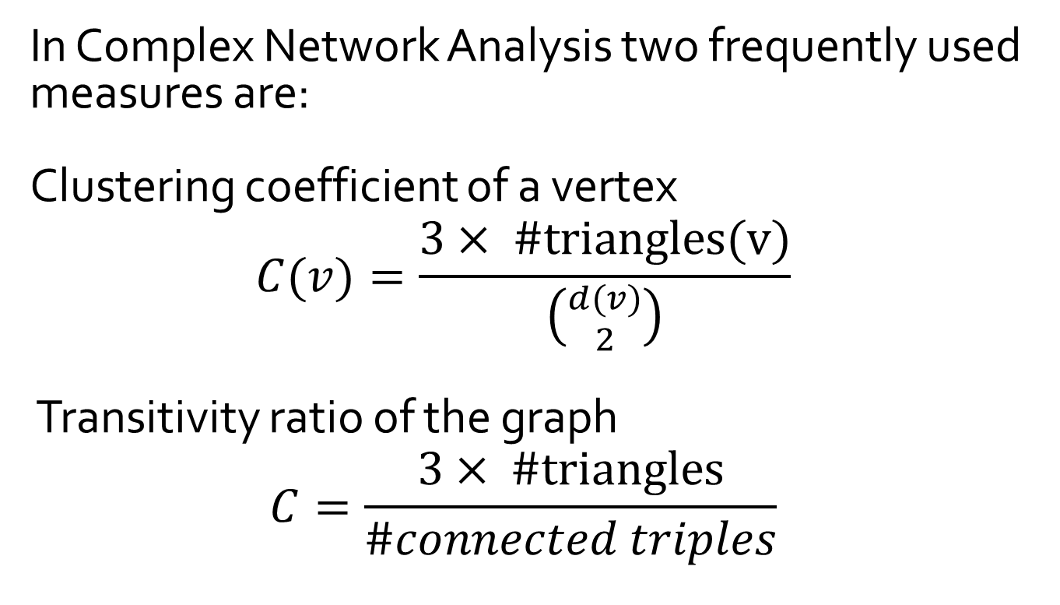
Motivation VI
In Complex Network Analysis two frequently used measures are:
Clustering coefficient of a vertex
$$C(v)=\frac{3× \#triangles(v)}{\left({d(v) \atop 2}\right)}$$
Transitivity ratio of the graph
$$C=\frac{3× \#triangles}{\#connected triples}$$
(Watts,Strogatz’98)

Slide 10
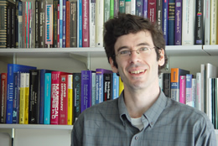
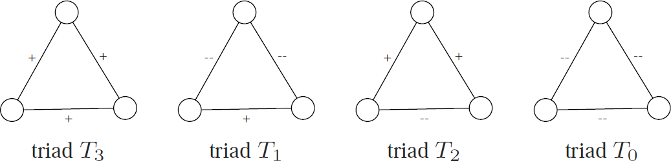
Motivation VII
Signed triangles in structural balance theory Jon Kleinberg’s talk (Leskovec et al. ‘10)
Triangle closing models also used to model the microscopic evolution of social networks (Leskovec et.al., KDD ‘08)

Slide 11
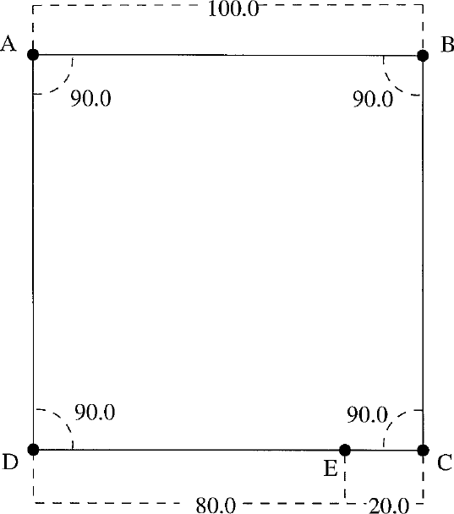
Motivation VIII
CAD applications,
E.g., solving systems of geometric constraints involves triangle counting!
(Fudos, Hoffman 1997)

Slide 12
Motivation IX
Numerous other applications including :
Motif Detection/ Frequent Subgraph Mining (e.g., Protein-Protein Interaction Networks)
Community Detection (Berry et al. ‘09)
Outlier Detection (Tsourakakis ‘08)
Link Recommendation
Fast triangle counting algorithms are necessary.

Slide 13
Outline
Motivation
Existing Work
Our contributions
Experimental Results
Ramifications
Conclusions

Slide 14
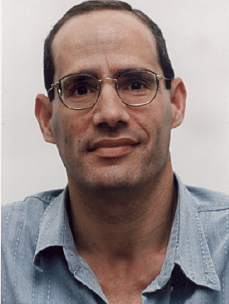

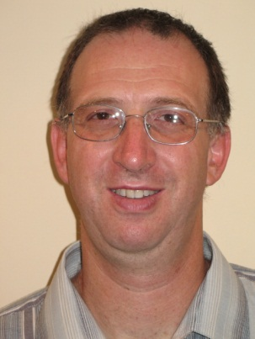
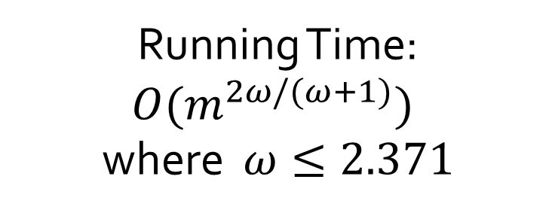
Exact Counting
Alon
Yuster
Zwick
Running Time: ${O(m}^{2ω/(ω+1)})$
where $ω≤2.371$
Asymptotically the fastest algorithm but not practical for large graphs.
In practice, one of the iterator algorithms are preferred.
Node Iterator (count the edges among the neighbors of each
vertex)
Edge Iterator (count the common neighbors of the endpoints of
each edge)
Both run asymptotically in O(mn) time.

Slide 15
Exact Counting
Remarks
  In Alon, Yuster, Zwick appears the idea of partitioning the vertices into “large” and “small” degree and treating them appropriately.
  For more work, see references in our paper:
    Itai, Rodeh (STOC ‘77)
    Papadimitriou, Yannakakis (IPL ‘81)
    ……

Slide 16
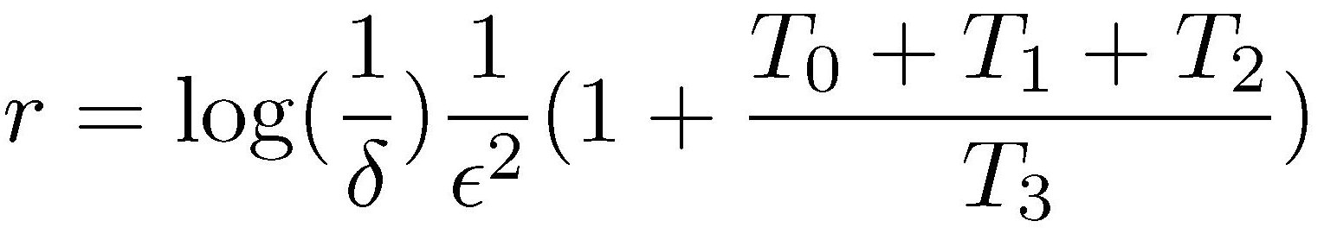
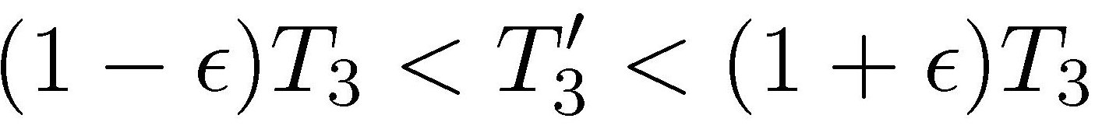
Approximate Counting
r independent samples of three distinct vertices
Then the following holds:
with probability at least 1-δ
Works for dense graphs. e.g., T₃ n²logn

Slide 17
Approximate Counting
(Yosseff, Kumar, Sivakumar ‘02) require n²/polylogn edges
More follow up work:
  (Jowhari, Ghodsi ‘05)
  (Buriol, Frahling, Leondardi, Marchetti, Spaccamela, Sohler ‘06)
  (Becchetti, Boldi, Castillio, Gionis ‘08)

Slide 18
Approximate Triangle Counting
Triangle Sparsifiers
  Keep an edge with probability p. Count the triangles in sparsified graph and multiply by 1/p³.
  If the graph has O(n polylogn) triangles we get concentration and we know how to pick p (Tsourakakis, Kolountzakis, Miller ‘08)
  Proof uses the Kim-Vu concentration result for multivariate polynomials which have bad Lipschitz constant but behave “well” on average.

Slide 19
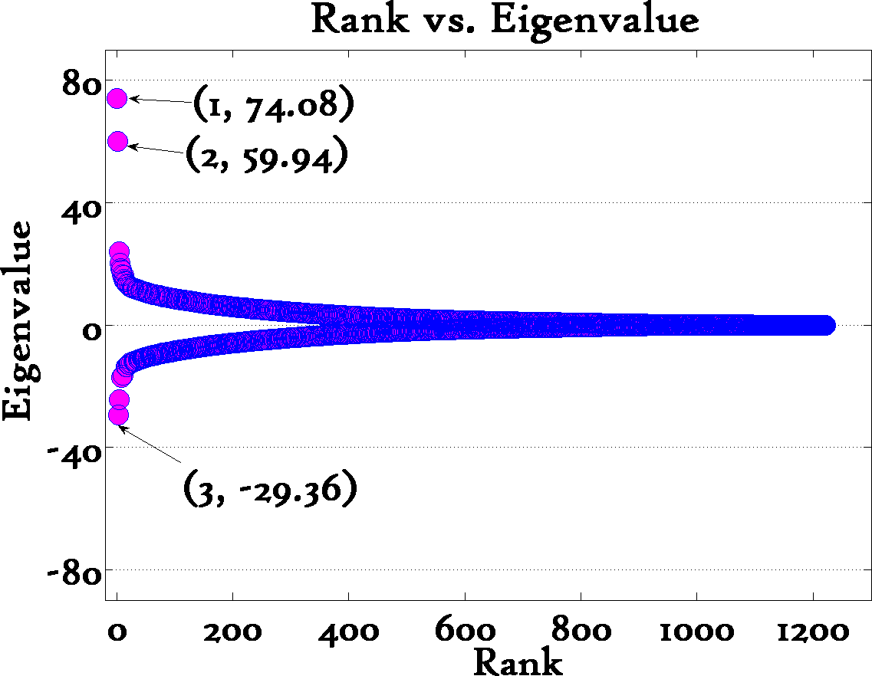
Linear Algebraic Algorithms
eigenvalues of
adjacency matrix
Keep only 3!
3
i-th eigenvector
Political Blogs
Tsourakakis (ICDM 2008)
More:
Tsourakakis (KAIS 2010) SVD also works
Haim Avron (KDD 2010) randomized trace estimation

Slide 20
Outline
Motivation
Existing Work
Our contributions
Experimental Results
Ramifications
Conclusions

Slide 21
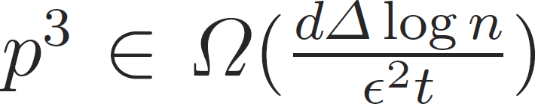
Edge Sparsification
Theorem
If then with probability 1-1/n^{3-d} the sampled graph has a triangle count that ε-approximates the true number of triangles for any 0<d<3.

Slide 22
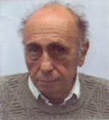
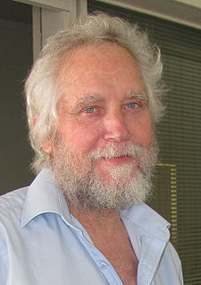
Hajnal-Szemerédi theorem
Every graph on n vertices with max. degree Δ(G) =k is
(k+1) -colorable with all color classes differing at size by at
most 1.
1
k+1
2
….

Slide 23
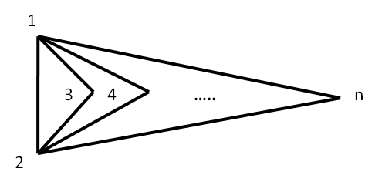
Proof sketch
Create an auxiliary graph where each triangle is a vertex and two vertices are connected iff the corresponding triangles share an edge.
Observe: Δ(G)=Ο(n)
Invoke Hajnal-Szemerédi theorem and apply Chernoff bound per each chromatic class. Finally, take a union bound. Q.E.D.

Slide 24
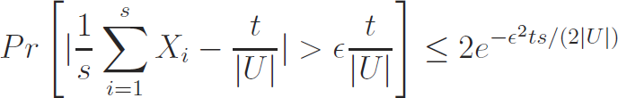
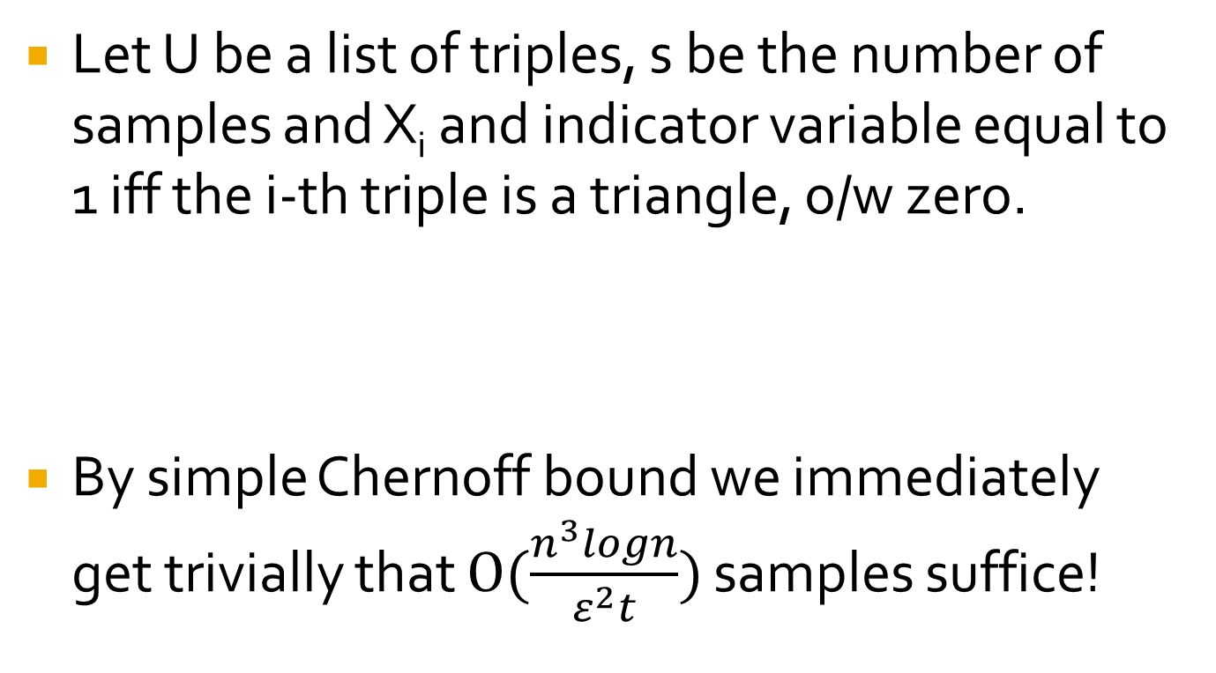
Triple Sampling
Let U be a list of triples, s be the number of samples and X_{i} and indicator variable equal to 1 iff the i-th triple is a triangle, o/w zero.
By simple Chernoff bound we immediately get trivially that $O(\frac{n^{3}logn}{ε^{2}t})$ samples suffice!

Slide 25
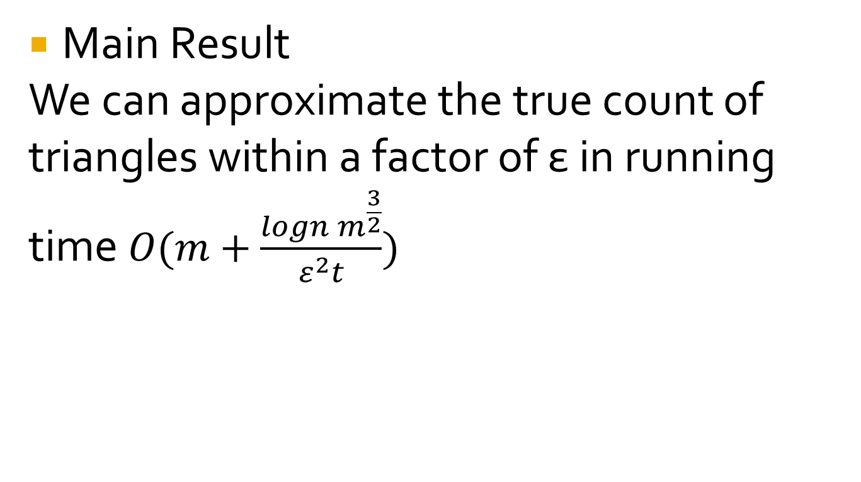
Triple Sampling
Main Result
We can approximate the true count of triangles within a factor of ε in running time $O(m+\frac{logn m^{\frac{3}{2}}}{ε^{2}t})$

Slide 26
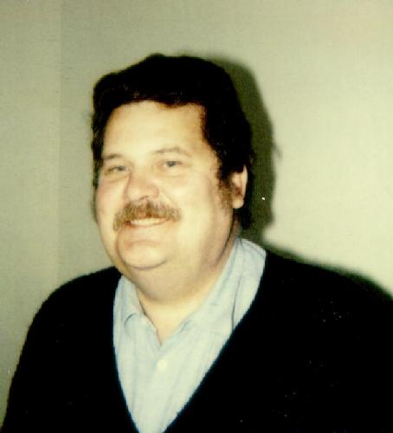
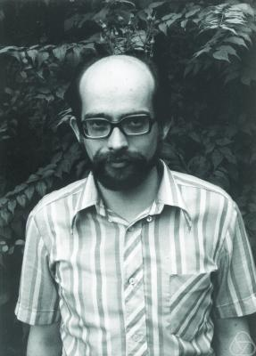
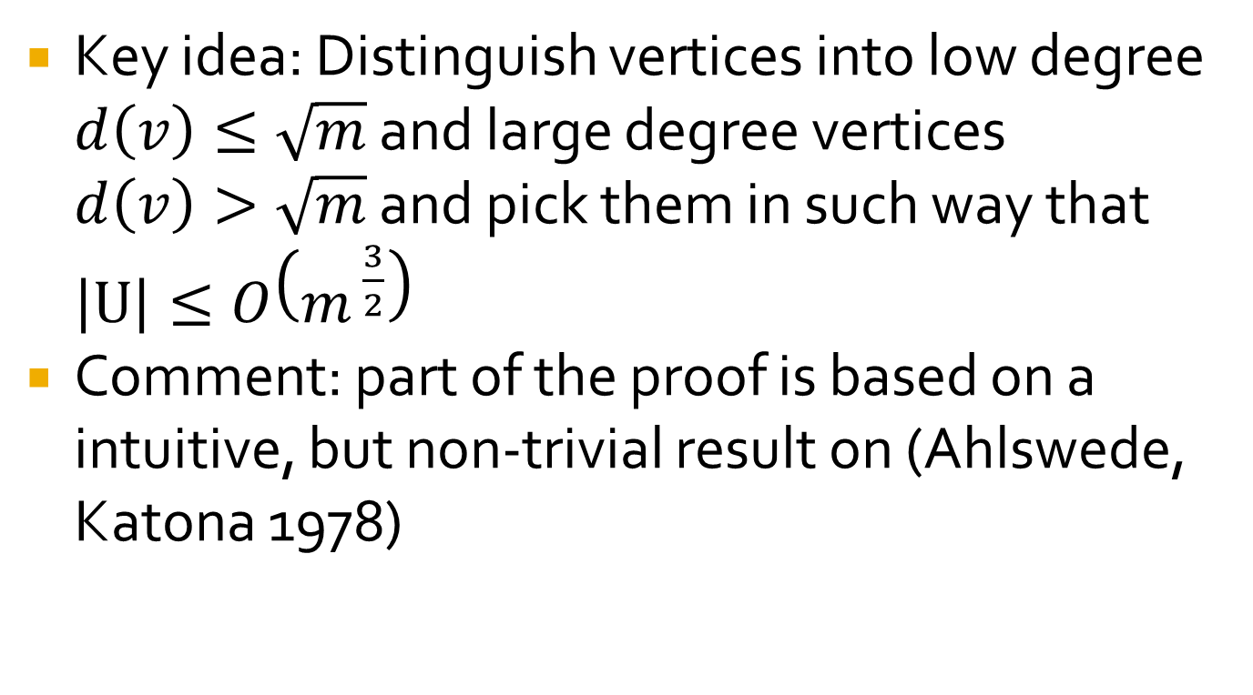
Key idea
Key idea: Distinguish vertices into low degree $d\left(v\right)≤\sqrt{m}$ and large degree vertices $d\left(v\right)>\sqrt{m}$ and pick them in such way that $\left|U\right|≤O\left(m^{ \frac{3}{2}}\right)$
Comment: part of the proof is based on a intuitive, but non-trivial result on (Ahlswede, Katona 1978)
Given a graph G with n vertices and m edges which graph maximizes the edges in the line graph L(G)?

Slide 27
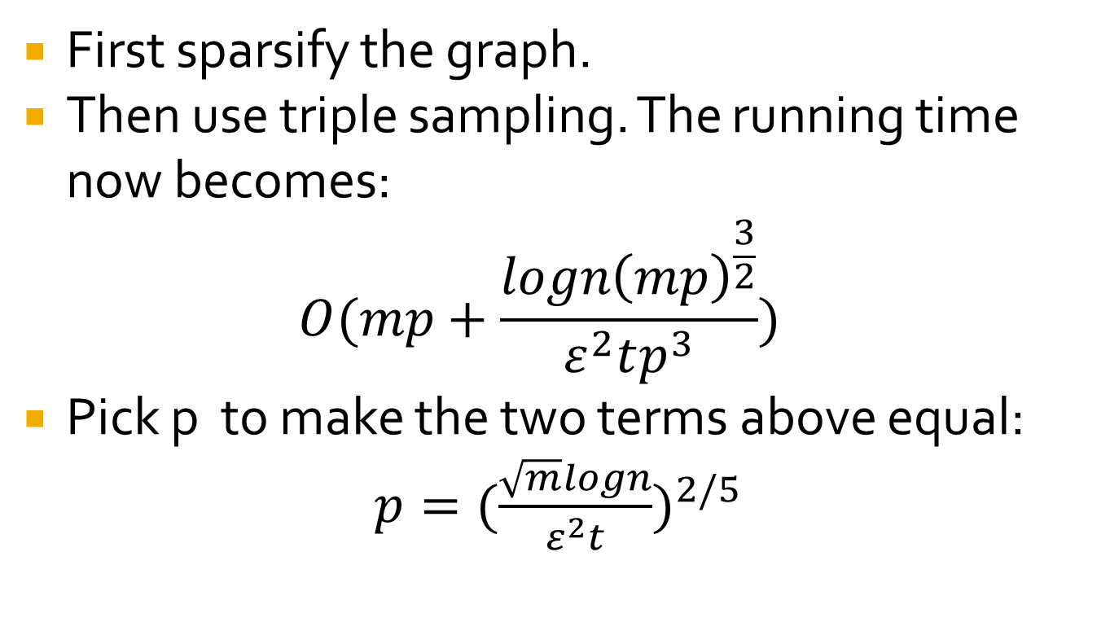
Hybrid Algorithm
First sparsify the graph.
Then use triple sampling. The running time now becomes:
$$O(mp+\frac{logn{\left(mp\right)}^{\frac{3}{2}}}{ε^{2}tp^{3}})$$
Pick p to make the two terms above equal: $p={(\frac{\sqrt{m}logn}{ε^{2}t})}^{2/5}$

Slide 28
Outline
Motivation
Existing Work
Our contributions
Experimental Results
Ramifications
Conclusions

Slide 29






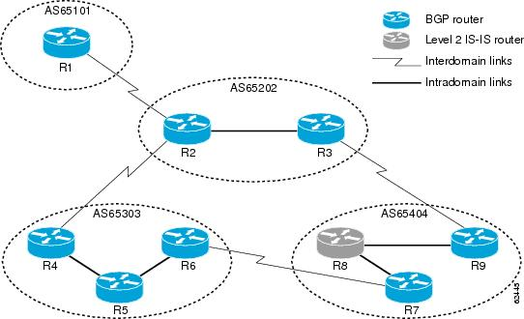
Datasets

Slide 30
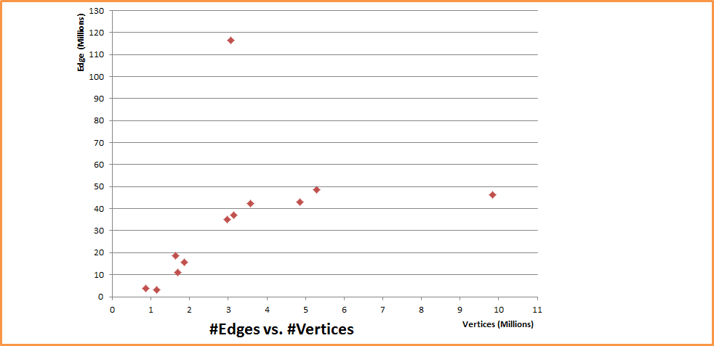
Edges vs. vertices
Orkut (3.1M,117M)
LiveJournal (5.4M,48M)
YouTube
(1.2M,3M)
Web-EDU
(9.9M,46.3M)
Flickr, (1.9M,15.6M)

Slide 31
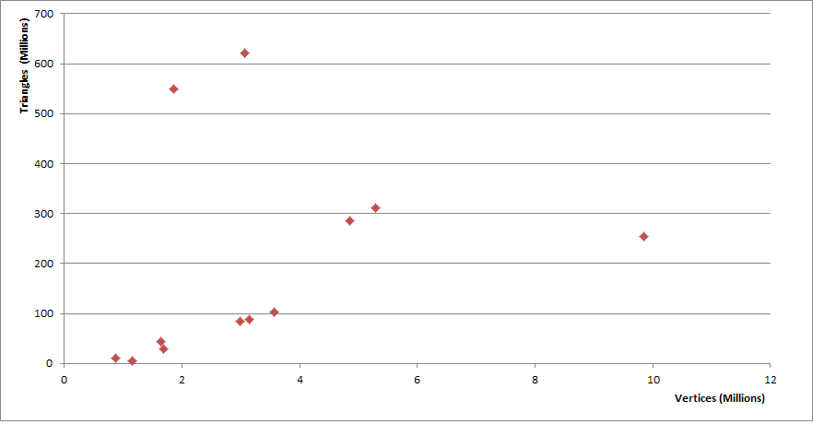


Triangles vs. Vertices
Social networks
abundant
in triangles!

Slide 32
Running times
secs

Slide 33
Remarks
p was set to 0.1. More sophisticated techniques for setting p exist (Tsourakakis, Kolountzakis, Miller ‘09) using a doubling procedure.
From our results, there is not a clear winner, but the hybrid algorithm achieves both high accuracy and speed.
Sampling from a binomial can be done easily in (expected) sublinear time.
Our code, even our exact algorithm, outperforms the fastest approximate counting competitors code, hence we compared different versions of our code!

Slide 34
Outline
Motivation
Existing Work
Our contributions
Experimental Results
Ramifications
Conclusions

Slide 35
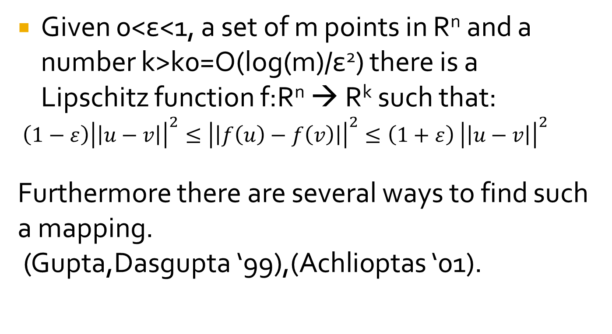
Johnson Lindenstrauss Lemma
Given 0<ε<1, a set of m points in R^{n} and a number k>k0=O(log(m)/ε²) there is a Lipschitz function f:R^{n} → R^{k} such that:
$\left(1−ε\right){\left|\left|u−v\right|\right|}^{2}≤{\left|\left|f\left(u\right)−f\left(v\right)\right|\right|}^{2}≤\left(1+ε\right) {\left|\left|u−v\right|\right|}^{2}$
Furthermore there are several ways to find such a mapping.
(Gupta,Dasgupta ‘99),(Achlioptas ‘01).

Slide 36
Remark
Observe that if we have an edge u~v and we “dot” the corresponding rows of the adjacency matrix we get the number of triangles.
Obviously a RP cannot preserve all inner products: consider the basis e₁,..,e_{n}. Clearly we cannot have all Re_{i} be orthogonal since they belong to a lower dimensional space.
When does RP work for triangle counting?

Slide 37
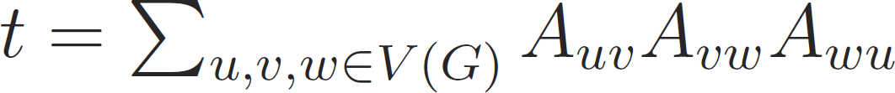
Random Projections
R kxn RP matrix, e.g., iid N(0,1) r.v
Y=
This random projection does not work!
E[Y]=0

Slide 38
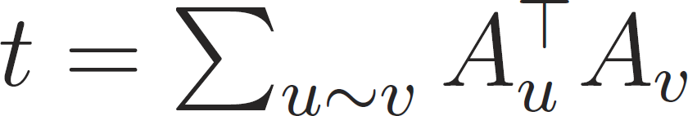
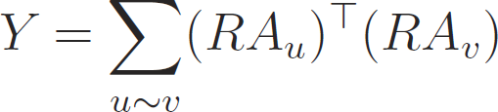
Random Projections
R kxn RP matrix, e.g., iid N(0,1) r.v
This random projection gives E[Y]=kt!
To have concentration it suffices:
Var[Y]=k(#circuits of length 6)=o(k(E[Y])²)

Slide 39
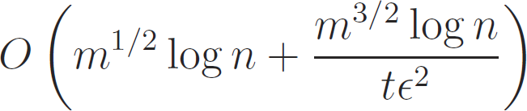
More Results
We can adapt our proposed method in the semi-streaming model with space usage
so that it performs only 3 passes over the data.
More experiments, all the implementation details.

Slide 40
Outline
Motivation
Existing Work
Our contributions
Experimental Results
Ramifications
Conclusions

Slide 41
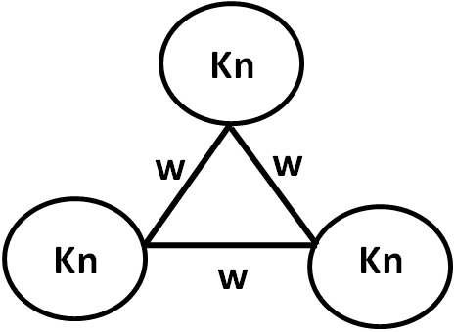
Conclusions
Remove edge (1,2)
Remove any weighted edge
w sufficiently large
Spielman-Srivastava and
Benczur-Karger
sparsifiers also don’t work!
(Tsourakakis, Kolountzakis, Miller ‘08)

Slide 42
Conclusions
State-of-the art results in triangle counting for massive graphs (sparsify and sample triples carefully)
Sampling results of different “flavor” compared to existing work.
Implement the algorithm in the MapReduce framework (done by Sergei Vassilvitskii et al., Yahoo! Research MADALGO ‘10)
For which graphs do random projections work?

Slide 43

THANK YOU!

Slide 44
APPENDIX SLIDES

Slide 45
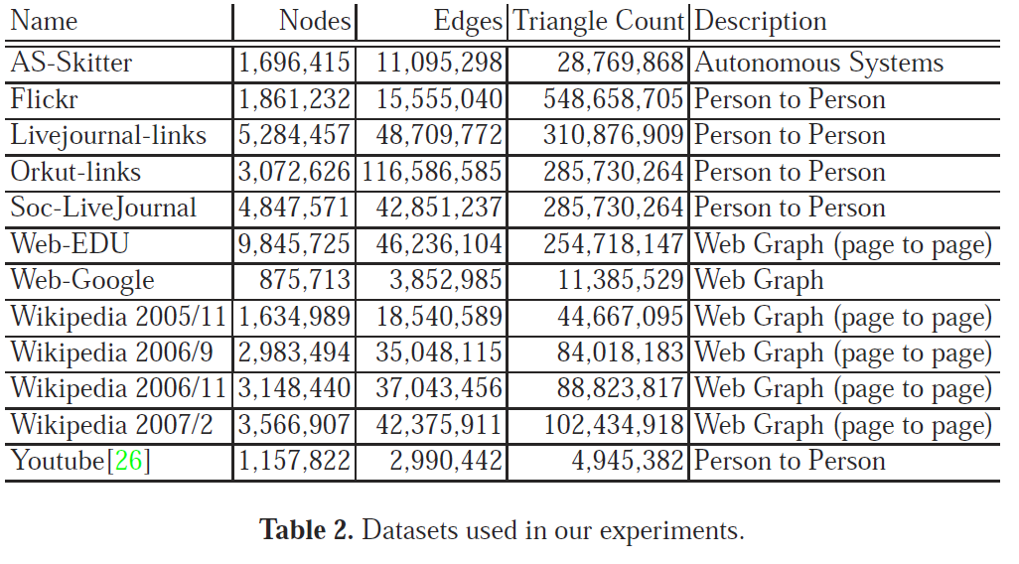
Datasets
621,963,073

Slide 46
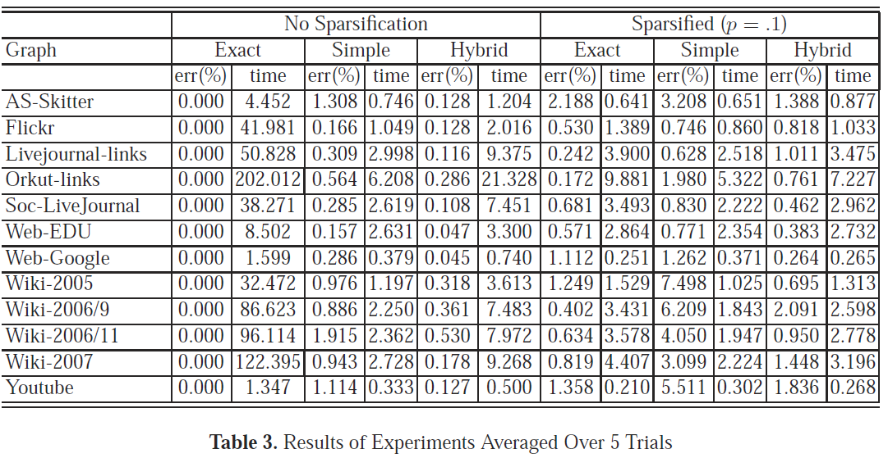
Results
Hybrid vs. Naïve Sampling improves accuracy, Increases running time
Best method for our applications: best running time, high accuracy

Slide 47
Semi-Streaming Model
Semi-streaming model (Feigenbaum et al., ICALP 2004) relaxes the strict constraints of the streaming model.
  Semi-external memory constraint
  Graph stored on disk as an adjacency list, no random access is allowed (only sequential accesses)
  Limited number of sequential scans

Slide 48
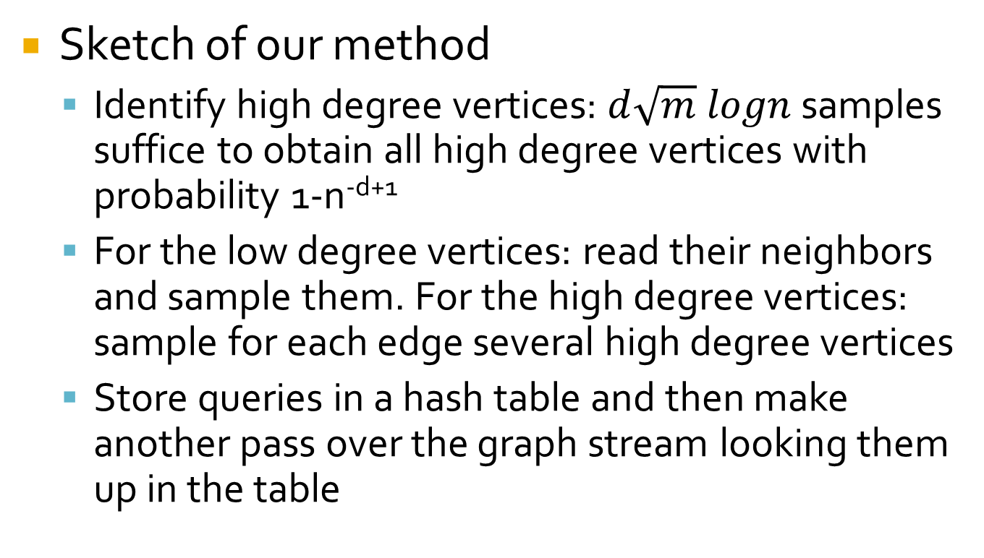
Semi-Streaming Model
Sketch of our method
  Identify high degree vertices: $d\sqrt{m} logn$ samples suffice to obtain all high degree vertices with probability 1-n^{-d+1}
  For the low degree vertices: read their neighbors and sample them. For the high degree vertices: sample for each edge several high degree vertices
  Store queries in a hash table and then make another pass over the graph stream looking them up in the table

Slide 49
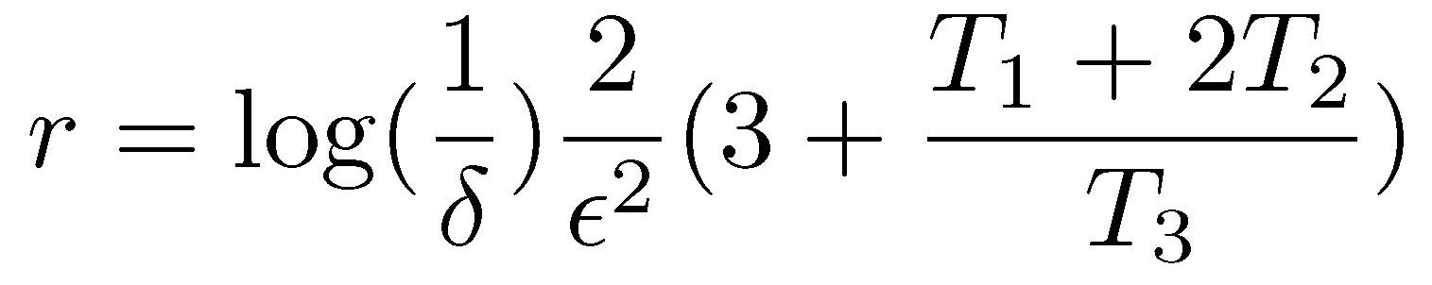
Buriol, Frahling, Leonardi, Marchetti-Spaccamela, Sohler
k
Sample uniformly
at random an edge
(i,j) and a node k in V-{i,j}
?
?
i
j
Check if edges (i,k) and (j,k) exist in E(G)
samples

Slide 50
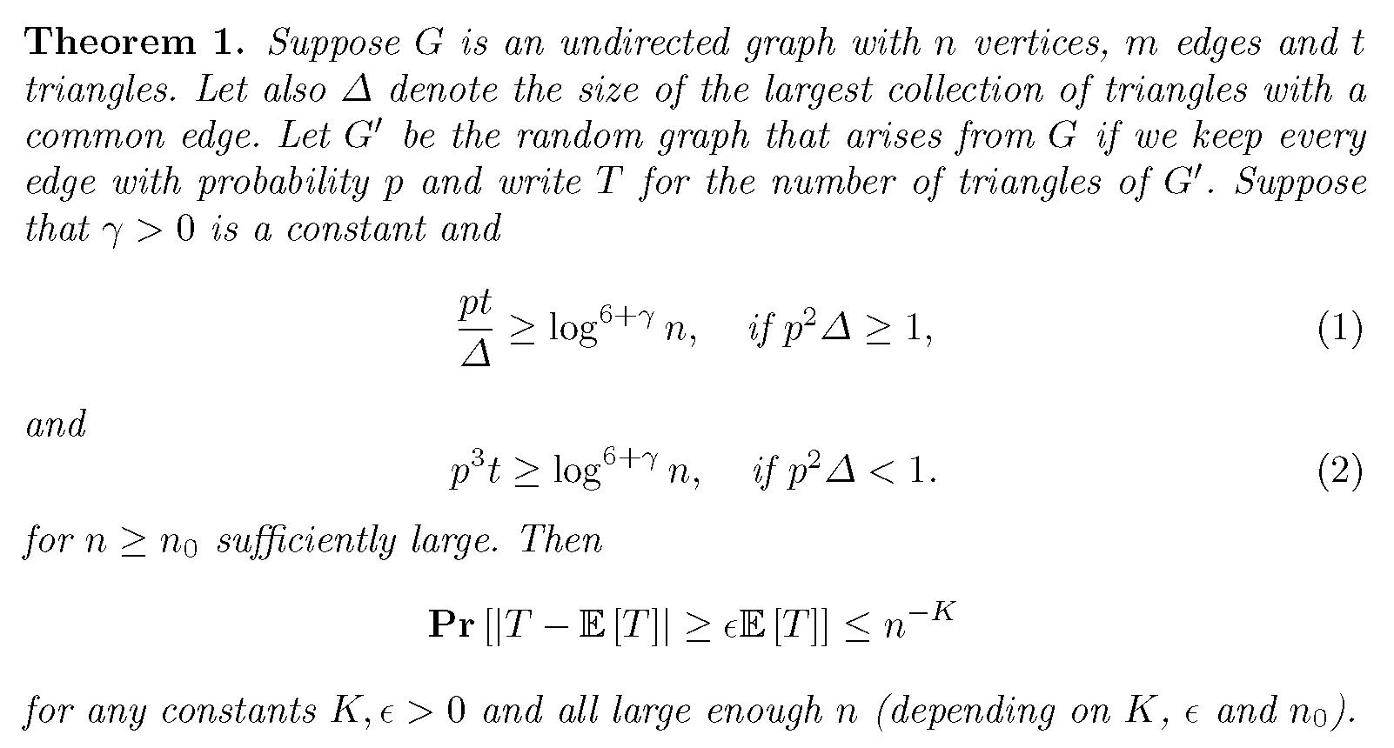
Triangle Sparsifiers
Tsourakakis,Kolountzakis,Miller(‘09): keep each edge with probability p
Mildness,
pick p=1
How to choose
p?
Concentration

