Slide 1
Modeling Intratumor Gene Copy Number Heterogeneity using Fluorescence in Situ Hybridization data
Charalampos (Babis) E. Tsourakakis
charalampos.tsourakakis@aalto.fi
WABI 2013, France

Slide 2
Tumor heterogeneity
t1 < t2 < t3 < t4 < t5
A
A
A
A
A
A
A
A
A
B
A
A
D
D
D
E
A
B
A
B
A
B
A
E
A
A
A
A
A
A
A
A
C
B
C
B
B
B
C
D
D
D
E
E
E
A
A
A
A
A
B
B
A
A
B
B
A
A
B
B
A
A
E
E
A
A
A
A
A
A
A
A
E
A
A
E
E
A
E
E
E
A
A
D
A
C
(4)
B
(3)
A
Copy numbers for a single gene
(2)
D
(1)
E
(0)

Slide 3
Tumor heterogeneity
Inverse problem approach
  High-throughput DNA sequencing data by
  Oesper, Mahmoody, Raphael
  (Genome Biology 2013)
  SNP array data by Van Loo et al. (PNAS 2010), Carter et al. (Nature Biotechnology 2012)

Slide 4
Tumor heterogeneity
FISH data,
direct
assessment
Gene 2
3
2
5
2
1
3
1
0
Gene 1
0
1
2
3

Slide 5
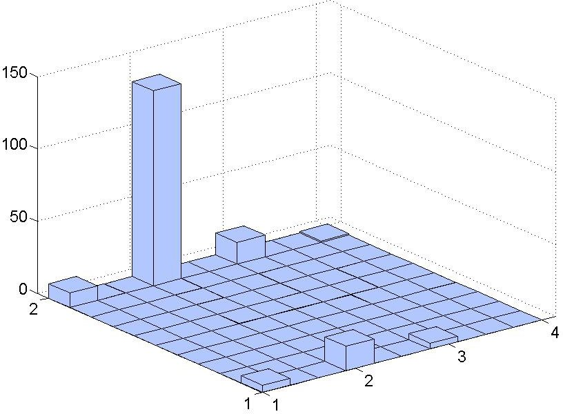
FISH data
Multidimensional histogram on the
positive integer cone, e.g., for 2 dimensions
CCND1
p53

Slide 6
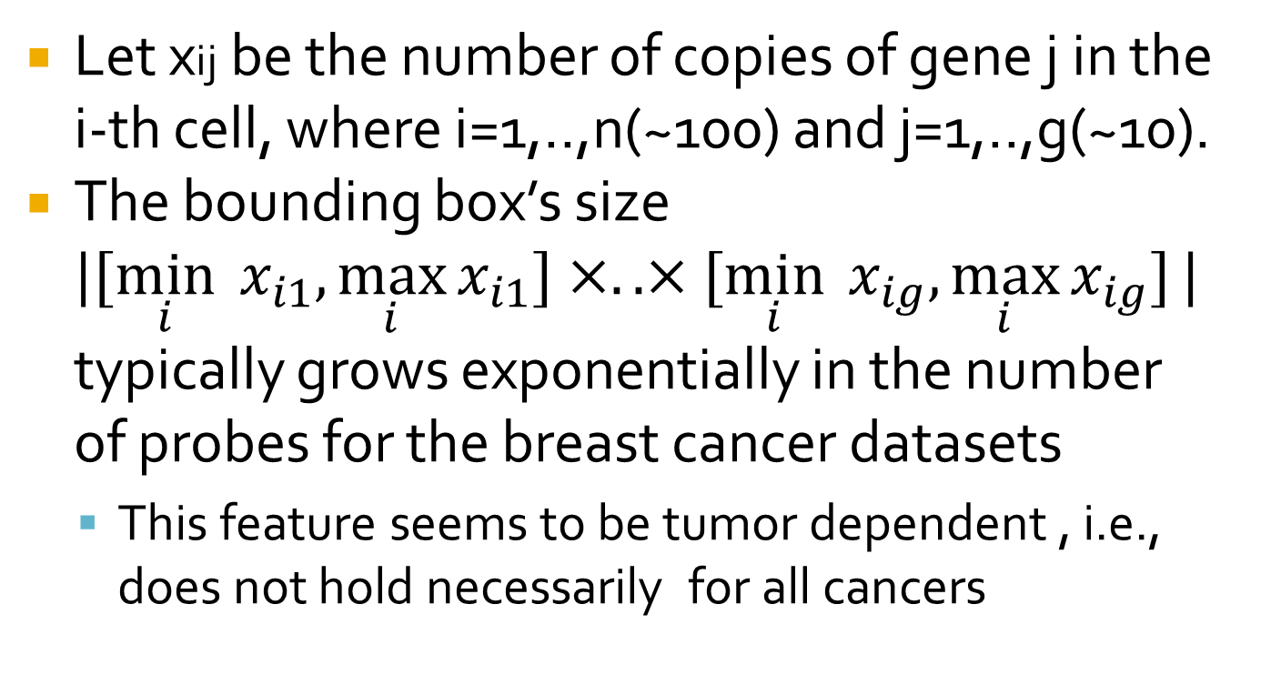
FISH data
Let xij be the number of copies of gene j in the i-th cell, where i=1,..,n(~100) and j=1,..,g(~10).
The bounding box’s size
$|[\min_{i}{ x_{i1},\max_{i}{x_{i1}]}}×.. ×[\min_{i}{ x_{ig},\max_{i}{x_{ig}]}}|$
typically grows exponentially in the number of probes for the breast cancer datasets
  This feature seems to be tumor dependent , i.e., does not hold necessarily for all cancers

Slide 7
FISH data
Breast and cervical cancer data publicly available from NIH
ftp://ftp.ncbi.nlm.nih.gov/pub/FISHtrees/data

Slide 8
Motivation
Understanding tumor heterogeneity is a key step towards:
  find first mutation events, hence identify new drugs and diagnostics
  predict response to selective pressure, hence develop strategies to avoid drug resistance
  identify tumors likely to progress, hence avoid over- and under-treatment.

Slide 9
Related work
Pennington, Smith, Shackney and Schwartz (J. of Bioinf. and Comp. B. 2007)
  Two probes
  Random walk where coordinate i is picked independently and with probabilities pi0,pi-1,pi1 is modified by {0,-1,+1} respectively.
  Efficient heuristic to maximize a likelihood function over all possible trees and parameters.

Slide 10
Related work
Chowdhury, Shackney, Heselmeyer-Haddad, Ried, Schäffer, Schwartz (Best paper in ISMB’13). Among other contributions:
  Methods which are able to handle large number of cells and probes.
  Exponential-time exact algorithm and an efficient heuristic for optimizing their objective
  New test statistics, tumor classification
  Extensive experimental evaluation

Slide 11
Related work
Copies of Gene 2
Chowdhury et al.:
  Problem: Find tree (and possibly Steiner nodes) to minimize cost of connecting all input (terminal) vertices
3
2
X
X
1
X
0
0
1
2
3
Copies of gene 1
Notes:
Costs of edges determined by Manhattan (L1) distance

Slide 12
Contributions I
Probabilistic approach
  We summarize the empirical distribution based on a model that captures complex dependencies among probes without over-fitting.
  Allows us to assign weights on the edges of the positive integer di-grid which capture how likely a transition is.
  And now, how do we derive a tumor phylogeny?..

Slide 13

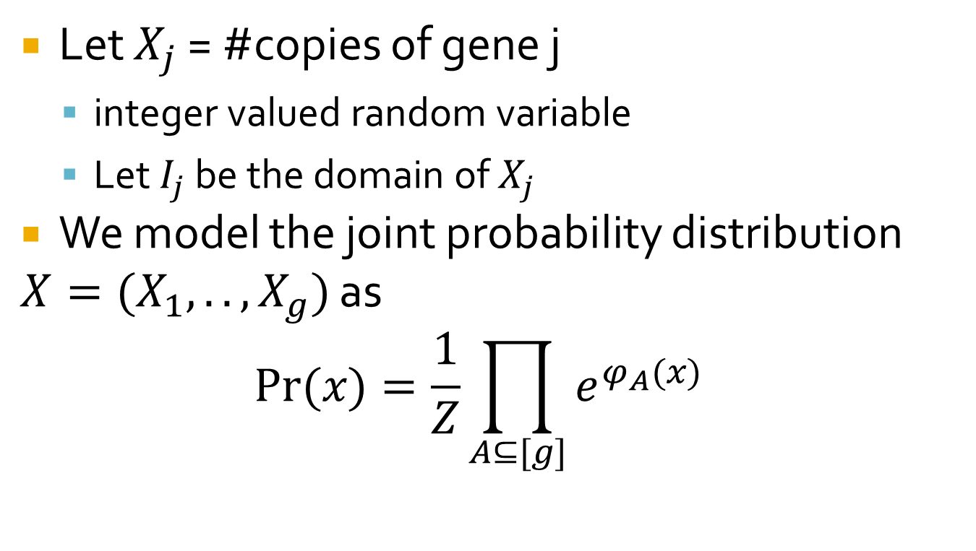
Proposed method
Let $X_{j}$ = #copies of gene j
  integer valued random variable
  Let $I_{j}$ be the domain of $X_{j}$
We model the joint probability distribution
$X=(X_{1},..,X_{g})$ as
$$Pr⁡(x)=\frac{1}{Z}\prod_{A⊆[g]}{e^{φ_{A}(x)}}$$
$$x=(x_{1},..,x_{g})$$
Potential function

Slide 14
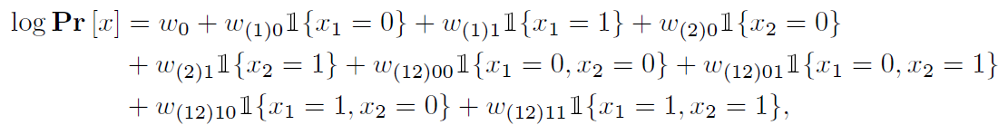
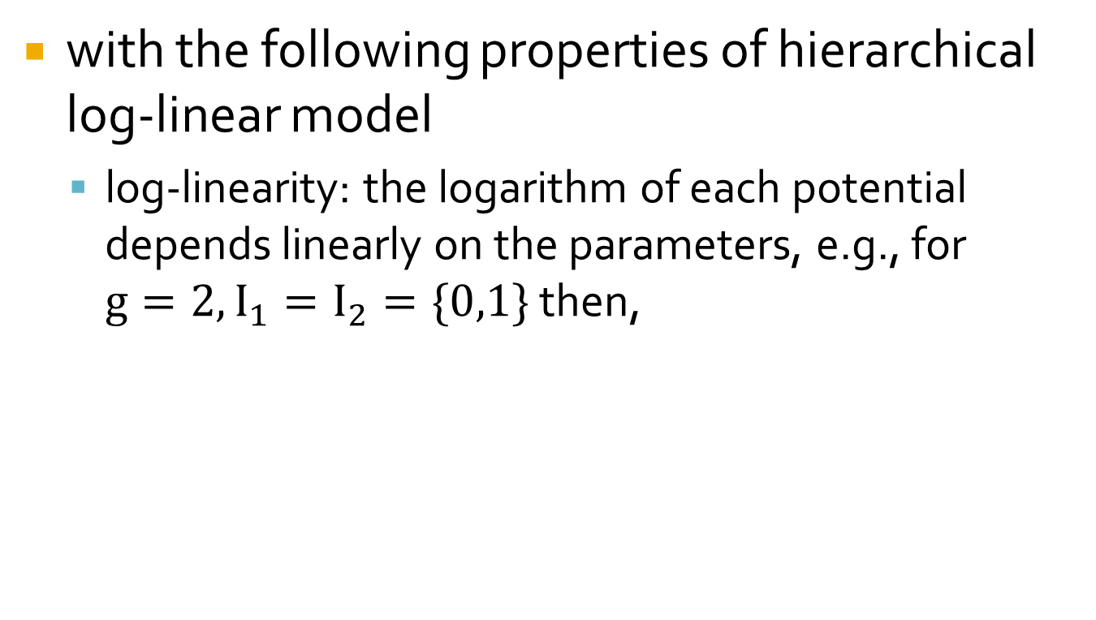
Proposed method
with the following properties of hierarchical log-linear model
  log-linearity: the logarithm of each potential depends linearly on the parameters, e.g., for $g=2, I_{1}=I_{2}=\{0,1\}$ then,

Slide 15
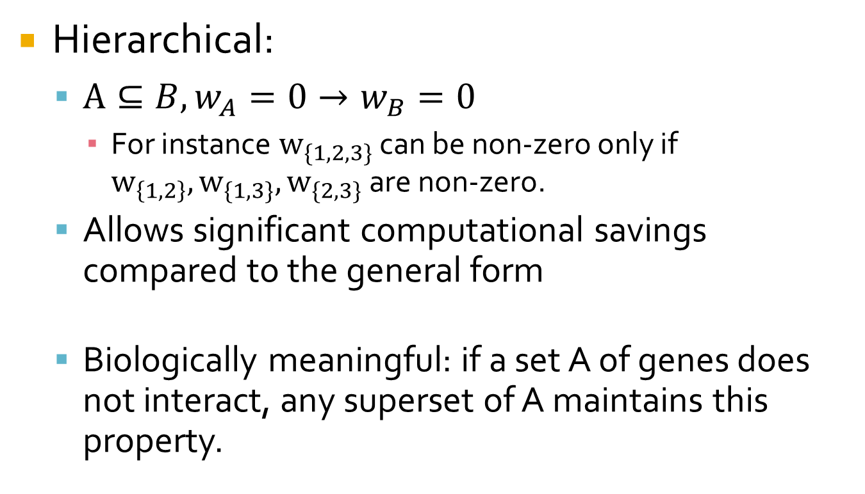
Proposed method
Hierarchical:
  $A⊆B, w_{A}=0→w_{B}=0$
    For instance $w_{\{1,2,3\}}$ can be non-zero only if $w_{\left\{1,2\right\}},w_{\{1,3\}}, w_{\{2,3\}}$ are non-zero.
  Allows significant computational savings compared to the general form
  Biologically meaningful: if a set A of genes does not interact, any superset of A maintains this property.

Slide 16
Proposed method
  A lot of related work and off-the-shelf software for learning the parameters
    Based on Zhao, Rocha and Yu who provide a general framework that allows us to respect the ‘hierarchical’ property ..
    … Schmidt and Murphy provide efficient optimization algorithms for learning a hierarchical log-linear model

Slide 17
Proposed method
  We use the learned hierarchical log-linear model in two ways
    The non-zero weights provide us insights into dependencies of factors
    We use them to assign weights on the positive integer di-grid

Slide 18
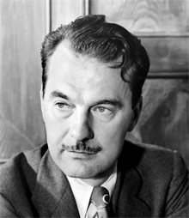
Proposed method
Copies of Gene 2
3
2
1
Nicholas Metropolis
Given a probability distribution π on
a state space we can define a Markov
Chain whose stationary
distribution is π.
0
0
1
2
3
Copies of gene 1

Slide 19
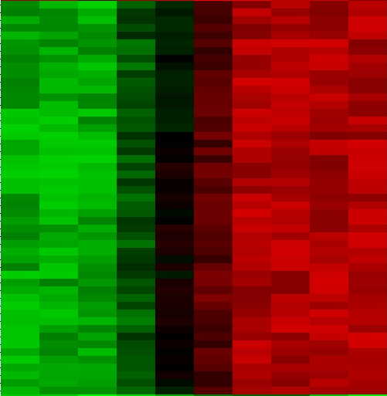
Contributions II
Question: Can we use the wealth of
inter-tumor
phylogenetic
methods to
understand
intra-tumor
cancer
heterogeneity?
.
.

Slide 20
Contributions II
Motivated by this question:
  We prove necessary and sufficient conditions for the reconstruction of oncogenetic trees, a popular method for inter-tumor cancer inference
  We exploit these to preprocess a FISH dataset into an inter-tumor cancer dataset that respects specific biological characteristics of the evolutionary process

Slide 21
Oncogenetic Trees
Desper, Jiang, Kallioniemi, Moch, Papadimitriou, Schäffer
  T(V,E,r) rooted branching
  F={A1,..,Am} where Ai is the set of vertices of a rooted sub-branching of T.
  What are the properties that F should have in order to uniquely reconstruct T?
    Let T be consistent with F if it could give rise to F.

Slide 22
Example
r
Onco-tree
a
b
Patient 1, A1 ={ r,a,b,c}
r
c
a
r
b
Patient 2, A2 ={ r,a,b}
a
b
c
d
r
Patient 3, A3 ={ r,a,b,d}
a
b
r
r
d
Also, consistent with
{A1, A2, A3}
b
a
a
b
c
d
c
d

Slide 23
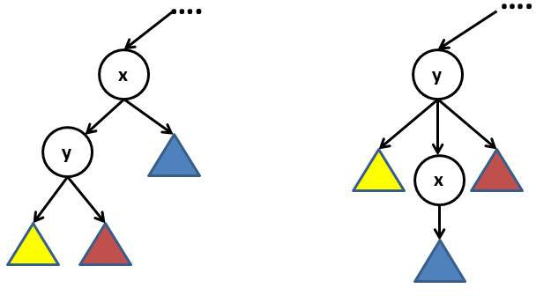
Oncogenetic Trees
Theorem
  The necessary and sufficient conditions to reconstruct T from F are the following:
    x,y such that (x,y) is an edge, there exists a set in the family that contains x but not y.
necessity

Slide 24
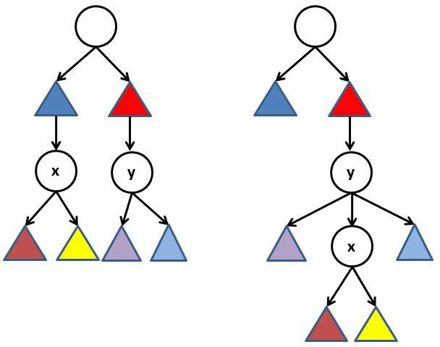
Oncogenetic Trees
    If x is not a descedant of y and vice versa then there exist two sets Ai,Aj such that
      x is in Ai but not in Aj
      y is in Aj but not in Ai
necessity

Slide 25
Oncogenetic trees
It turns out that the necessary conditions are sufficient (constructive proof)
Allows us to force an oncogenetic tree to capture certain aspects of intratumor heterogeneity dynamics

Slide 26
Contributions III
We evaluate our method on real FISH data where we show findings consistent with cancer literature
  Here, we show results for a breast cancer dataset

Slide 27
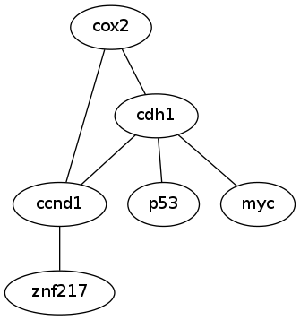
Experimental results
No ground truth, but
  concurrent loss of cdh1 function and p53 inactivation play a key role in breast cancer evolution
  subsequent changes in ccnd1, myc, znf217 according to our tree are consistent with oncogenetic literature

Slide 28
Conclusions
There exists a lot of interest in understanding intra-tumor heterogeneity
  Releasement of FISH data that assess it directly can promote this understanding
Concerning our work:
  Better algorithms for fitting the model
  Allow higher-order interactions but use additional penalty (e.g., AIC)

Slide 29
Conclusions
… concerning our work
  Other choices of inter-tumor methods
  Tumor classification applications
  Consensus FISH trees
  Allow more mechanisms in copy number changes
Understand better the connection between our work and Chowdhury et al.

Slide 30
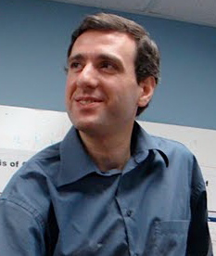



Acknowledgements
Russell Schwartz
Alejandro Schäffer
NSF Grant
CCF-1013110

Slide 31
Thanks!

Slide 32
Appendix

Slide 33
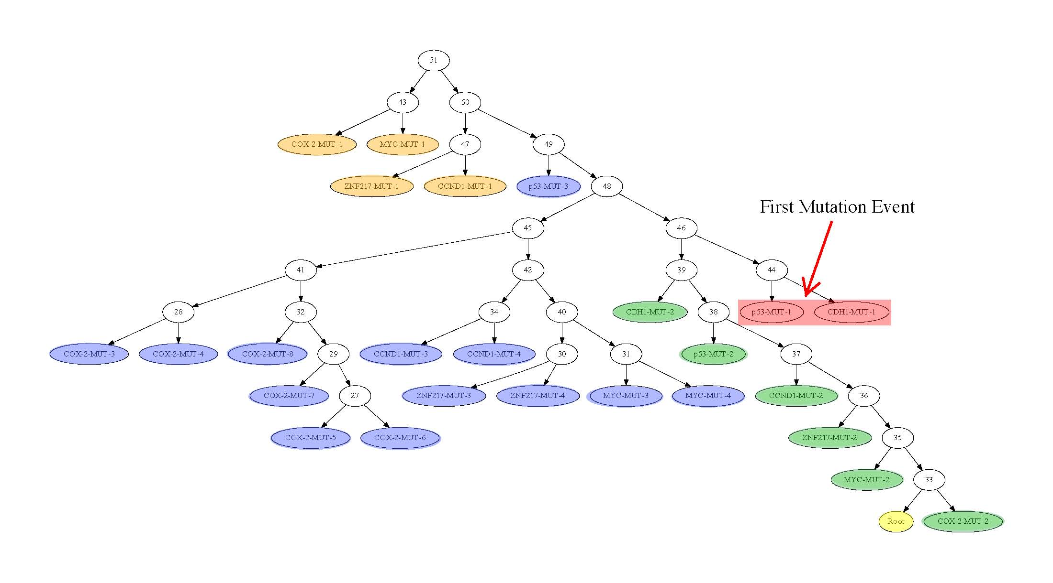
Experimental results

Slide 34
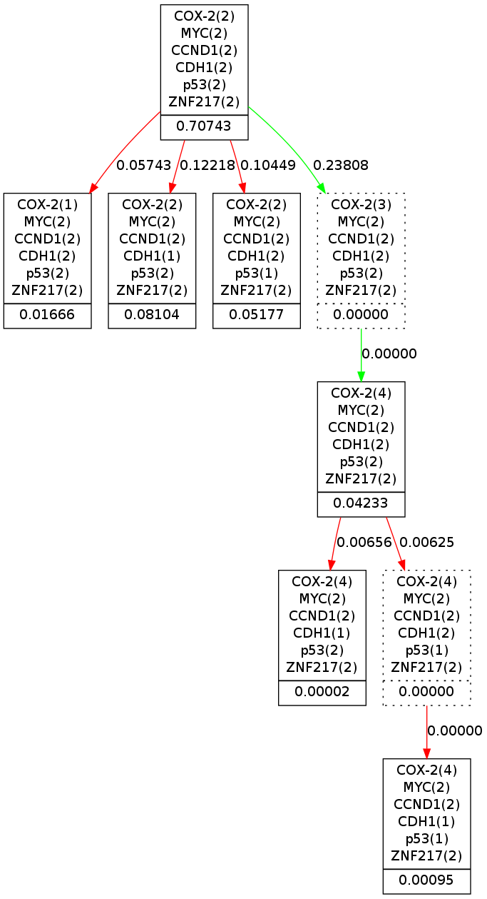
Experimental results
Generated with code available at
ftp://ftp.ncbi.nlm.nih.gov/pub/FISHtrees

