Slide 1
Approximate Dynamic Programming using Halfspace Queries and Multiscale Monge Decomposition
Charalampos (Babis) E. Tsourakakis
ctsourak@math.cmu.edu
SODA 2011
25th January ‘11

Slide 2
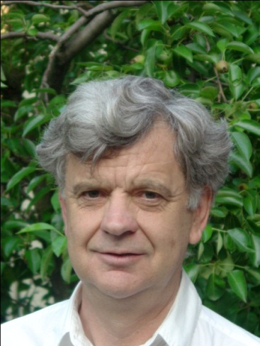
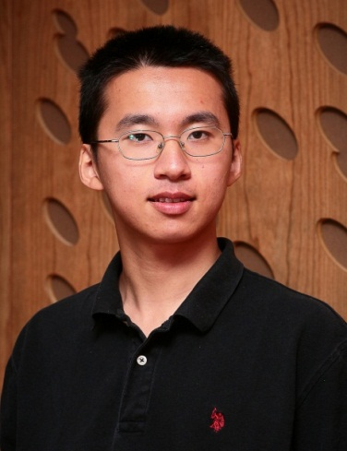
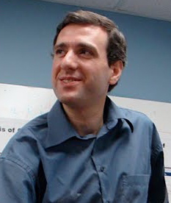
Joint work
Gary L. Miller
SCS, CMU
Richard Peng SCS, CMU
Russell Schwartz
SCS & BioSciences
CMU

Slide 3
Outline
Motivation
Related Work
“Vanilla” DP algorithm
Our contributions
Analysis of the recurrence
Halfspaces and DP
Multiscale Monge optimization
Conclusions

Slide 4
Motivation
log T/R
for humans
R=2
Array based comparative
genomic hybridization
(aCGH)
Genome

Slide 5
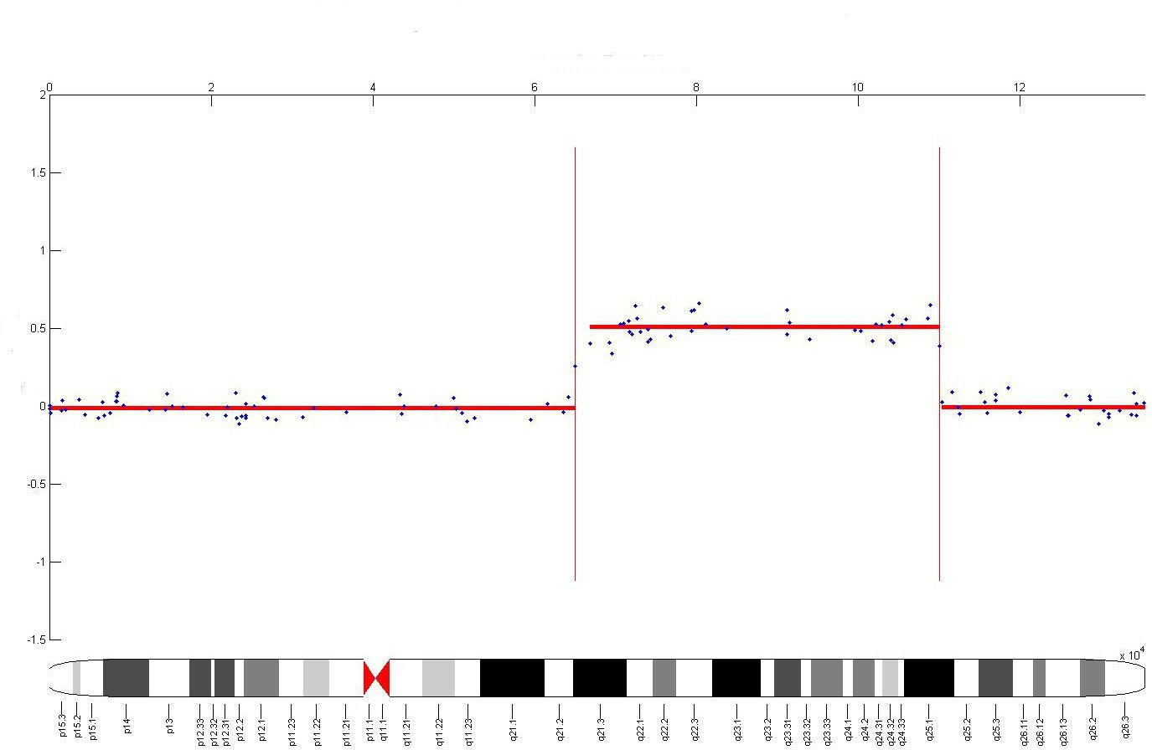
Motivation
Near-by probes (genomic positions) tend to have the same DNA copy number.
Treat the data as 1d time series.
Fit piecewise constant segments.
log T/R
for humans
R=2
Genome

Slide 6
Motivation
Other applications
Histogram construction
Speech recognition
Data mining
Biology
and many more…

Slide 7
Problem Formulation
Input: Noisy sequence (P₁,..,P_{n})
Output: (F₁,..,F_{n}) which minimizes
Digression: Constant C is determined by training on data with ground truth.
Goodness of fit
Regularization/avoid overfitting

Slide 8
Outline
Motivation
Related Work
“Vanilla” DP algorithm
Our contributions
Analysis of the recurrence
Halfspaces and DP
Multiscale Monge optimization
Conclusions

Slide 9
Related Work
Optimal BSTs in O(n²) time
Recurrence
Don Knuth
$$c\left(i,i\right)=0$$
$$c\left(i,j\right)=w\left(i,j\right)+\min_{i<k≤j}{\{c\left(i,k−1\right)+c\left(k,j\right)\}}$$
Frances Yao
Quadrangle inequality
(Monge)
$$w\left(k,x\right)+w\left(j,y\right)≤w\left(k,y\right)+w\left(j,x\right)$$
$$for all k≤j≤x≤y$$
Then we can turn the naïve O(n³) algorithm to O(n²)

Slide 10
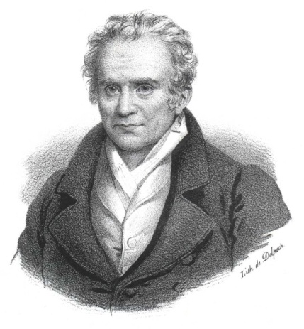
Related Work
Transportation problems (1781)
Gaspard Monge
$$w\left(k,x\right)+w\left(j,y\right)≤w\left(k,y\right)+w\left(j,x\right)$$
$$for all k≤j≤x≤y$$
Quadrangle inequality
Inverse
Quadrangle inequality
$$w\left(k,x\right)+w\left(j,y\right)≥w\left(k,y\right)+w\left(j,x\right)$$
$$for all k≤j≤x≤y$$

Slide 11
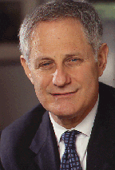
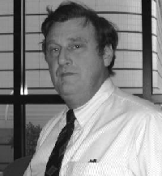
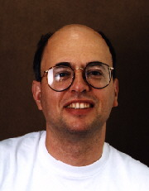
Related Work
$$E\left(j\right)=\min_{1≤i<j}{E\left(i\right)+w\left(i,j\right), w() Monge}$$
$O\left(nlogn\right)$time
Eppstein
Galil
Giancarlo
$O(n)$time
Larmore
Schieber

Slide 12
Related Work
SMAWK algorithm : finds all row minima of a totally monotone matrix NxN in O(N) time!
Bein, Golin, Larmore, Zhang showed that the Knuth-Yao technique is implied by the SMAWK algorithm.
Weimann [PhD thesis] improved state of the art results in several problems on planar graphs.

Slide 13
Related Work
(1+ε) approximation O(n+Κ³logn+K²/ε) time
Guha
Koudas
Shim
Synopsis of data distributions: fit K segments to 1d time series.
Monotonicity properties of the key quantities involved.
Notes:
The function minimum error function for points 1 until i using k buckets TERR(i,k) is approximated “carefully” using piecewise constant segments.

Slide 14
Outline
Motivation
Related Work
“Vanilla” DP algorithm
Our contributions
Analysis of the recurrence
Halfspaces and DP
Multiscale Monge optimization
Conclusions

Slide 15
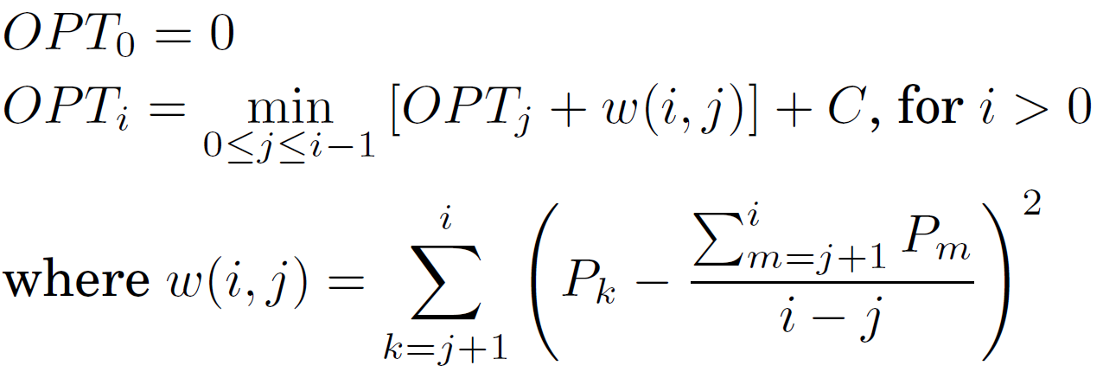
Vanilla DP
Recurrence for our optimization problem:

Slide 16
Vanilla DP
Compute nxn matrix M where M_{j,i} = mean squared error for fitting a segment from point j to point i.
This can be done in O(n²) time by keeping first and second moments in “online” way

Slide 17
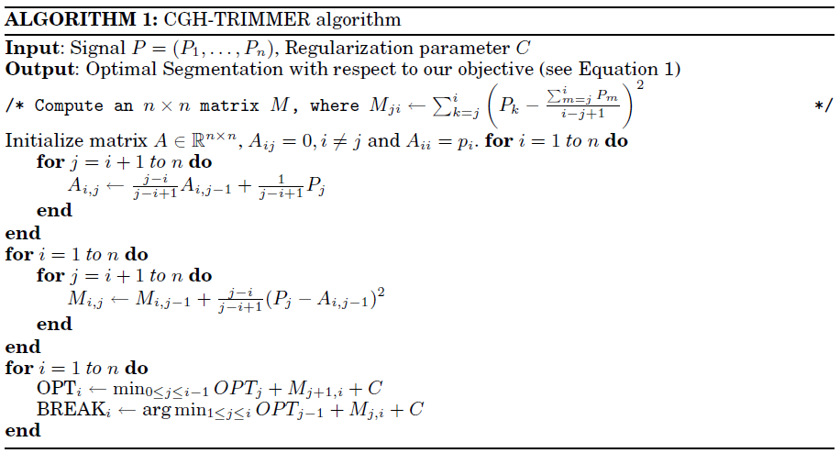
Vanilla DP
First Moments
Squared Errors
Recurse

Slide 18
Questions
Is the O(n²) running time tight?
Probably not
What do halfspace queries have to do with this problem?
What is Multiscale Monge analysis?

Slide 19
Outline
Motivation
Related Work
“Vanilla” DP algorithm
Our contributions
Analysis of the recurrence
Halfspaces and DP
Multiscale Monge optimization
Conclusions

Slide 20
Our contributions
Technique 1: Using halfspace queries we get an approximation algorithm with ε additive error which runs in O(n^{4/3+δ} log(U/ε) ) time.
Technique 2: break carefully the original problem into a “small” number of Monge optimization problems. Approximates the optimal answer for the shifted objective within a factor of (1+ε), O(nlogn/ε) time.
~

Slide 21
Outline
Motivation
Related Work
“Vanilla” DP algorithm
Our contributions
Analysis of the recurrence
Halfspaces and DP
Multiscale Monge optimization
Conclusions

Slide 22
Analysis of our Recurrence
Recurrence for our optimization problem:
Equivalent formulation where $S_{i}= \sum_{k=1}^{i}{P_{i}}$

Slide 23
Analysis of our Recurrence
Let
Claim:
This term kills the Monge property!

Slide 24
Why it’s not Monge?
Basically, because we cannot be searching for the optimum breakpoint in a restricted range.
E.g., for C=1 and the sequence (0,2,0,2,….,0,2) : fit a segment per point
(0,2,0,2,….,0,2,1): fit one segment for all
points

Slide 25
Outline
Motivation
Related Work
“Vanilla” DP algorithm
Our contributions
Analysis of the recurrence
Halfspaces and DP
Multiscale Monge optimization
Conclusions

Slide 26
Notation
$DP_{i}=$the quantity we wish to approximate
$DP_{i}=$ the approximate value of $DP_{i}$
$DP_{i}=$ the optimum value of the recurrence by examining the values $DP_{j}$
~
-
~

Slide 27
Halfspaces and DP
Do binary searches to approximate DP_{i} for every i=1,..,n.
Let
We do enough iterations in order to get
. O(logn log(U/ε))
iterations suffice where $U^{2}=\max{\{\left(P_{i}^{2}\right),}$C}
By induction we can show that
,i.e., additive ε error
approximation

Slide 28
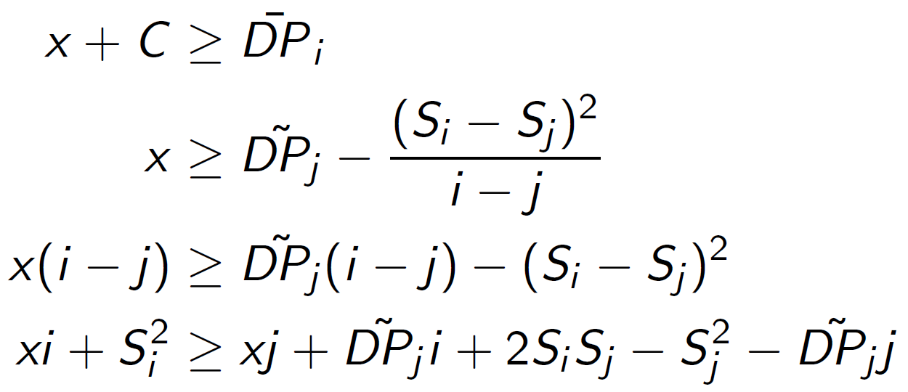
Halfspaces and DP
i fixed, binary search query
~
~
$$(x,i,S_{i},−1)$$
$$(j,DP_{j},2S_{j},S_{j}^{2}+DP_{j}j)$$
constant

Slide 29
Dynamic Halfspace Reporting
Agarwal
Eppstein
Matousek
Halfspace emptiness query
$$S∩γ= ∅$$
Given a set of points S in R⁴ the halfspace
range reporting problem can be solved
query time $O\left(n^{\frac{1}{3}}logn\right)$
space and preprocessing time $O\left(n^{\frac{4}{3}+δ}\right)$
update time$O\left(n^{\frac{1}{3}+δ}\right)$

Slide 30
Halfspaces and DP
Hence the algorithm iterates through the indices i=1..n, and maintains the Eppstein et al. data structure containing one point for every j<i.
It performs binary search on the value, which reduces to emptiness queries
It provides an answer within ε additive error from the optimal one.
Running time: O(n^{4/3+δ} log(U/ε) )
~

Slide 31
Outline
Motivation
Related Work
“Vanilla” DP algorithm
Our contributions
Analysis of the recurrence
Halfspaces and DP
Multiscale Monge optimization
Conclusions

Slide 32
Multiscale Monge Decomposition
By simple algebra we can write our weight function w(j,i) as w’(j,i)/(i-j)+C where
The weight function w’ is Monge!
Key Idea: approximate i-j by a constant!
But how?

Slide 33
Multiscale Monge Decomposition
For each i, we break the choices of j into intervals [l_{k},r_{k}] s.t i-l_{k} and i-r_{k} differ by at most 1+ε.
Ο(logn/ε) such intervals suffice to get a 1+ε approximation.
However, we need to make sure that when we solve a specific subproblem, the optimum lies in the desired interval.
How?

Slide 34
Multiscale Monge Decomposition
M is a sufficiently large positive constant
Running time O(nlogn/ε)
using an O(n) time per
subproblem
Larmore
Schieber

Slide 35
Outline
Motivation
Related Work
“Vanilla” DP algorithm
Our contributions
Analysis of the recurrence
Halfspaces and DP
Multiscale Monge optimization
Conclusions

Slide 36
Summary
Two new techniques for approximate DP for a recurrence not treated by existing methods:
Halfspace emptiness queries
Multiscale Monge Decomposition

Slide 37
Problems
Other problems where our techniques are directly or almost directly applicable?
O(n²) is unlikely to be tight. E.g., if two points P_{i} and P_{j} satisfy $\left|P_{i}−P_{j}\right|>2\sqrt{2C}$ then they belong in different segments. Can we find a faster exact algorithm?

Slide 38
Thanks a lot!

