Slide 1
Denser than the Densest Subgraph:
Extracting Optimal Quasi-Cliques with Quality Guarantees
Charalampos (Babis) E. Tsourakakis
charalampos.tsourakakis@aalto.fi
KDD 2013

Slide 2
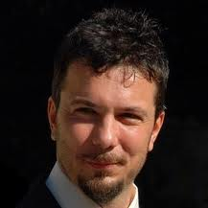
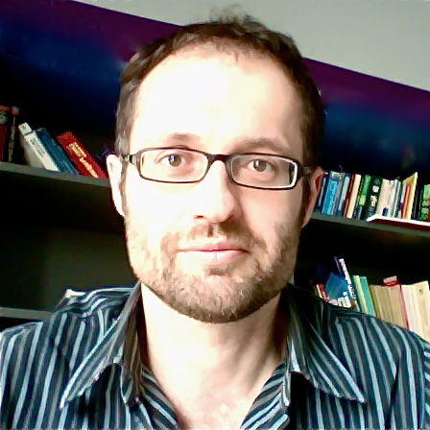
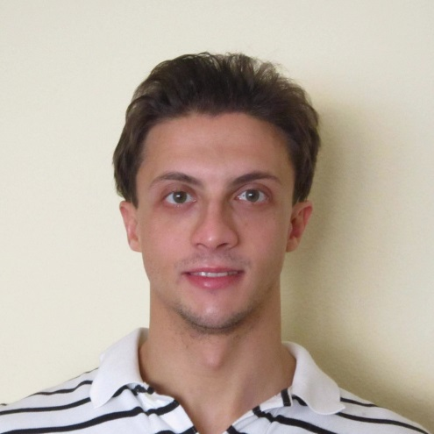
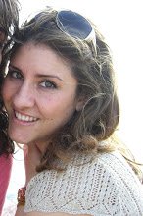
Francesco Bonchi
Yahoo! Research
Aristides Gionis
Aalto University
Francesco Gullo
Yahoo! Research
Maria Tsiarli
University of
Pittsburgh

Slide 3
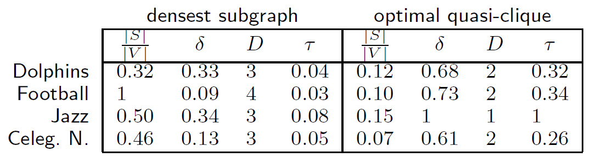
Denser than the densest
Densest subgraph problem is very popular in practice. However, not what we want for many applications.
δ=edge density,D=diameter,τ=triangle density

Slide 4
Graph mining applications
Thematic communities and spam link farms
[Gibson, Kumar, Tomkins ‘05]
Graph visualization[Alvarez-Hamelin etal.’05]
Real time story identification [Angel et al. ’12]
Motif detection [Batzoglou Lab ‘06]
Epilepsy prediction [Iasemidis et al. ‘01]
Finding correlated genes [Horvath et al.]
Many more ..
Notes:
link spam, i.e., websites
that attempt to manipulate search engine rankings
through aggressive interlinking to simulate popular
content

Slide 5
Measures
Clique: each vertex in S connects to every other vertex in S.
α-Quasi-clique:
the set S has at least α|S|(|S|-1)/2 edges.
k-core: every vertex connects to at least k other vertices in S.
K4

Slide 6

Measures
$\text{δ} \text{(}\text{S}\text{)=}\frac{e[S]}{(\begin{aligned}\left|S\right| \\ 2\end{aligned})}$
$d\text{ (}\text{S}\text{)=}\frac{2e[S]}{|S|}$
$t\text{ (}\text{S}\text{)=}\frac{t[S]}{(\begin{aligned}\left|S\right| \\ 3\end{aligned})}$
Density
Average degree
Triangle Density

Slide 7
Contributions
General framework which subsumes popular density functions.
Optimal quasi-cliques.
An algorithm with additive error guarantees and a local-search heuristic.
Variants
  Top-k optimal quasi-cliques
  Successful team formation

Slide 8
Contributions
Experimental evaluation
  Synthetic graphs
  Real graphs
Applications
  Successful team formation of computer scientists
  Highly-correlated genes from microarray datasets
First, some related work.

Slide 9
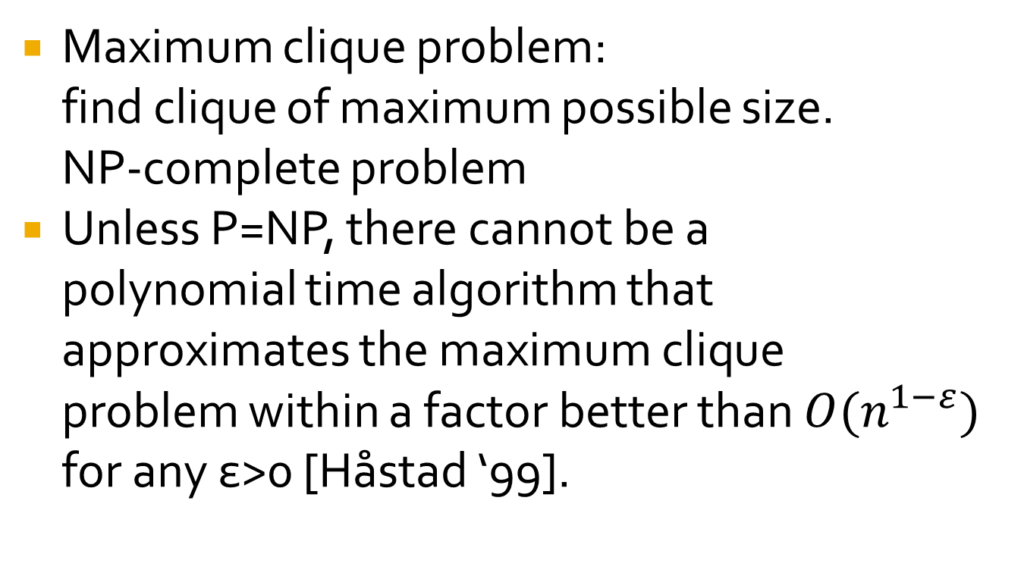
Cliques
Maximum clique problem:
find clique of maximum possible size.
NP-complete problem
Unless P=NP, there cannot be a
polynomial time algorithm that
approximates the maximum clique
problem within a factor better than $O(n^{1−ε})$
for any ε>0 [Håstad ‘99].
K4

Slide 10

(Some) Density Functions
$\text{δ} \text{(}\text{S}\text{)=}\frac{e[S]}{(\begin{aligned}\left|S\right| \\ 2\end{aligned})}$
$d\text{ (}\text{S}\text{)=}\frac{e[S]}{|S|}$
$d\text{ (}\text{S}\text{)=}\frac{e[S]}{|S|}\text{, |}\text{S}\text{|=}\text{k}$
$d\text{ (}\text{S}\text{)=}\frac{e[S]}{|S|}\text{, |}\text{S}\text{|}≥\text{k} \text{(|}\text{S}\text{| }≤$ k)
A single edge achieves
always maximum possible δ(S)
Densest subgraph problem
k-Densest subgraph problem
DalkS (Damks)

Slide 11
Densest Subgraph Problem
Maximize average degree
Solvable in polynomial time
  Max flows (Goldberg)
  LP relaxation (Charikar)
Fast ½-approximation algorithm (Charikar)

Slide 12
k-Densest subgraph
k-densest subgraph problem is NP-hard
Feige, Kortsatz, Peleg
Bhaskara, Charikar, Chlamtac, Vijayraghavan
Asahiro et al.
Andersen
Khuller, Saha [approximation algorithms], Khot [no PTAS].

Slide 13
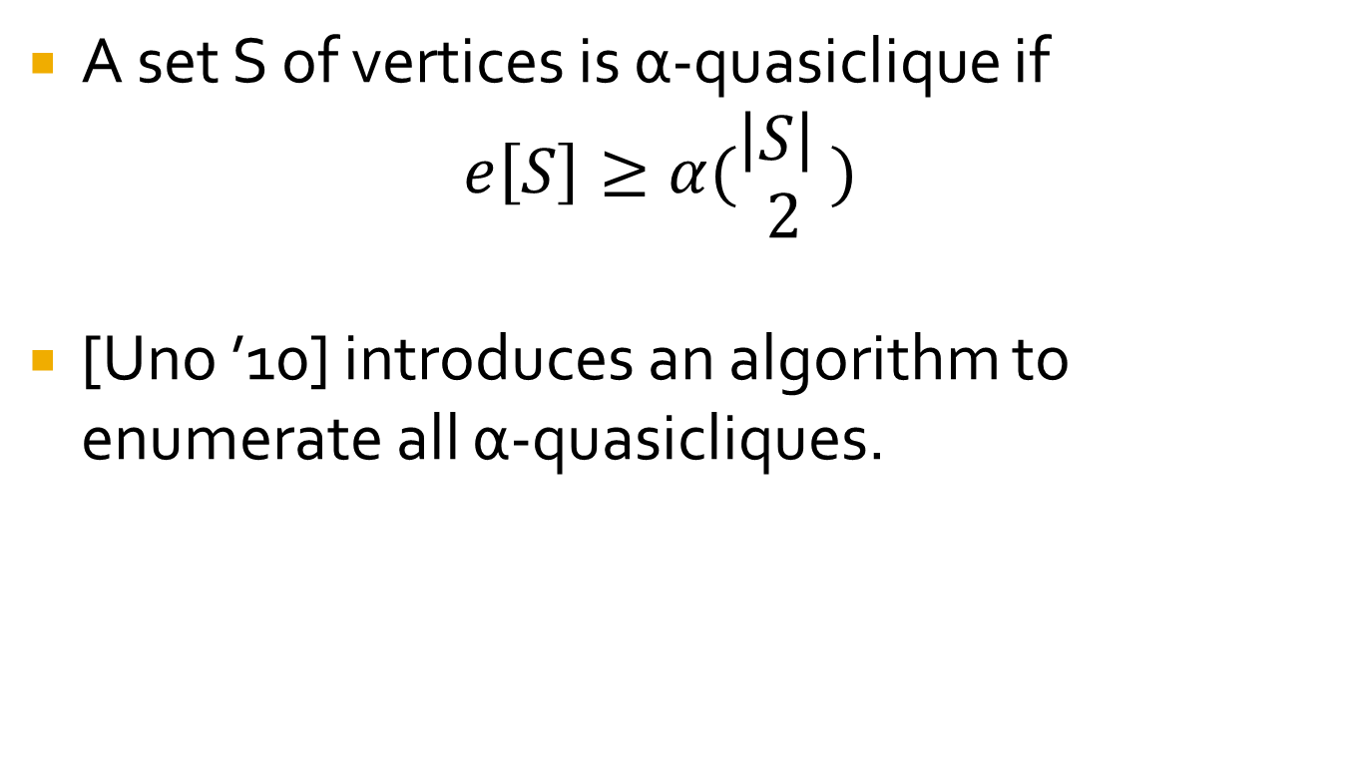
Quasicliques
A set S of vertices is α-quasiclique if
$$e\left[S\right]≥α(\begin{aligned}\left|S\right| \\ 2\end{aligned})$$
[Uno ’10] introduces an algorithm to enumerate all α-quasicliques.

Slide 14
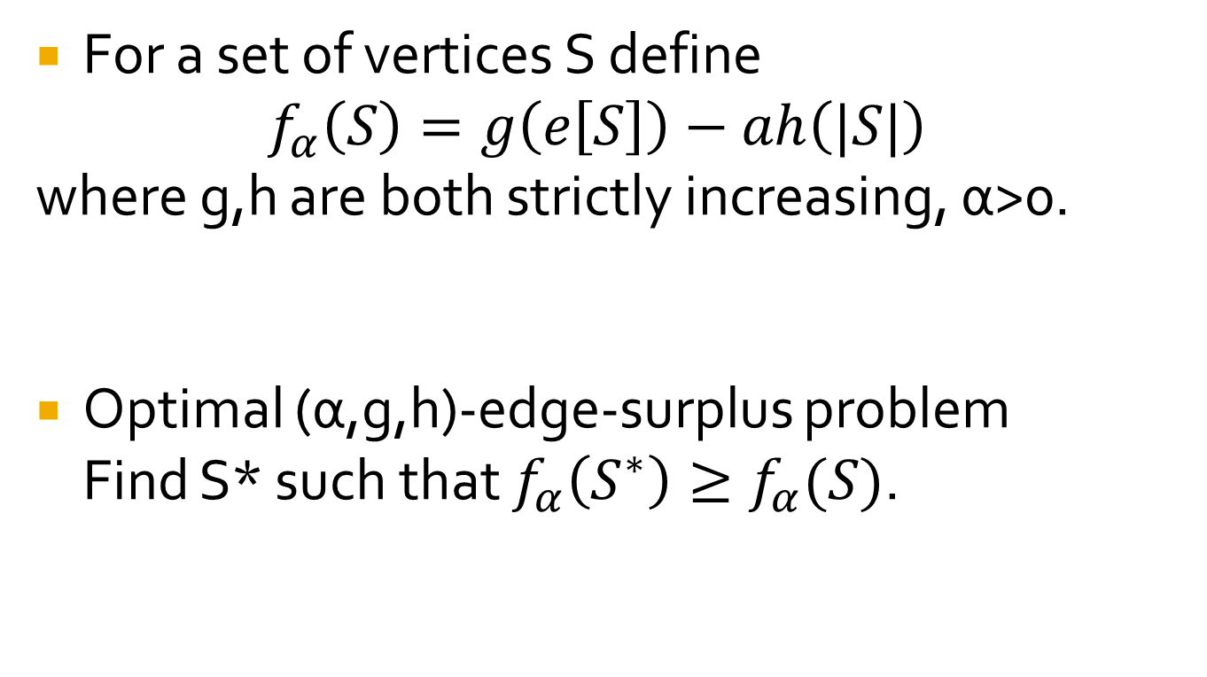
Edge-Surplus Framework
For a set of vertices S define
$$f_{α}\left(S\right)=g\left(e\left[S\right]\right)−ah\left(|S|\right)$$
where g,h are both strictly increasing, α>0.
Optimal (α,g,h)-edge-surplus problem
Find S* such that $f_{α}\left(S^{∗}\right)≥f_{α}(S)$.

Slide 15
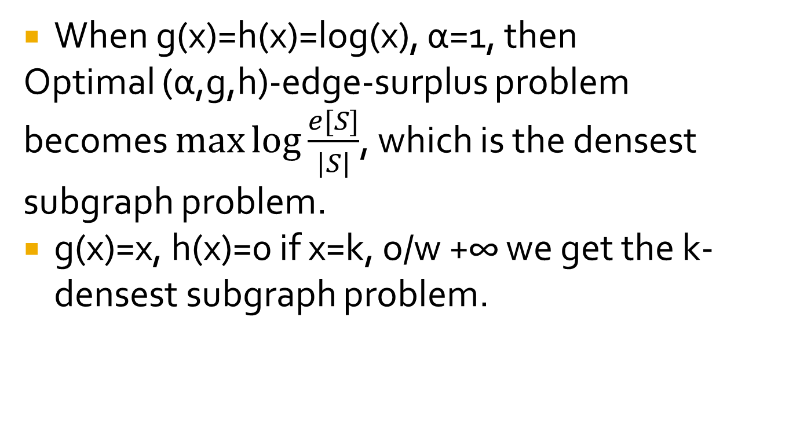
Edge-Surplus Framework
When g(x)=h(x)=log(x), α=1, then
Optimal (α,g,h)-edge-surplus problem becomes $\max{\log{\frac{e[S]}{|S|}}}$, which is the densest subgraph problem.
g(x)=x, h(x)=0 if x=k, o/w +∞ we get the k-densest subgraph problem.

Slide 16
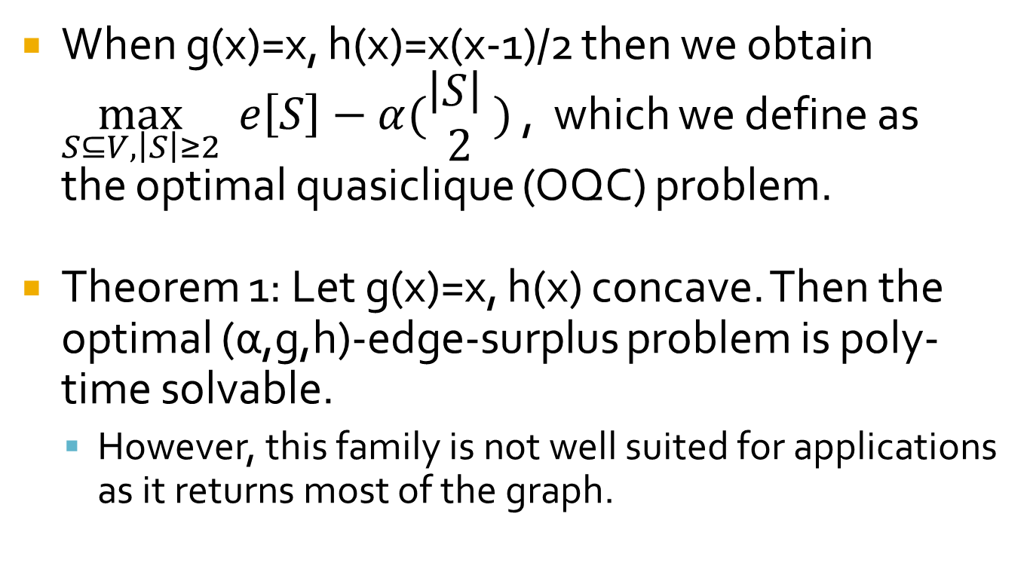
Edge-Surplus Framework
When g(x)=x, h(x)=x(x-1)/2 then we obtain $\max_{S⊆V,\left|S\right|≥2}{ e\left[S\right]−α(\begin{aligned}\left|S\right| \\ 2\end{aligned}) }$, which we define as
the optimal quasiclique (OQC) problem.
Theorem 1: Let g(x)=x, h(x) concave. Then the optimal (α,g,h)-edge-surplus problem is poly-time solvable.
  However, this family is not well suited for applications as it returns most of the graph.

Slide 17
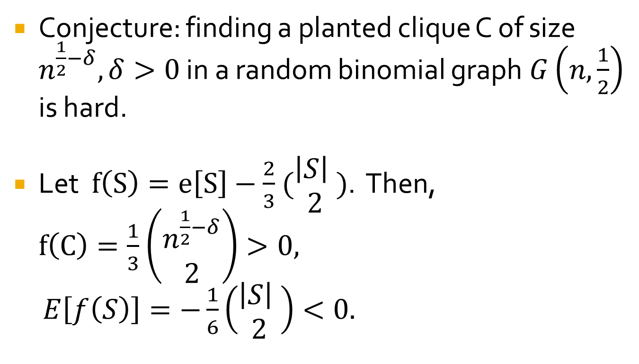
Hardness of OQC
Conjecture: finding a planted clique C of size $n^{\frac{1}{2}−δ}, δ>0$ in a random binomial graph$G\left(n,\frac{1}{2}\right)$ is hard.
Let $f\left(S\right)=e\left[S\right]−\frac{2}{3}$ $(\begin{aligned}\left|S\right| \\ 2\end{aligned})$. Then,
$f\left(C\right)=\frac{1}{3}$ $\left(\begin{aligned}n^{\frac{1}{2}−δ} \\ 2\end{aligned}\right)>0,$
$E\left[f\left(S\right)\right]=−\frac{1}{6}\left(\begin{aligned}\left|S\right| \\ 2\end{aligned}\right)<0.$

Slide 18
Multiplicative approximation algorithms
Notice that in general the optimal value can be negative.
We can obtain guarantees for a shifted objective but introduces large additive error making the algorithm almost useless, i.e., except for very special graphs.
Other type of guarantees more suitable.

Slide 19
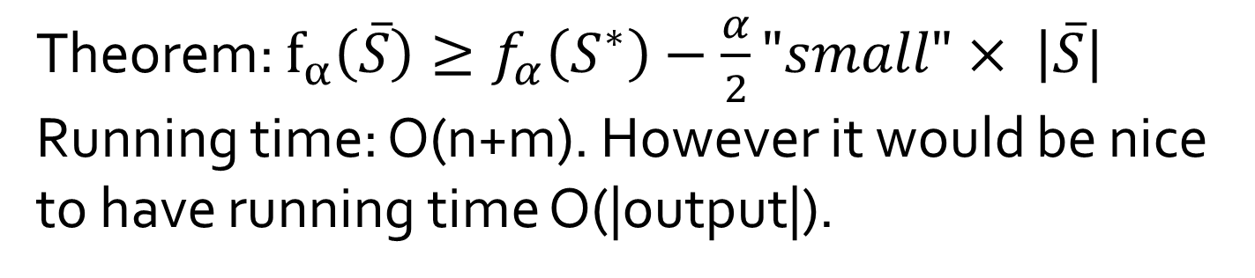
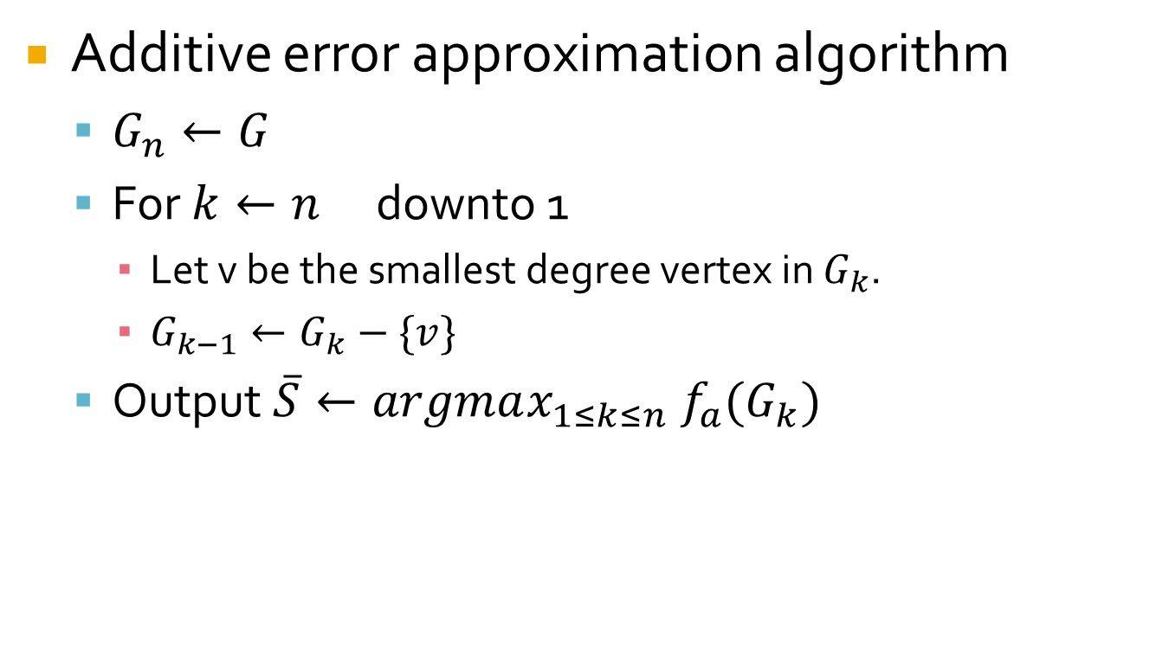
Optimal Quasicliques
Additive error approximation algorithm
  $G_{n}←G$
  For ${k←n}_{}$ downto 1
    Let v be the smallest degree vertex in $G_{k}$.
    $G_{k−1}←G_{k}−\{v\}$
  Output $\overline{S}←argmax_{1≤k≤n} f_{a}(G_{k})$
Theorem: $f_{α}\left(\overline{S}\right)≥f_{α}\left(S^{∗}\right)−\frac{α}{2}"small"× \left|\overline{S}\right|$
Running time: O(n+m). However it would be nice
to have running time O(|output|).

Slide 20
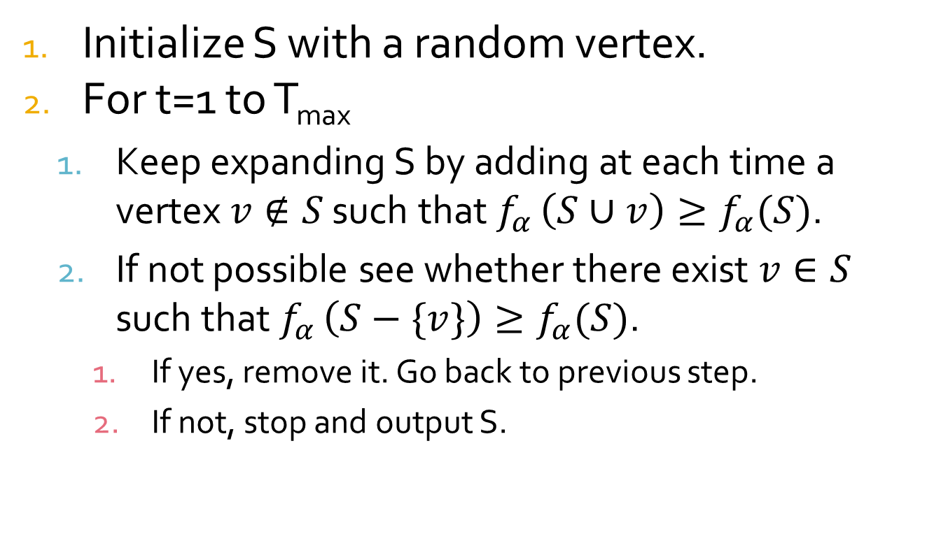
Optimal Quasicliques
Local Search Heuristic
Initialize S with a random vertex.
For t=1 to T_{max}
  Keep expanding S by adding at each time a vertex $v∉S$ such that $f_{α }\left(S∪v\right)≥f_{α}(S)$.
  If not possible see whether there exist $v∈S$ such that $f_{α }\left(S−\{v\}\right)≥f_{α}(S)$.
    If yes, remove it. Go back to previous step.
    If not, stop and output S.

Slide 21
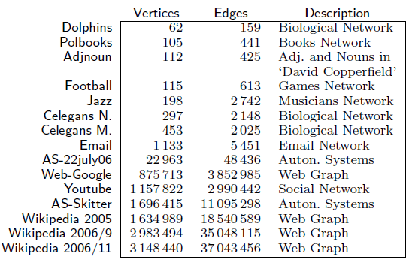
Experiments

Slide 22
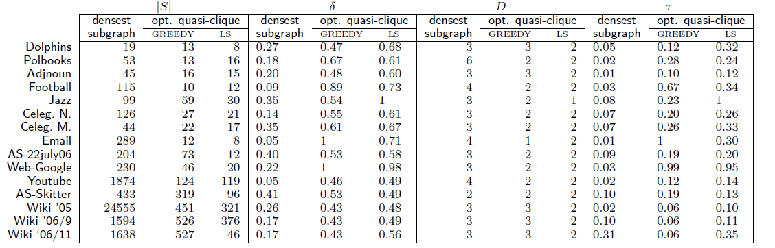
Experiments
 | DS | M1 | M2 | DS | M1 | M2 | DS | M1 | M2 | DS | M1 | M2
Wiki ‘05 | 24.5K | 451 | 321 | .26 | .43 | .48 | 3 | 3 | 2 | .02 | .06 | .11
Youtube | 1.9K | 124 | 119 | 0.05 | 0.46 | 0.49 | 4 | 2 | 2 | .02 | .12 | .14

Slide 23
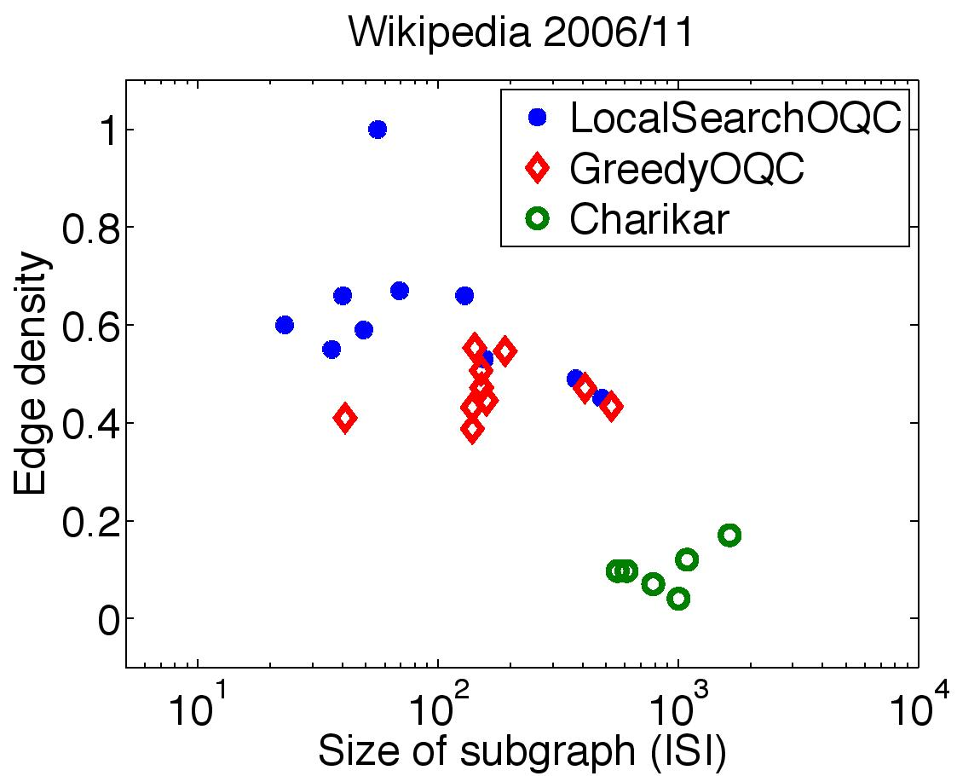
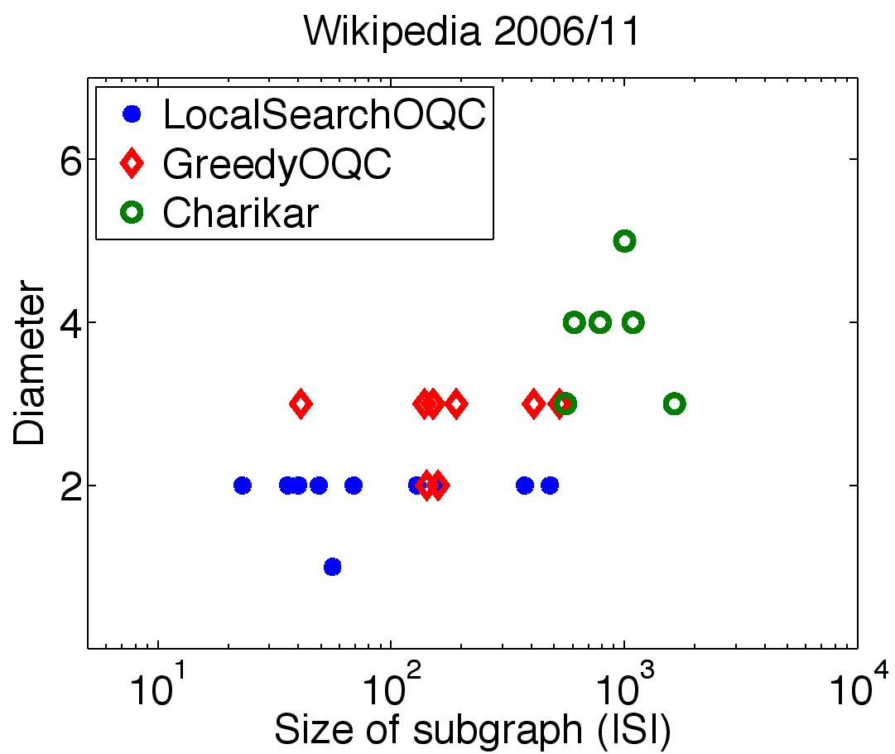
Top-k densest subgraphs

Slide 24
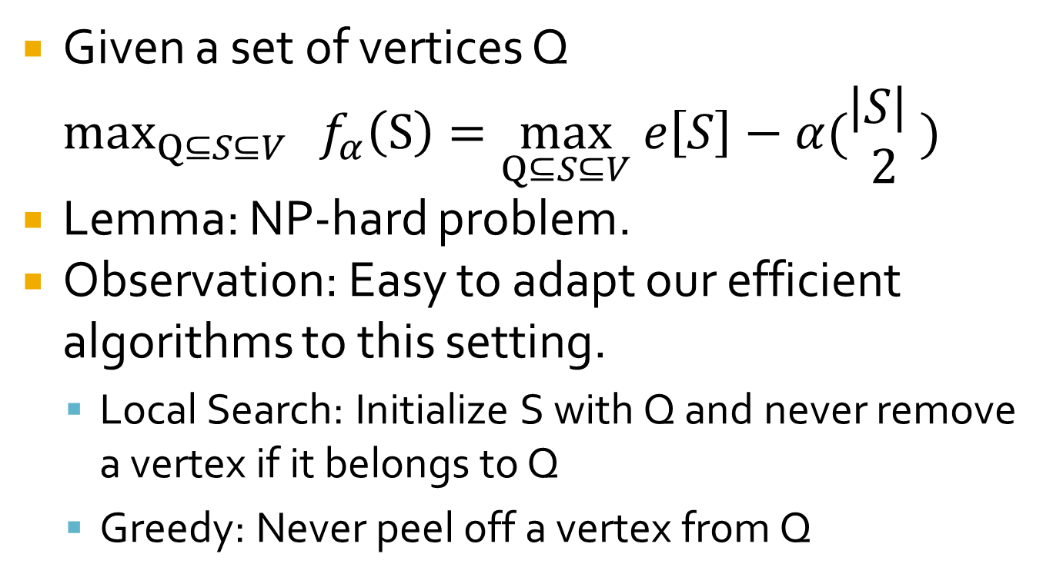
Constrained Optimal Quasicliques
Given a set of vertices Q $\max_{Q⊆S⊆V}{ f_{α}\left(S\right)=\max_{Q⊆S⊆V} e\left[S\right]−α(\begin{aligned}\left|S\right| \\ 2\end{aligned}) }$
Lemma: NP-hard problem.
Observation: Easy to adapt our efficient algorithms to this setting.
  Local Search: Initialize S with Q and never remove a vertex if it belongs to Q
  Greedy: Never peel off a vertex from Q

Slide 25
Application 1
Suppose that a set Q of scientists wants to organize a workshop. How do they invite other scientists to participate in the workshop so that the set of all participants, including Q, have similar interests ?

Slide 26
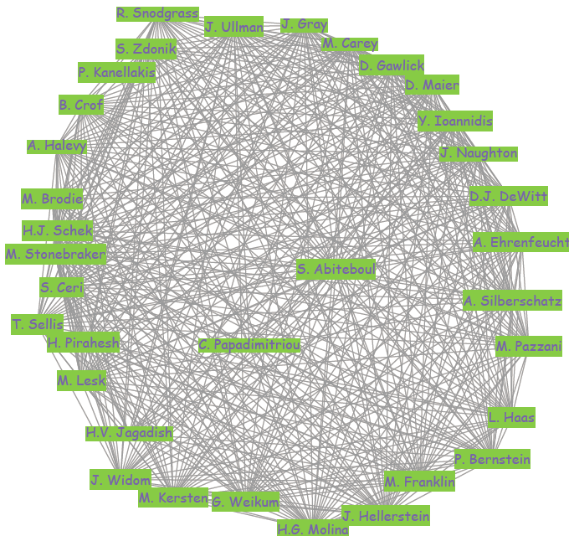
Query 1,
Papadimitriou and Abiteboul
34 vertices , δ(S)= 0.81

Slide 27
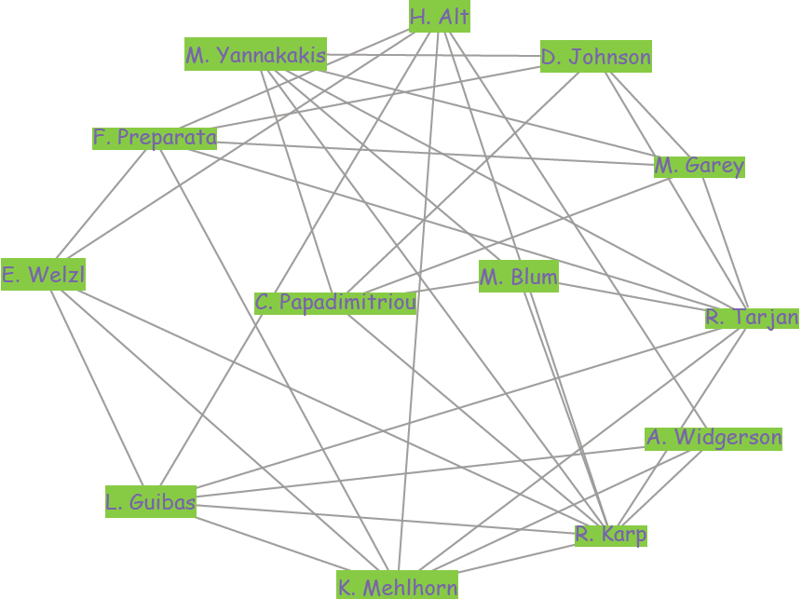
Query 2,
Papadimitriou and Blum
13 vertices, δ(S)=0.49

Slide 28
Application 2
Given a microarray dataset and a set of genes Q, find a set of genes S that includes Q and they are all highly correlated.
Co-expression network
  Measure gene expression across multiple samples
  Create correlation matrix
  Edges between genes if their correlation is > ρ.
A dense subgraph in a co-expression network corresponds to a set of highly correlated genes.

Slide 29
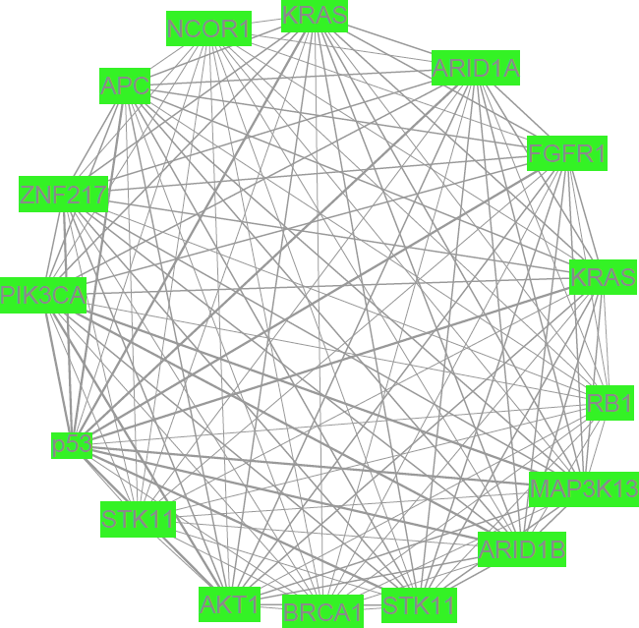
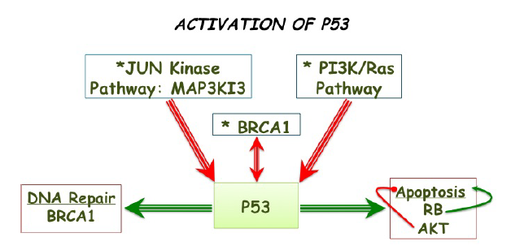
Query, p53

Slide 30
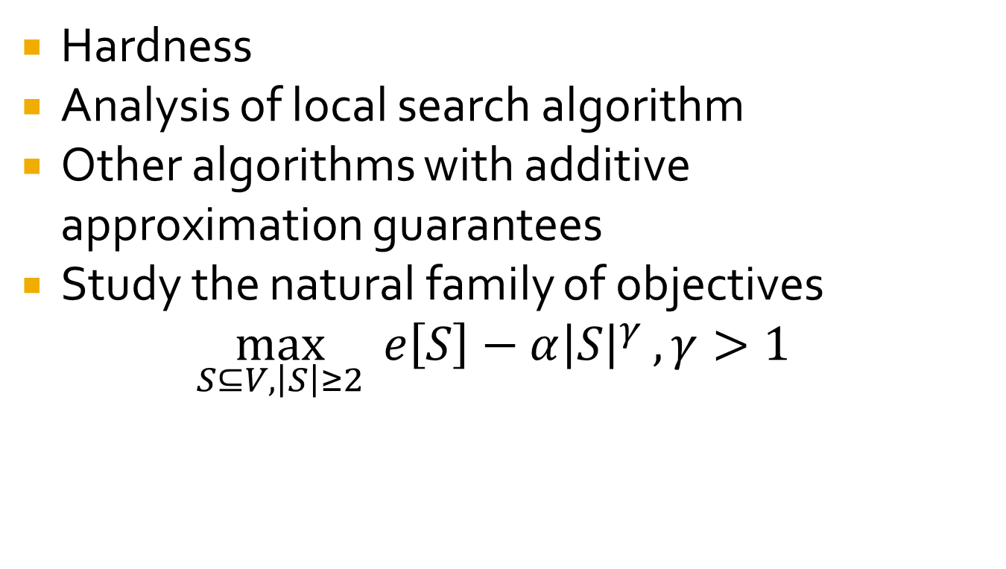
Future Work
Hardness
Analysis of local search algorithm
Other algorithms with additive approximation guarantees
Study the natural family of objectives
$\max_{S⊆V,\left|S\right|≥2}{ e\left[S\right]−α{\left|S\right|}^{γ}}, γ>1$

Slide 31
Thank you!

