Slide 1
Teaching Problem Solving
Marie Norman, PhD
Associate Director and Coordinator of Graduate Student Programs
Eberly Center for Teaching Excellence
mnorman@andrew.cmu.edu

Slide 2
Mathematical problem solving: 4 steps
Posing the right question
Translating a real-world problem into math
Computation
Translating math back into the real world
Conrad Wolfram, TED Talks: http://www.youtube.com/watch?v=60OVlfAUPJg
Notes:
Worried you don’t know enough about teaching?
Feel that you don’t yet have the expertise in your field?

Slide 3
Mathematical problem solving: 4 steps
Posing the right question
Translating a real-world problem into math
Computation
Translating math back into the real world
80% of math teaching focuses on this step.
Notes:
Worried you don’t know enough about teaching?
Feel that you don’t yet have the expertise in your field?

Slide 4
Mathematical problem solving: 4 steps
Posing the right question
Translating a real-world problem into math
Computation
Translating math back into the real world
These steps tend to be neglected.
Notes:
According to Wolfram, computers have liberated math from calculating, so we can focus more on problem formulation.

Slide 5
Dan Myer: Math class needs a makeover
TED talk, 2010
http://www.youtube.com/watch?v=BlvKWEvKSi8
What exactly is Myer advocating?
What ideas translate to your teaching context?
What other strategies can help?

Slide 6
“Patient problem solving”
Begin with a real-world problem.
Keep it messy (noise/missing info).
Emphasize reasoning over calculation.
Show how math creates efficiencies.

Slide 7
Begin with a real-world problem
You don’t need to solve the real-world problem in order to highlight the usefulness of the math it involves.
Ex. Tacoma Narrows Bridge collapse
Think of some of the mathematical skills you teach.
What are some real-world uses for these skills? How could you highlight them for students?
Take a minute and jot down some ideas.
Notes:
Ex. On July 1, 1940, the Tacoma Narrows Bridge opened in Washington state. Four months after it was built, it collapsed. Why did it collapse? This is a question that can be solved using eigenvalues...

Slide 8
Keep it messy
Offer problems with irrelevant/missing information rather than nice, neat pieces, and ask questions like...
  What information here is/isn’t relevant?
  What additional information do you need?

Slide 9
Emphasize reasoning
Take time with problem formulation.
  What are we trying to find out?
Encourage students to draw on their intuition.
  What are some possible solution strategies?
  Where have we seen this kind of problem before?
  Does that answer feel right to you? Why not?
Focus on thought processes, not right answers.
  Require students to explain answers, right or wrong.

Slide 10
Show how math creates efficiencies
Highlight when problem solving would be inefficient and laborious without mathematical modeling.
“We could watch the tank fill for 6 hours to get the answer, or we could solve it mathematically...”
“We could add up every one of these columns and rows by hand, or we could just...”

Slide 11
2 useful things to keep in mind...

Slide 12
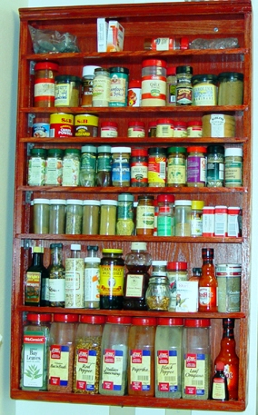
#1. Expert blind spot
Imagine you are a novice cook...
How helpful is it if an experienced chef gives you instructions like: “add spices until it tastes right” and “cook until the sauce looks done”?

Slide 13
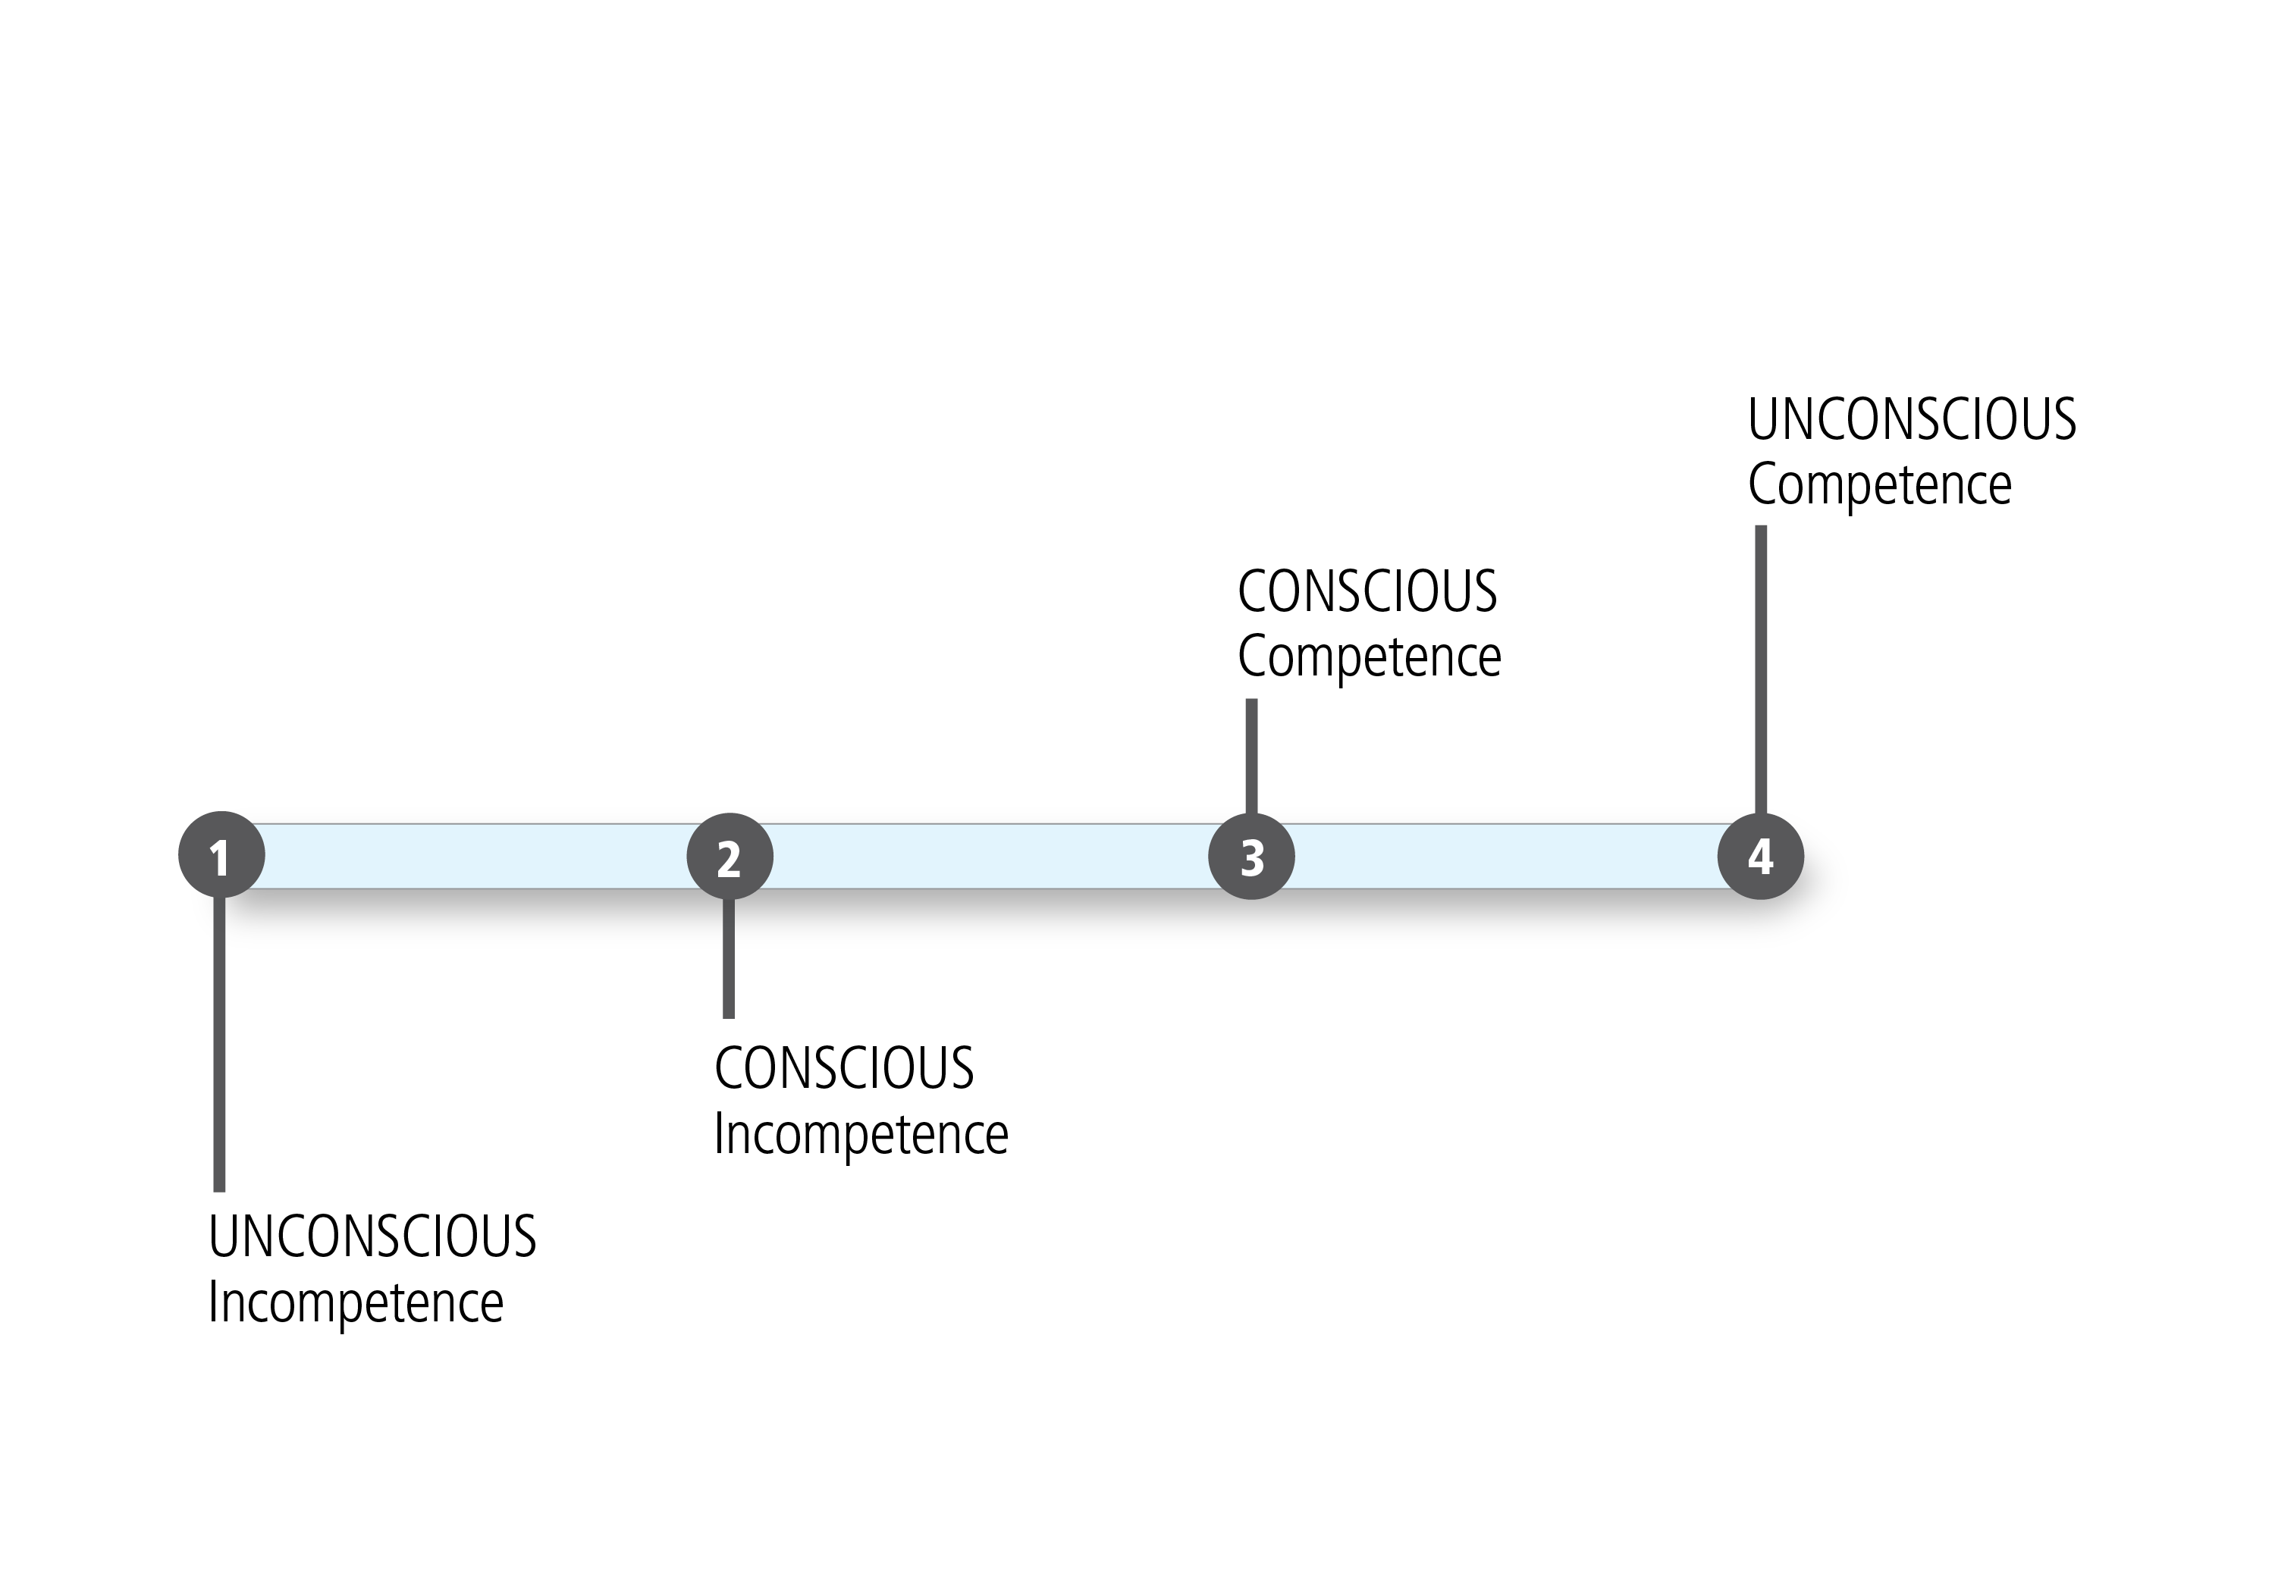
The development of expertise

Slide 14
Expert blind spot = ENEMY #1!
Experts often…
  Over-estimate what novices know and can do
  Under-estimate how long novices will take
  Don’t see the steps/pieces novices must learn
  Mis-predict where novices will have difficulty
  Presume that novices do things the way they do
Hinds (1999); Nathan & Koedinger (2000); Nickerson (1999)
Notes:
Office hours: Aha moments!

Slide 15
#2: Types of knowledge
  Knowing what: facts, definitions, formulae
  Knowing why: concepts, relationships
  Knowing how: procedures, methods, steps
  Knowing when: conditions of applicability
  Not the same!

Slide 16
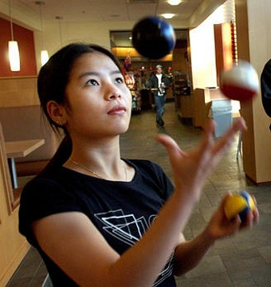
Juggling theorem:
b/h = (d+f)/(d+e)

Slide 17
#2: Types of knowledge
  Knowing what: facts, definitions, formulae
  Knowing why: concepts, relationships
  Knowing how: procedures, methods, steps
  Knowing when: conditions of applicability
  Which do you think get the most emphasis in math ed?

Slide 18
If we don’t teach all four types...
  Students may be able to...
  apply a formula, but not explain the concept from which it is derived (how but not why).
  state a theorem but not know when or where to apply it (what but not when).
  explain a procedure but not perform it (why but not how)
  Sound familiar?
Notes:
Does this sound familiar??

Slide 19
What are some things you can do to guard against expert blind spot?

Slide 20
Break down skills and steps
Identify all the components of a complex skill.
Teach them systematically and slowly.
Spell out (and number, if appropriate) steps.
See Khan Academy videos for excellent examples of step by step teaching: http://www.khanacademy.org/

Slide 21
Give students targeted practice
Sometimes the best way to teach problem solving isn’t to solve whole problems.
Instead (or in addition), consider doing the following...

Slide 22
Assign “worked problems”
Give students step-by-step solutions to study before they attempt similar problems.
Sweller & Cooper, 1987: students who studied worked examples perform significantly better than students who just solved problems.
Most effective with novice students, where text and diagrams are effectively integrated (or animated.)
Notes:
Must be clear, without distractions, to be useful.

Slide 23
Assign partially worked problems
Give students worked problems with blanks for missing steps and have them complete just those steps.
Focus on steps they struggle with or often omit.

Slide 24
Have students plan solution strategies
Have students plan solution strategies for multiple problems without implementing them.
This gives them targeted practice with planning, a step they generally neglect (experts generally spend far more time planning a solution and less time executing it, while novices do the reverse.)

Slide 25
Have students find errors
Give students solutions that they know contain errors and ask them to identify and fix the errors
This requires a deep understanding of the problem and all its steps.

Slide 26
What can you do to reinforce key types of knowledge (e.g., why/when/how)?

Slide 27
Require students to explain
Never accept an answer without an explanation. Instead, ask: How did you get that?
This reinforces “conceptual knowledge” (knowing why).

Slide 28
Reinforce skill of selection
Ask students to sort problems by solution type.
Have students generate a range of solution strategies and compare/evaluate them.
Discuss “conditions of applicability”:
  Would you use ANOVA here? Why or why not?
  Would you use algebra or calculus to solve this?
This reinforces “conditional knowledge” (knowing when).

Slide 29
Teach heuristics
Identify short-cuts and rules of thumb that you (an expert) use, e.g. “When I see a complicated problem, I try to think of a simpler, analogous problem...”
This reinforces “procedural knowledge” (knowing how).
What heuristics do you use that would be useful for your students to know? Jot one or two down.

Slide 30
Heuristics (examples)
Sketch it out
Look for patterns
Work backwards
Make a guess and check
Restate the problem in another way
Simplify the problem (e.g., use whole numbers)
??

Slide 31
Summary
Link math to the real world.
Focus on reasoning.
Watch out for expert blind spot
Reinforce all four types of knowledge

Slide 32
Mathy TED Talks
Geoffrey West: The Surprising Math of Cities and Corporations
Margaret Wertheim: The Beautiful Math of Coral
Kevin Slavin: How Algorithms Shape Our World
Dan Myer: Math Class Needs a Makeover
Conrad Wolfram: Teaching Kids Real Math with Computers
Arthur Benjamin’s formula for changing math education
Benoit Mandelbrot: Fractals and the Art of Roughness
Scott Rickard: The beautiful math behind the ugliest music
Marcus Du Sautoy: Symmetry, reality’s riddle
Ron Eglash on African fractals
For these and others, see http://www.ted.com/talks

