Slide 1


When and How Fracture Nucleates and Propagates in Rubber
Oscar Lopez-Pamies
Collaborators: Aditya Kumar, Gilles A. Francfort
Work supported by the National Science Foundation (DMS, CMMI)
Center for Nonlinear Analysis, Carnegie Mellon University
April 28, 2020

Slide 2
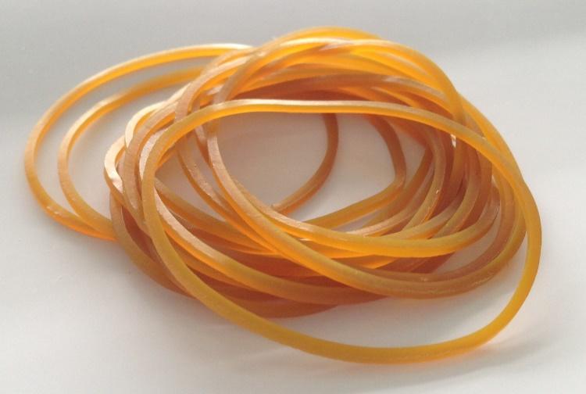


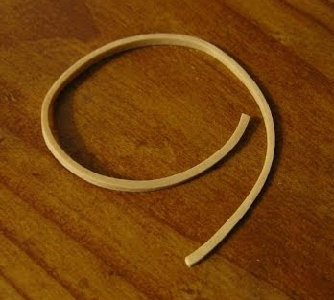
When and how rubber bands fracture?
Stephen Perry (1845)
Notes:
The theory is predicated on two basic ideas.
So consider these solid that has two phases. Z=1: solid phase and z=0 the fractured phase.

Slide 3

When and how rubber fractures?
Notes:
The theory is predicated on two basic ideas.
So consider these solid that has two phases. Z=1: solid phase and z=0 the fractured phase.

Slide 4
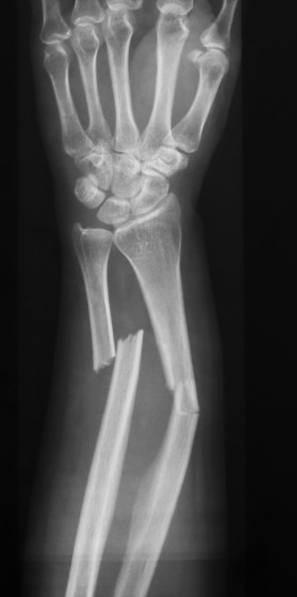

When and how brittle materials fracture?
Notes:
The theory is predicated on two basic ideas.
So consider these solid that has two phases. Z=1: solid phase and z=0 the fractured phase.

Slide 5
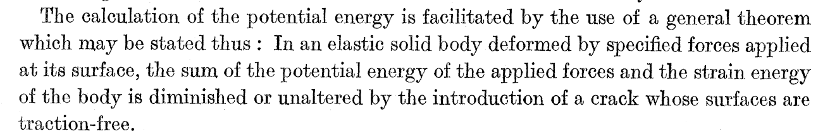
Brittle fracture
The idea: Griffith (1921)
The mathematical formulation: Francfort and Marigo (1998)
Its phase-field regularization: Bourdin, Francfort, Marigo (2000, 2008)
Notes:
The theory is predicated on two basic ideas.
So consider these solid that has two phases. Z=1: solid phase and z=0 the fractured phase.

Slide 6
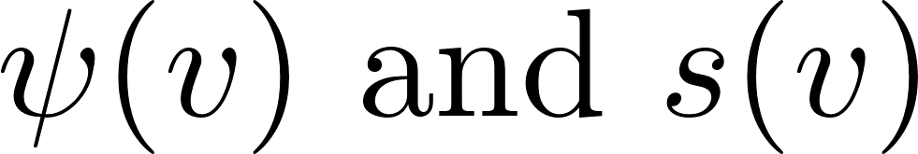
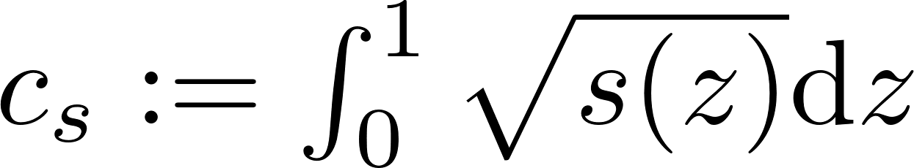
The phase-field approach to brittle fracture
where are monotonic functions such that
with
Fracture propagation?
Notes:
The theory is predicated on two basic ideas.
So consider these solid that has two phases. Z=1: solid phase and z=0 the fractured phase.

Slide 7
The phase-field approach to brittle fracture
where are monotonic functions such that
with
Fracture propagation
Comparisons with experiments over the last 20 years confirm so
Notes:
The theory is predicated on two basic ideas.
So consider these solid that has two phases. Z=1: solid phase and z=0 the fractured phase.

Slide 8
The phase-field approach to brittle fracture
where are monotonic functions such that
with
Fracture propagation
Comparisons with experiments over the last 20 years confirm so
Fracture nucleation?
Over the last 10 years significant efforts have been devoted to trying to establish that the phase-field formulation is also able to describe fracture nucleation…
Notes:
The theory is predicated on two basic ideas.
So consider these solid that has two phases. Z=1: solid phase and z=0 the fractured phase.

Slide 9
The phase-field approach to brittle fracture
where are monotonic functions such that
with
Fracture propagation
Comparisons with experiments over the last 20 years confirm so
Fracture nucleation
The phase-field approach to brittle fracture
is fundamentally incomplete to describe fracture nucleation
Notes:
The theory is predicated on two basic ideas.
So consider these solid that has two phases. Z=1: solid phase and z=0 the fractured phase.

Slide 10
The basic ingredients for the modeling of fracture nucleation
bulk (no singularity)
large pre-existing crack
(crack singularity)
smooth boundary point
(no singularity)
rounded corner
(no singularity)
small pre-existing crack
(crack singularity)
sharp corner
(weak singularity)
Nucleation in the bulk: the strength
Nucleation from large pre-existing cracks: the critical energy release
Nucleation from the boundary and small pre-existing cracks: the transition zone
Notes:
The theory is predicated on two basic ideas.
So consider these solid that has two phases. Z=1: solid phase and z=0 the fractured phase.

Slide 11
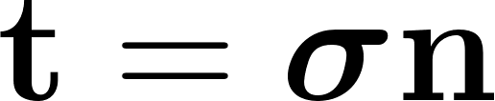

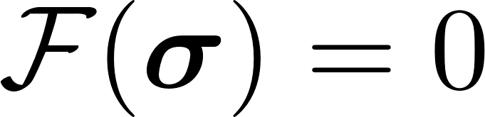
Nucleation in the bulk: the strength
General affine stress BCs
uniform stress
Strength surface
Notes:
The theory is predicated on two basic ideas.
So consider these solid that has two phases. Z=1: solid phase and z=0 the fractured phase.

Slide 12
Nucleation in the bulk: the strength
General affine stress BCs
Isotropic strength surface
Stress invariants
Notes:
The theory is predicated on two basic ideas.
So consider these solid that has two phases. Z=1: solid phase and z=0 the fractured phase.

Slide 13
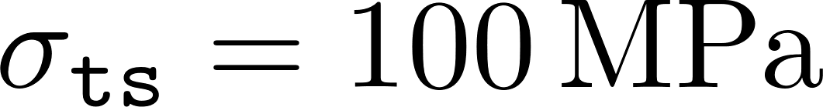
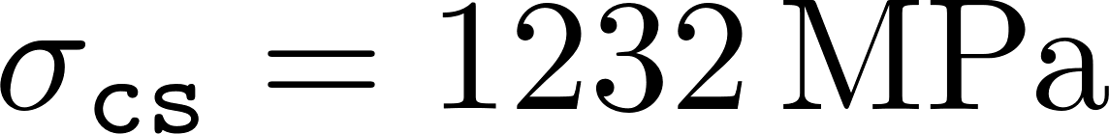
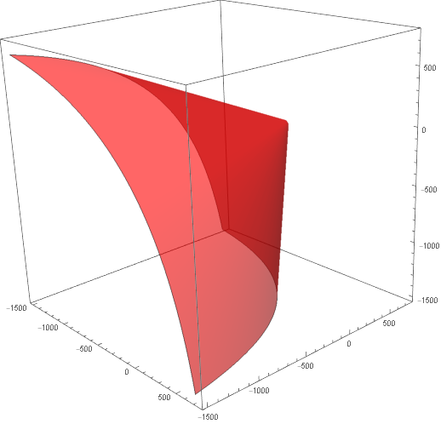
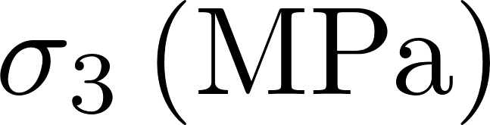
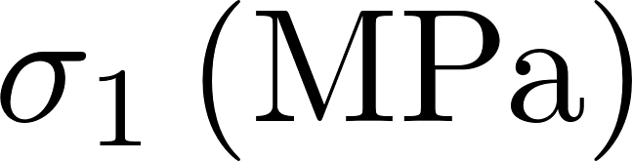
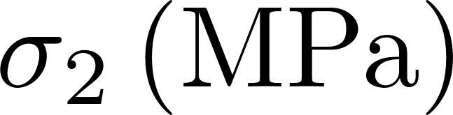
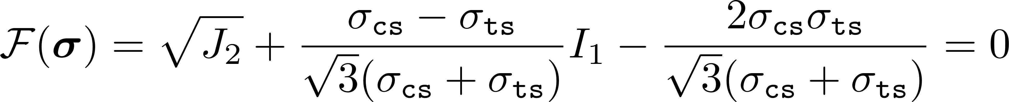
Nucleation in the bulk: the strength
General affine stress BCs
DP Strength Surface for Titania ( , )
500
0
-500
-1500
-1500
500
Isotropic strength surface
-500
0
0
-500
500
-1500
An example: Drucker-Prager strength surface
Drucker and Prager (1952); Ely (1972)
Notes:
The theory is predicated on two basic ideas.
So consider these solid that has two phases. Z=1: solid phase and z=0 the fractured phase.

Slide 14
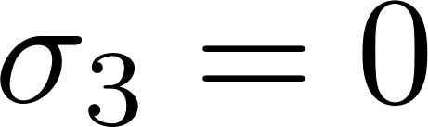


Nucleation in the bulk: the strength
General affine stress BCs
Strength Surface for Titania ( )
Experiments (titania)
DP Strength Surface
Isotropic strength surface
An example: Drucker-Prager strength surface
Drucker and Prager (1952); Ely (1972)
Notes:
The theory is predicated on two basic ideas.
So consider these solid that has two phases. Z=1: solid phase and z=0 the fractured phase.

Slide 15
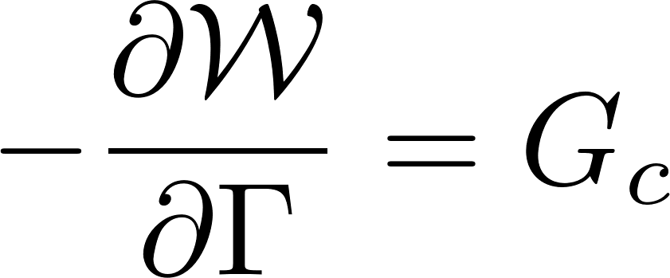
Nucleation from large pre-existing cracks: the critical energy release
Critical energy release rate
large pre-existing crack
Notes:
The theory is predicated on two basic ideas.
So consider these solid that has two phases. Z=1: solid phase and z=0 the fractured phase.

Slide 16

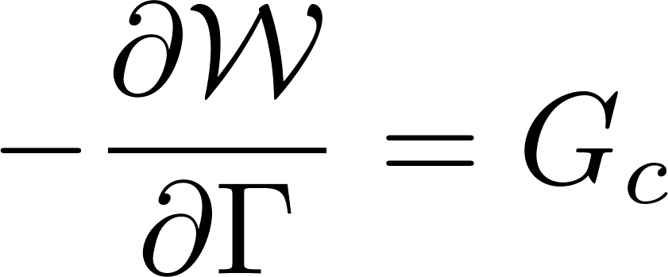
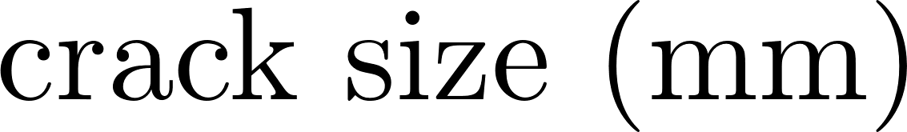
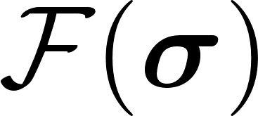
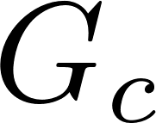
Nucleation form the boundary & small pre-existing cracks: the transition zone
Transition zone for Alumina
small pre-existing crack
(crack singularity)
Transition zone: mediation between the strength and the critical energy release rate
Kimoto et al. (1985)
Notes:
The theory is predicated on two basic ideas.
So consider these solid that has two phases. Z=1: solid phase and z=0 the fractured phase.

Slide 17

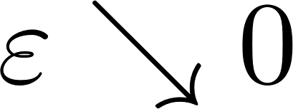
In summary
stored-energy function
Material Input Data:
strength surface
critical energy release rate
The phase-field approach
is purely energetic and does not account for the strength of the material, which is not an energetic quantity, but rather a stress-based one
This is the reason why the stresses predicted by the phase-field framework for fracture nucleation in the bulk, from the boundary, and from small-cracks become unbounded in the limit as
Notes:
The theory is predicated on two basic ideas.
So consider these solid that has two phases. Z=1: solid phase and z=0 the fractured phase.

Slide 18
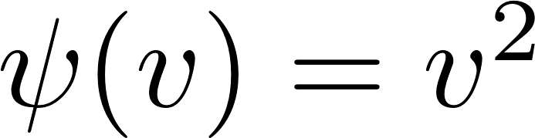
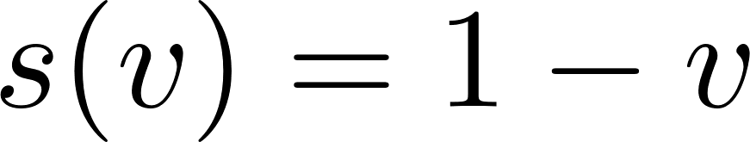
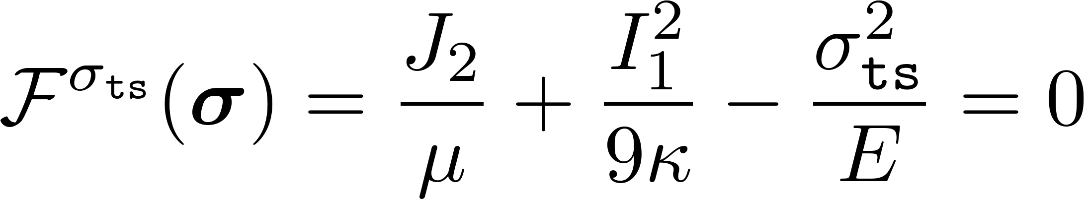
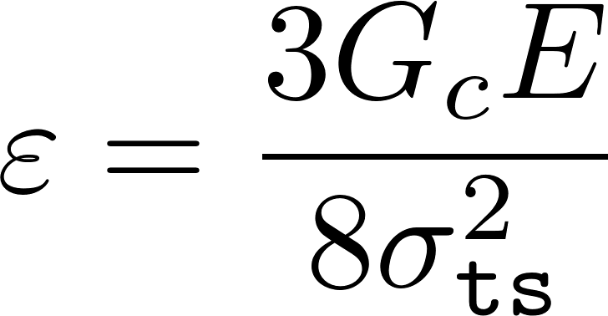
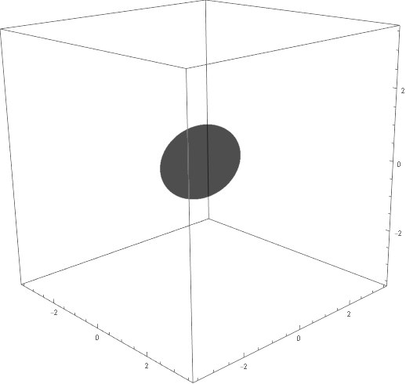

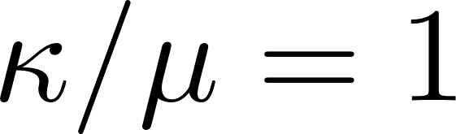
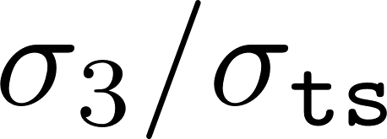
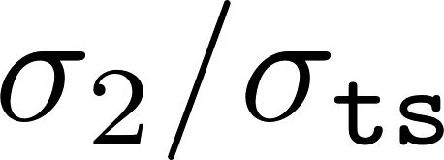
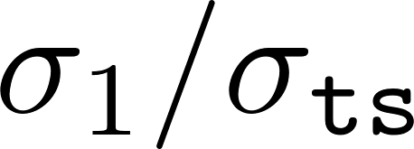
Illustration of the purely energetic character of the phase-field framework
For the case when
The strength surface predicted by the phase-field model is given by
2
0
-2
-2
2
0
0
2
-2
Notes:
The theory is predicated on two basic ideas.
So consider these solid that has two phases. Z=1: solid phase and z=0 the fractured phase.

Slide 19
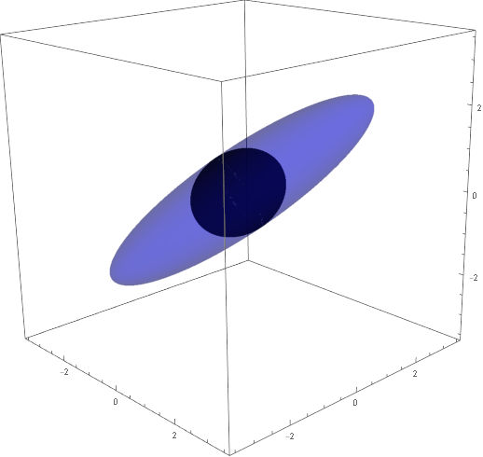
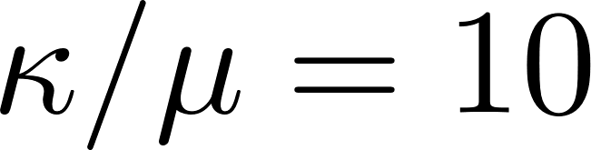
Illustration of the purely energetic character of the phase-field framework
For the case when
The strength surface predicted by the phase-field model is given by
2
0
-2
-2
2
0
0
2
-2
Notes:
The theory is predicated on two basic ideas.
So consider these solid that has two phases. Z=1: solid phase and z=0 the fractured phase.

Slide 20
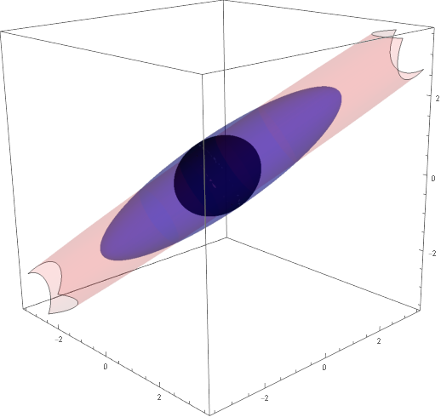
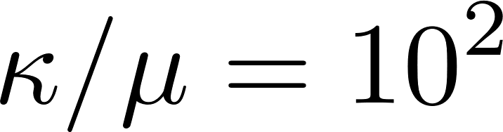
Illustration of the purely energetic character of the phase-field framework
For the case when
The strength surface predicted by the phase-field model is given by
2
0
-2
-2
2
0
0
2
-2
Notes:
The theory is predicated on two basic ideas.
So consider these solid that has two phases. Z=1: solid phase and z=0 the fractured phase.

Slide 21
Illustration of the purely energetic character of the phase-field framework
For the case when
The strength surface predicted by the phase-field model is given by
Experiments (titania)
P-F Strength Surface
Notes:
The theory is predicated on two basic ideas.
So consider these solid that has two phases. Z=1: solid phase and z=0 the fractured phase.

Slide 22
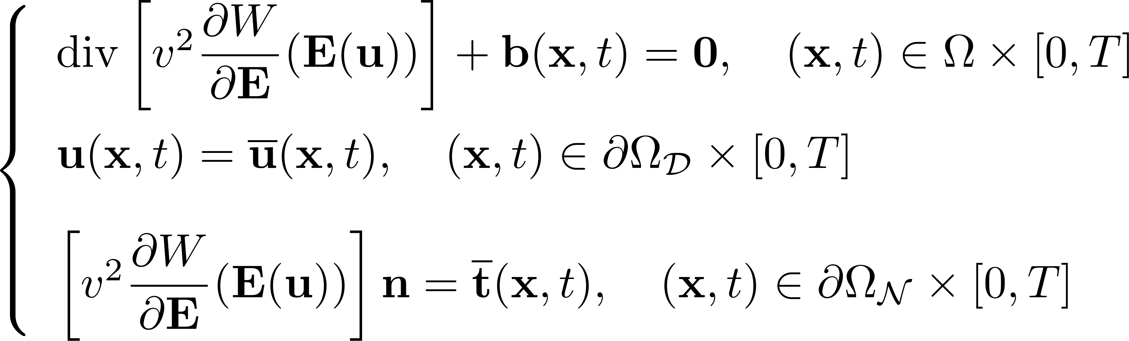
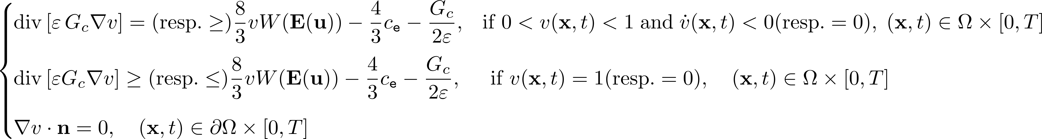
A new phase-field framework that can describe nucleation
The two-pronged idea is:
To consider the Euler-Lagrange equations of the classical phase-field as the primal model, and
To add an external driving force c_{e} in the Euler-Lagrange equation governing the evolution of the phase field v that brings into the model direct dependence on the strength of the material
Notes:
The theory is predicated on two basic ideas.
So consider these solid that has two phases. Z=1: solid phase and z=0 the fractured phase.

Slide 23

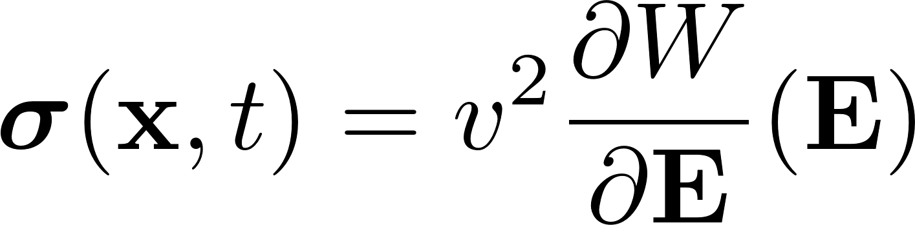
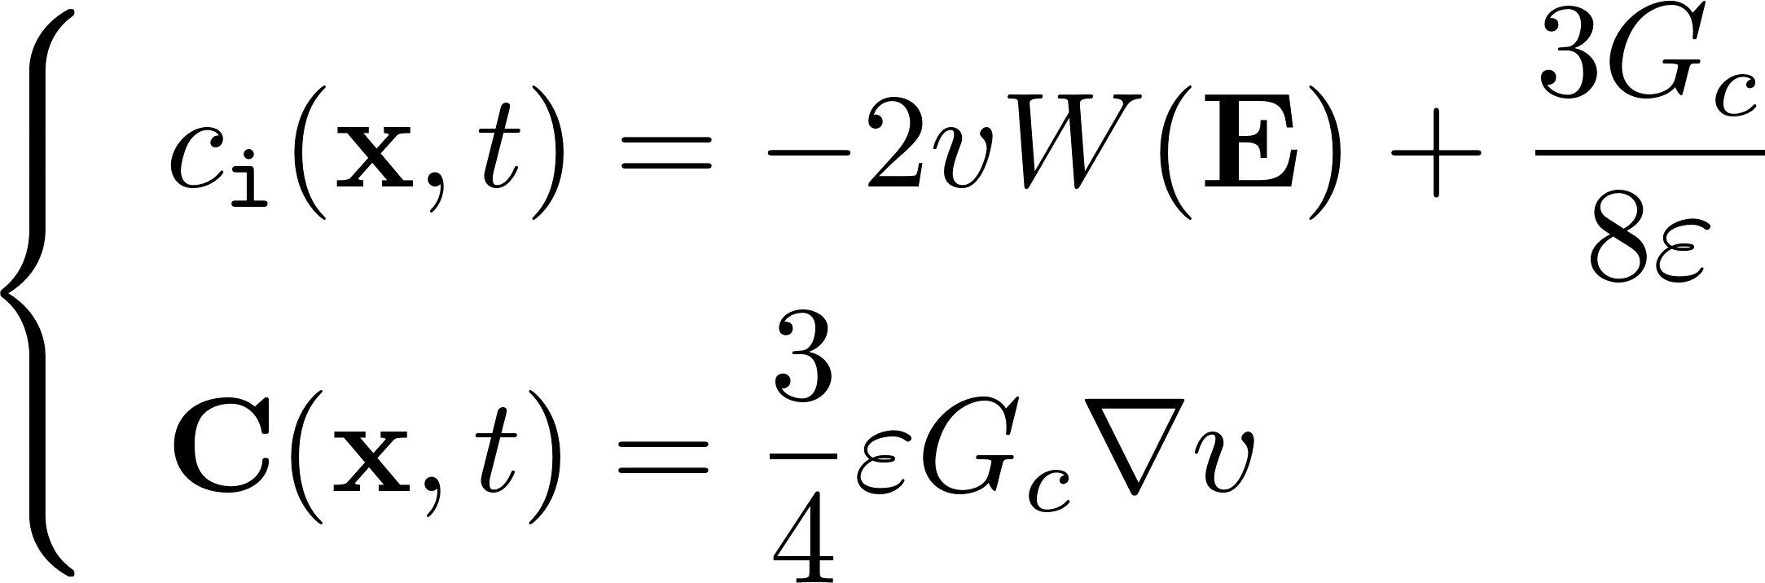

The framework as an Allen–Cahn phase-transition model
Balance principles
Balance of Linear Momentum
Balance of Configurational Forces
Constitutive relations
Stress: conjugate to the strain
Configurational internal force: conjugate to the phase field
Configurational stress: conjugate to the gradient of the phase field
Configurational external force
Gurtin (1996)
Kumar, Ravi-Chandar, Lopez-Pamies Int. J. Frac. (2018)
Notes:
The theory is predicated on two basic ideas.
So consider these solid that has two phases. Z=1: solid phase and z=0 the fractured phase.

Slide 24
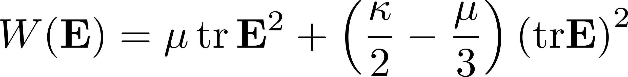
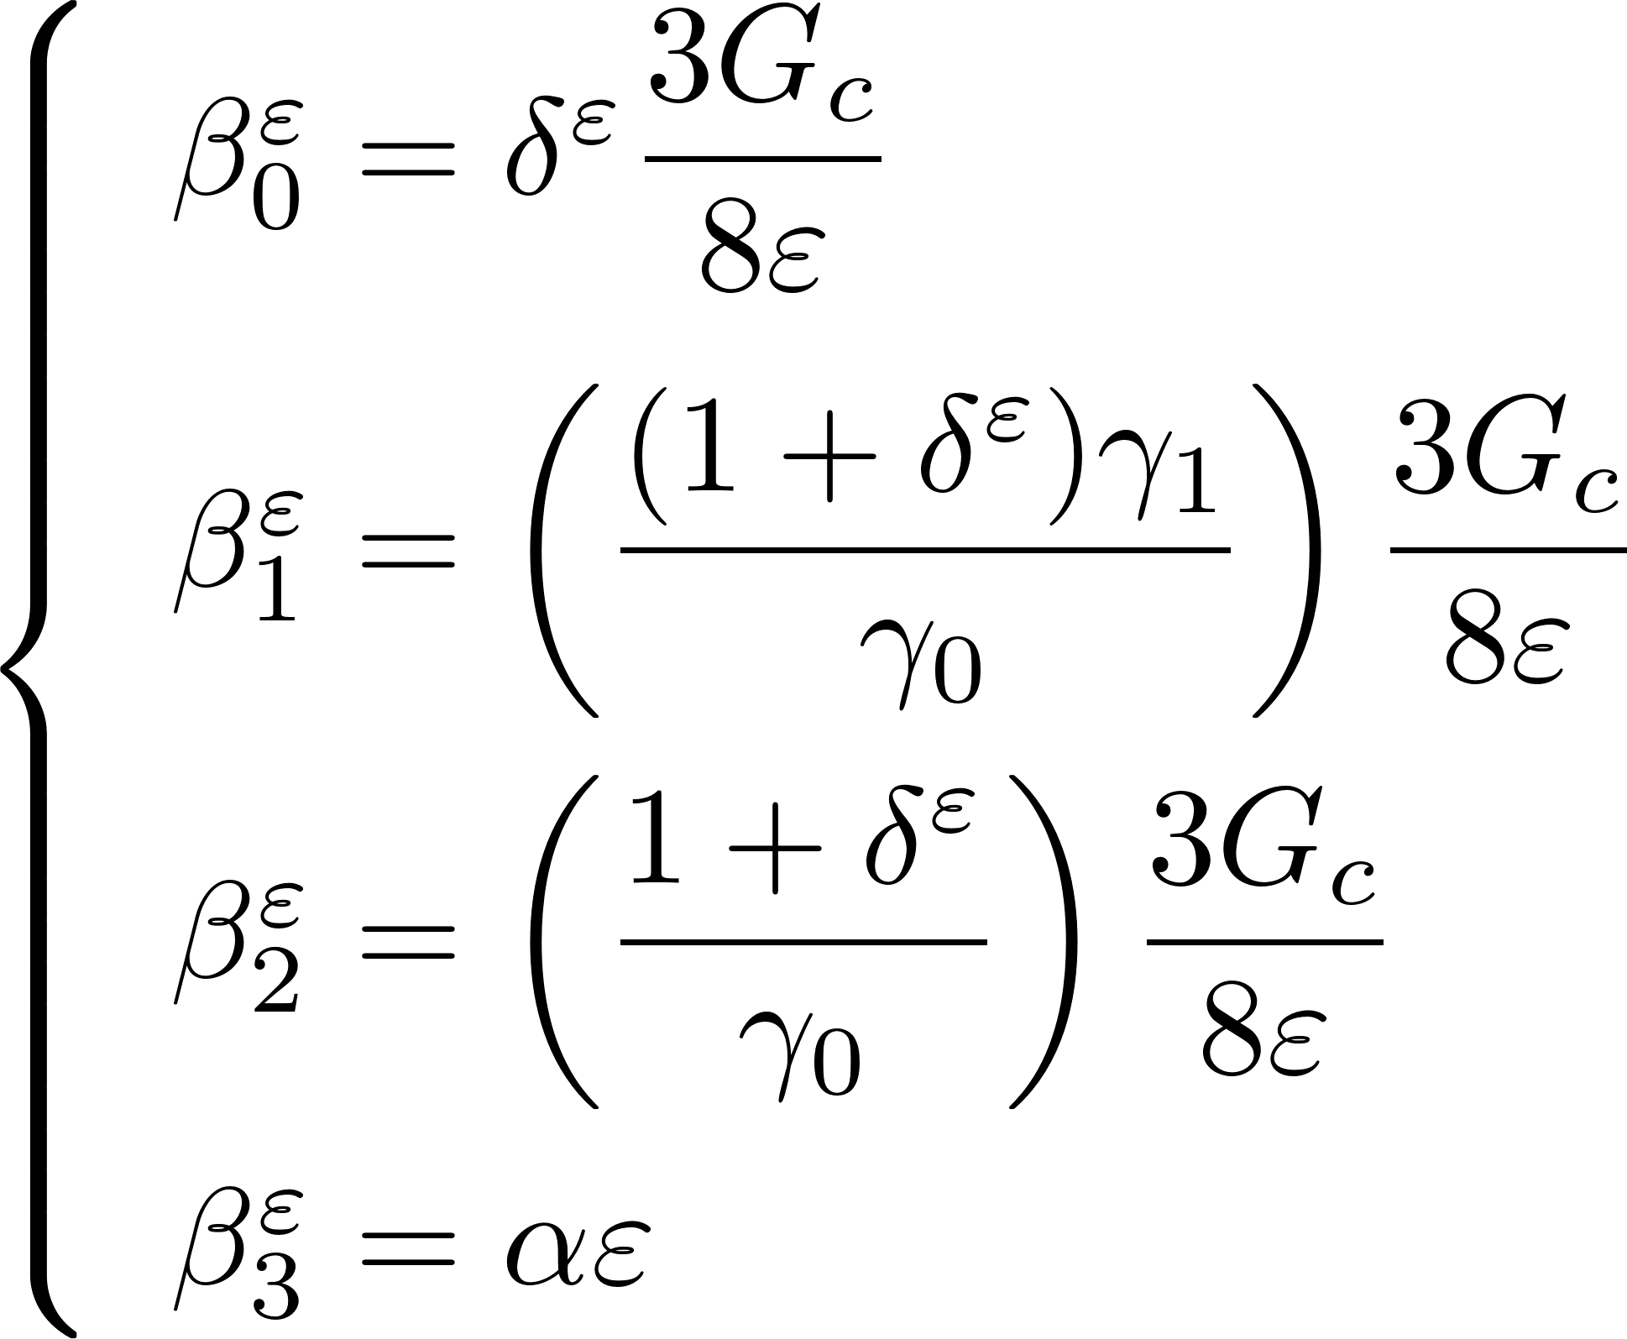
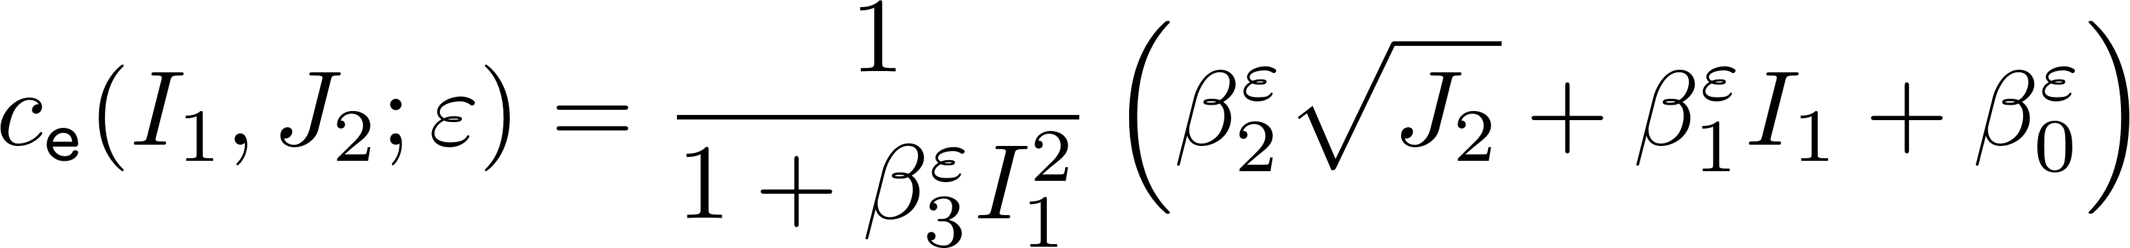
An example
Material Input:
with
Notes:
The theory is predicated on two basic ideas.
So consider these solid that has two phases. Z=1: solid phase and z=0 the fractured phase.

Slide 25
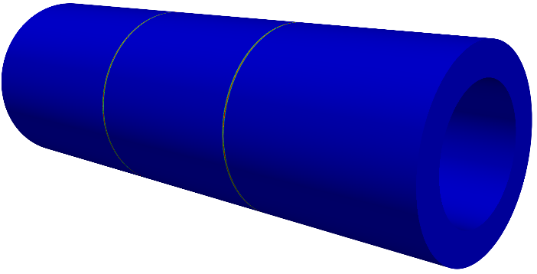


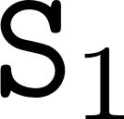
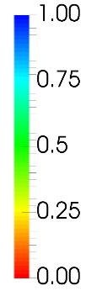
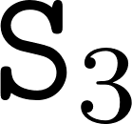
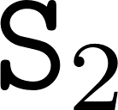

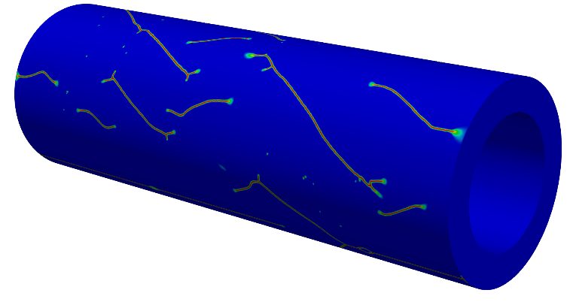
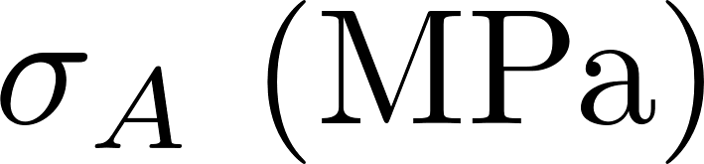
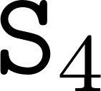



Nucleation in the bulk: graphite tubes
90
P_{A}
P_{A}
30
20
p_{i}
Sato et al. (1987)
Notes:
The theory is predicated on two basic ideas.
So consider these solid that has two phases. Z=1: solid phase and z=0 the fractured phase.

Slide 26




Nucleation in the bulk: polyurethane
+
R = 18.2
P,u
1.7
1
10
Cristiano et al. (2010)
Notes:
The theory is predicated on two basic ideas.
So consider these solid that has two phases. Z=1: solid phase and z=0 the fractured phase.

Slide 27







Nucleation from large pre-existing cracks: PMMA
63.5
12.7
15.8
16.51
P,u
21.48
y
x
10
60.96
22.86
13.47
12.7
P,u
front of the pre-existing crack
Pham et al. (2017)
Notes:
The theory is predicated on two basic ideas.
So consider these solid that has two phases. Z=1: solid phase and z=0 the fractured phase.

Slide 28




Nucleation from a boundary point: the L-shape concrete experiment
250
250
250
P,u
30
250
Experiment
(front side)
Phase-field
Experiment
(back side)
Winkler (2001)
Notes:
The theory is predicated on two basic ideas.
So consider these solid that has two phases. Z=1: solid phase and z=0 the fractured phase.

Slide 29


Nucleation from a small pre-existing crack: alumina
s
a
40
6
s
Kimoto et al. (1985)
Notes:
The theory is predicated on two basic ideas.
So consider these solid that has two phases. Z=1: solid phase and z=0 the fractured phase.

Slide 30



Going finite deformations: a few more historical notes on rubber
The fracture mechanics of rubber
Nucleation in the bulk (a.k.a. cavitation)
Gent and Lindley (1959)
Busse (1934)
Vulcanization of natural rubber
Charles Goodyear (1844)
Nucleation/Propagation from a large pre-existing crack
Griffith (1921)
Rivlin and Thomas (1953)

Slide 31









The actual story as revealed by new high-resolution experiments
glass spheres
transparent PDMS 45:1 matrix
Geometry
Rate of macroscopic loading
Spatiotemporal resolution
  Gent and Park (1984)
  Poulain, Lefèvre, Lopez-Pamies, Ravi-Chandar Int. J. Frac. (2016)

Slide 32

The actual story as revealed by new high-resolution experiments
glass spheres
transparent PDMS 45:1 matrix
Geometry
Rate of macroscopic loading
Spatiotemporal resolution
  Gent and Park (1984)
  Poulain, Lefèvre, Lopez-Pamies, Ravi-Chandar Int. J. Frac. (2016)

Slide 33

















The actual story as revealed by new high-resolution experiments
unloaded

Slide 34




Some key remarks
Remark I: The nucleation of “cavities”
is stochastic in nature
10 mm diameter
“cavity”
Remark II: The nucleation of “cavities” is an extremely fast process involving stretch rates in excess of 100 s⁻¹
Remark III: The nucleation of “cavities” is fundamentally a by-product of fracture and not solely of elasticity
d diameter
submicron defect
10 mm diameter “cavity”
initial penny-shaped
crack (150 μm diameter)
Remark IV: The “cavities” are actually deformed cracks

Slide 35



The phase-field model in finite deformations
Notes:
The theory is predicated on two basic ideas.
So consider these solid that has two phases. Z=1: solid phase and z=0 the fractured phase.

Slide 36





An example
and
Material Input:
Notes:
The theory is predicated on two basic ideas.
So consider these solid that has two phases. Z=1: solid phase and z=0 the fractured phase.

Slide 37
























Calibration of PDMS 30:1
Lopez-Pamies C R Mecanique (2010)

Slide 38



Calibration of PDMS 30:1
s₃ = s₂
1
0
s₃ (MPa)
s₂ (MPa)
-1
-2
-2
1
-1
0
0
-1
s₁ (MPa)
s₂ (MPa)
1
-2
s₁ (MPa)

Slide 39











Some Validation: Fracture nucleation within the bulk of PDMS 30:1
PDMS 30:1,
1st cycle
Kumar, Ravi-Chandar, Lopez-Pamies Int. J. Frac. (2018)

Slide 40
Back to when and how rubber bands break
Stephen Perry (1845)
u, P
e₃
very short band
e₁
d₀
l₀
l₀ = d₀/35 = 0.057 mm
d₀
short band
e₃
e₂
e₁
l₀ = d₀/13.3 = 0.15 mm
e₁
d₀ = 2 mm
long band
d₀
l₀ = 20×d₀ = 40 mm
Notes:
The theory is predicated on two basic ideas.
So consider these solid that has two phases. Z=1: solid phase and z=0 the fractured phase.

Slide 41



When and how rubber bands break
The poker-chip experiment Gent and Lindley (1959)
elastomer
midplane
very short band
short band
The “simple” tension experiment
Smith (1964)
long band
Notes:
The theory is predicated on two basic ideas.
So consider these solid that has two phases. Z=1: solid phase and z=0 the fractured phase.

Slide 42









Very short band
s (MPa)
e₁
e₂
e₂
e₃
e₁
l = 1.150
l = 1.028
l
e₂
e₂
e₂
e₁
e₁
e₁
l = 1.067
l = 1.150
Notes:
The theory is predicated on two basic ideas.
So consider these solid that has two phases. Z=1: solid phase and z=0 the fractured phase.

Slide 43





Short band
s (MPa)
e₁
e₂
e₂
e₃
l = 1.150
e₁
l = 1.105
l
e₂
e₂
e₁
e₁
l = 1.120
l = 1.150
Notes:
The theory is predicated on two basic ideas.
So consider these solid that has two phases. Z=1: solid phase and z=0 the fractured phase.

Slide 44




Long band
s (MPa)
e₃
e₁
l = 4.01
l
Notes:
The theory is predicated on two basic ideas.
So consider these solid that has two phases. Z=1: solid phase and z=0 the fractured phase.

Slide 45






Warning on surface defects
u, P
a
15 mm
5 mm
Notes:
The theory is predicated on two basic ideas.
So consider these solid that has two phases. Z=1: solid phase and z=0 the fractured phase.

Slide 46
Three take-home messages
stored-energy function
Basic Ingredients:
strength surface
A Promising Approach:
critical energy release rate
Many mathematical questions remain open!
Notes:
The theory is predicated on two basic ideas.
So consider these solid that has two phases. Z=1: solid phase and z=0 the fractured phase.

